Slide 1
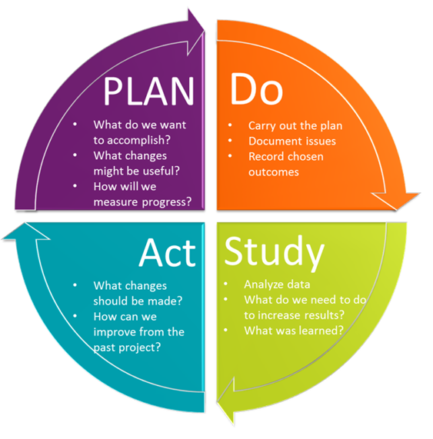
Cobb & Douglas Public Health QI Storyboard [Insert Project Title]
PLAN
Identify an Opportunity and Plan for Improvement
DO
Test the Theory for Improvement
1. Aim Statement
Start typing here
2. Examine the Current Approach
Start typing here
3. Baseline Data
Start typing here
4. Identify Potential Solutions
Start typing here
5. Develop an Improvement Theory
Start typing here
6. Test the Theory
Start typing here
7. Collect and Document Data
Insert charts or graphs or other visual depictions of data.
STUDY
Use Data to Study Results of the Test
8. Analyze the Effect of the Improvement
Start typing here
ACT
Standardize the Improvement and
Establish Future Plans
9. QI Status: (ADOPT, ADAPT, OR ABANDON)
Start typing here
Team Members:
List team member names here

