Slide 1
Department of Health
Early Intervention Program Lean Launch
March 25th – March 28th, 2013

Slide 2
Launch Overview
Review of Lean principles and concepts
Mapped the Current State of the Process
Identified Issues, Pain Points and Ideas for Improvement
Revisited Goals
Envisioned Future State
Prioritized Issues, Pain Points and Ideas for Improvement
Identified Kaizens (focused objectives)
Discussed Next Steps following the Launch

Slide 3
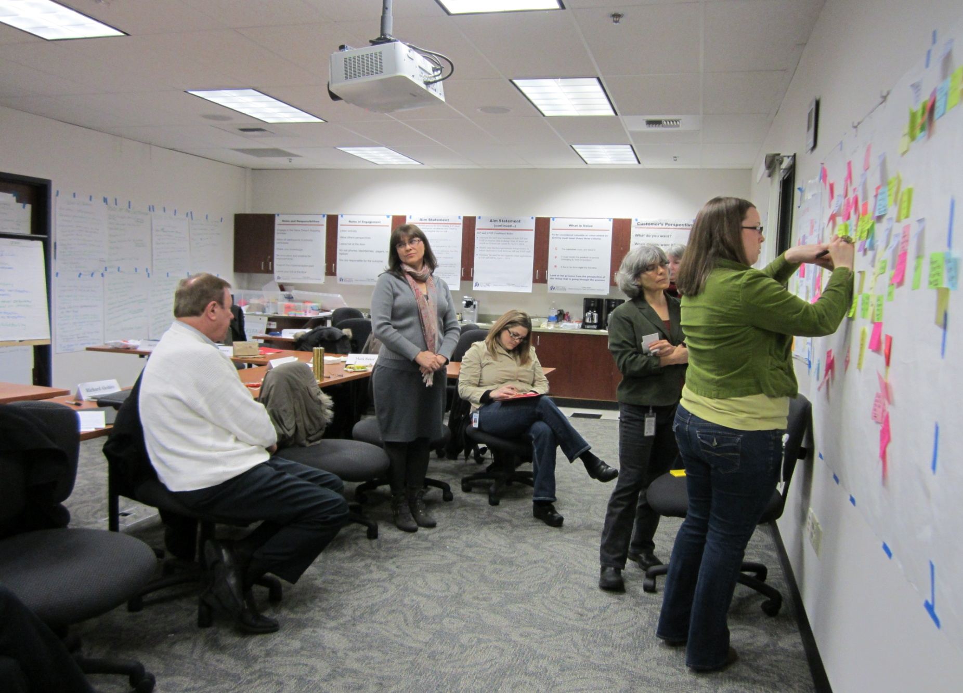
Launch Photos

Slide 4
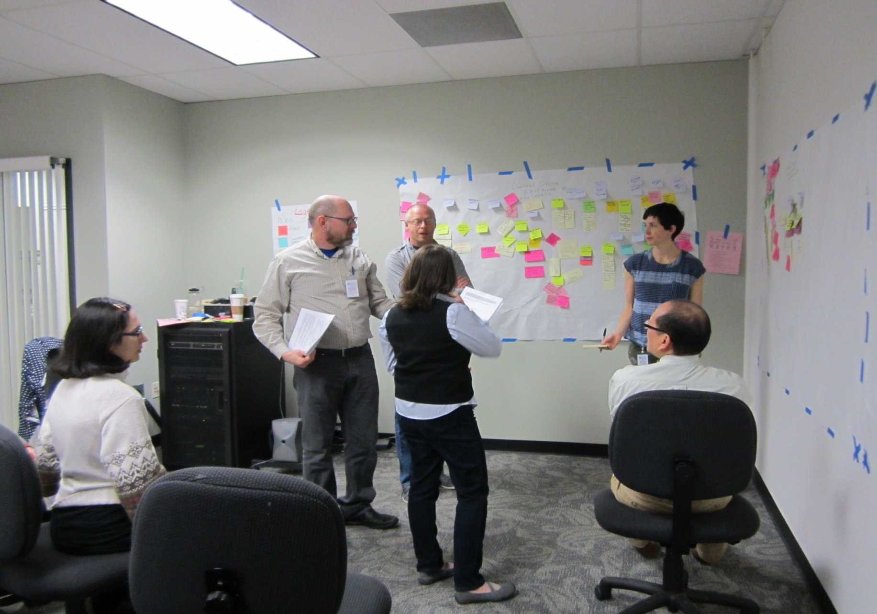
Launch Photos

Slide 5
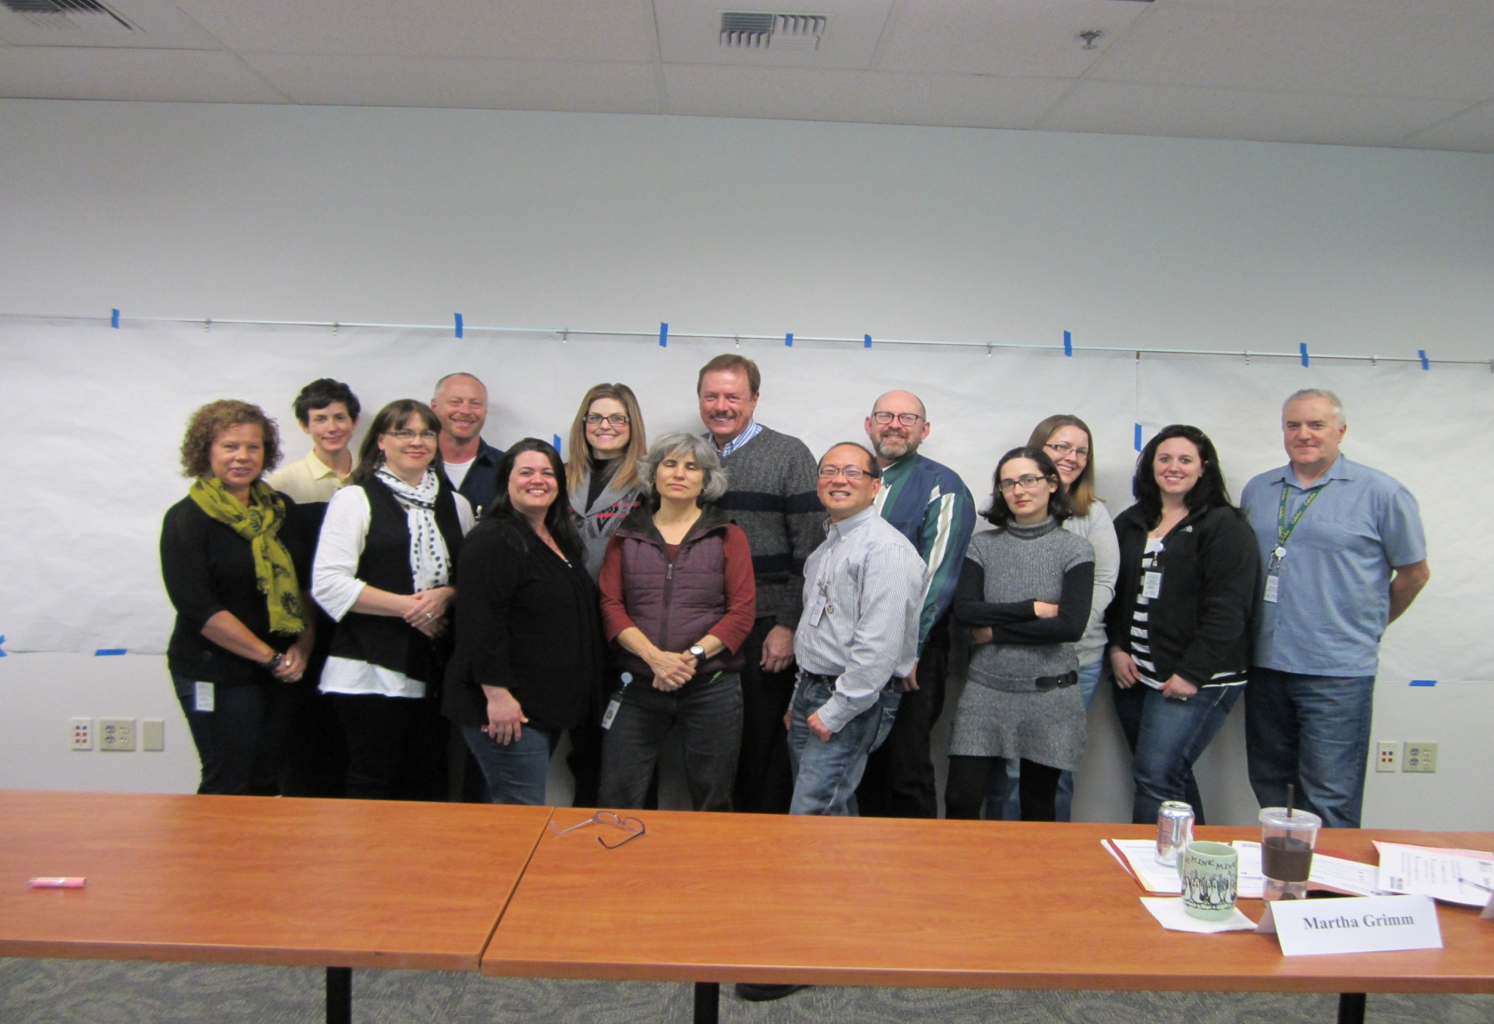
Team Photo

Slide 6
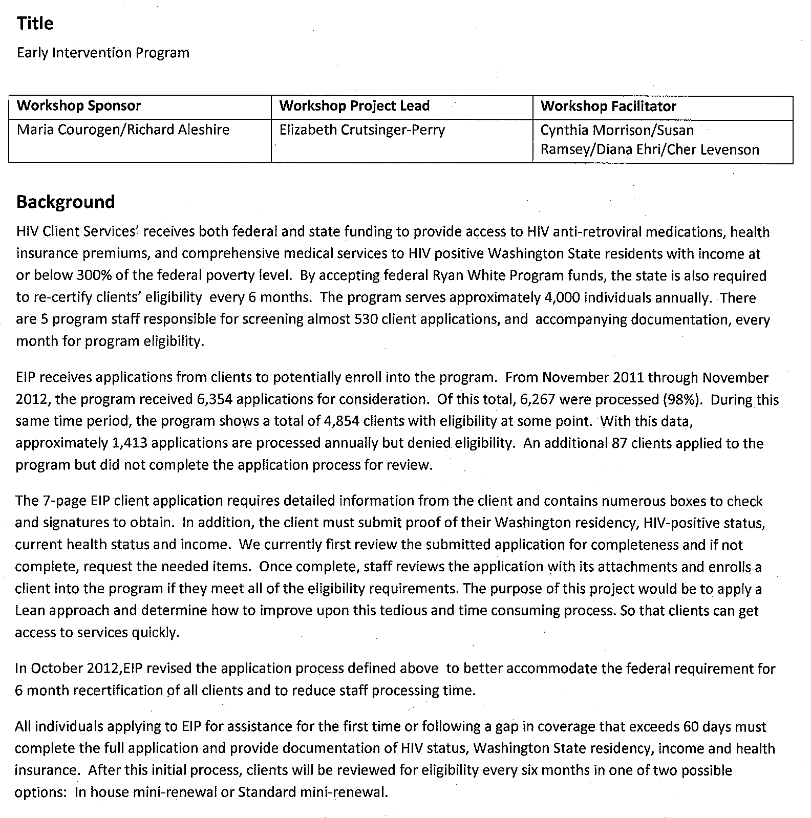
Launch Team Charter

Slide 7
Team’s Process Goals/Aim Statement
Create an efficient process for determining EIP client eligibility and subsequent enrollment into EHIP by April 1, 2014. To accomplish this we will:
EIP Role:
Begin successfully tracking applications received by two categories: mini and full by April 1, 2013.
Establish baseline of completed full applications by July 1, 2013.
Increase the percentage of completed mini applications from 80% to 85% by July 1, 2013 and to 95% by January 1, 2014.
Once baseline result has been established on completed full applications, a target will be determined.
Increase the percentage of EIP applications processed within 10 business days from 10% to 35% by July 1, 2013 and to 60% by January 1, 2014.
Increase the average number of EIP applications processed per week from 120 to 150 by July 1, 2013 and to 200 by April 1, 2014 or 100% of applications received if less than these totals.

Slide 8
Team’s Process Goals/Aim Statement
EIP and EHIP Combined Roles
Decrease the staff time necessary at both EIP and EHIP to monitor data exchange from 40 hours per month to 10 hours per month by April 1, 2014.
Modify data sharing requirements and processes to reduce duplicative work between EIP and EHIP staff.
Eliminate the need for two separate client applications to EIP and EHIP by April 1, 2014.

Slide 9
Customer’s Value Perspective
Understanding how income is defined
6 month renewals burdensome
Short form works well
Case manager and client communication
Information on letters and insurance card
Medical appointments
Pharmacy issues
Use of electronic methods to share and transfer information

Slide 10
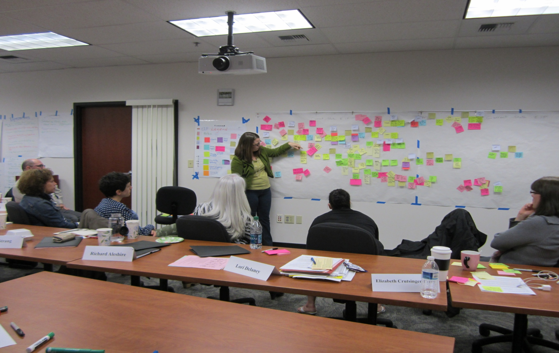
Current State Map - EIP

Slide 11
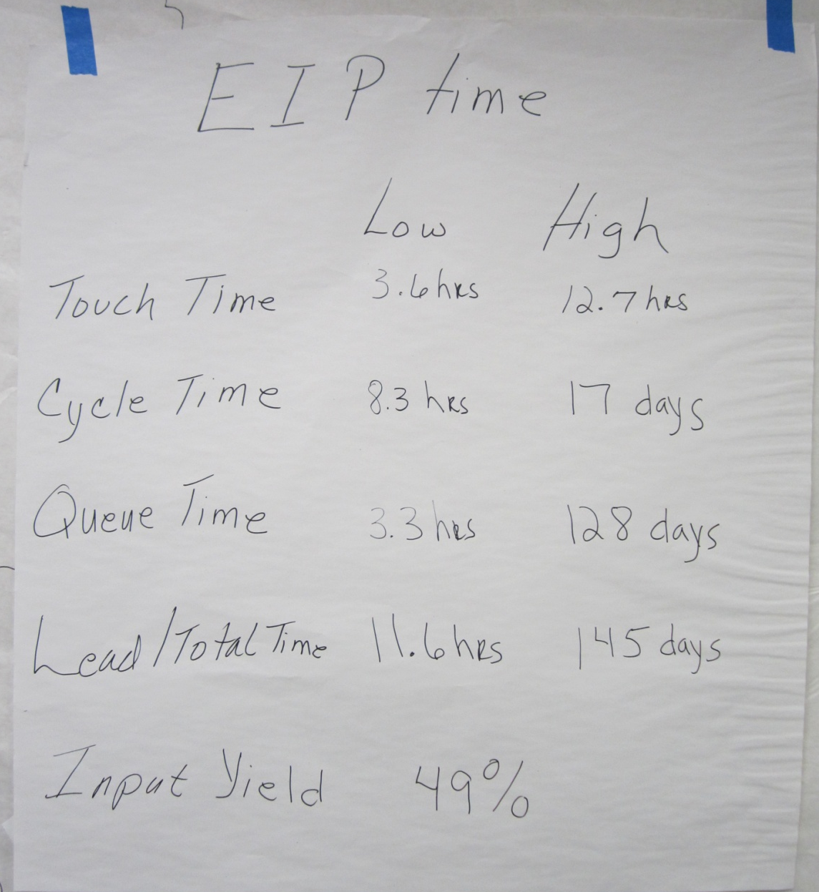
Summary of the Current State Map

Slide 12
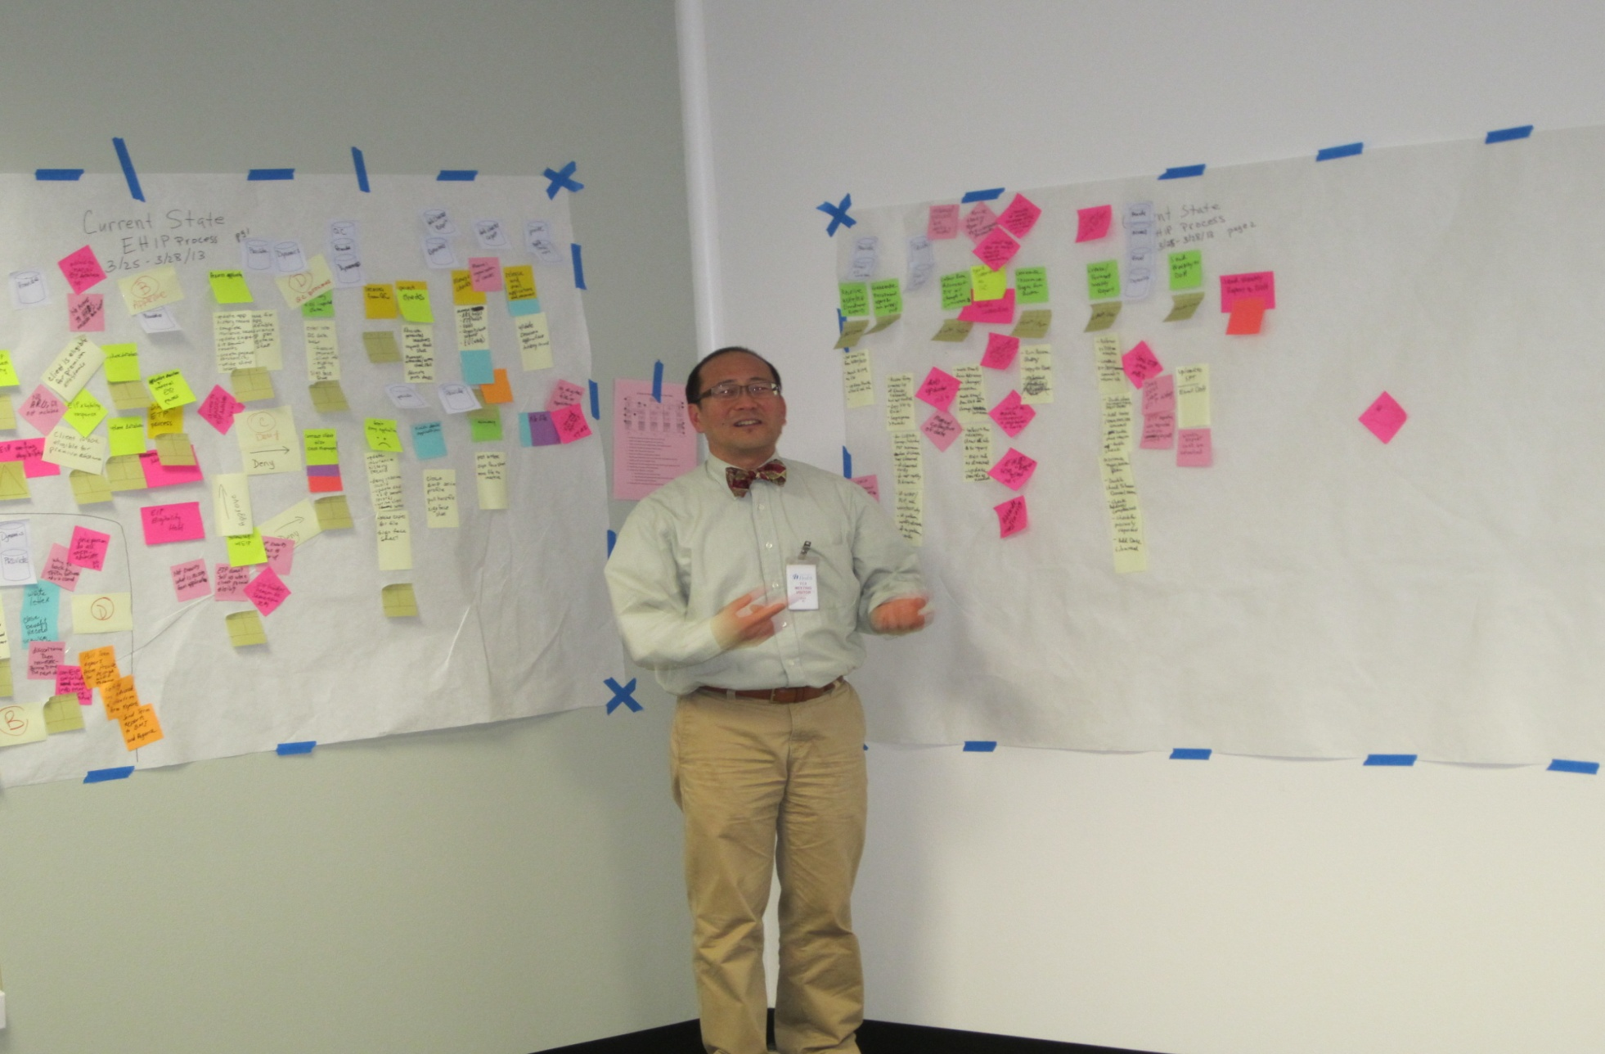
Current State Map – EHIP

Slide 13
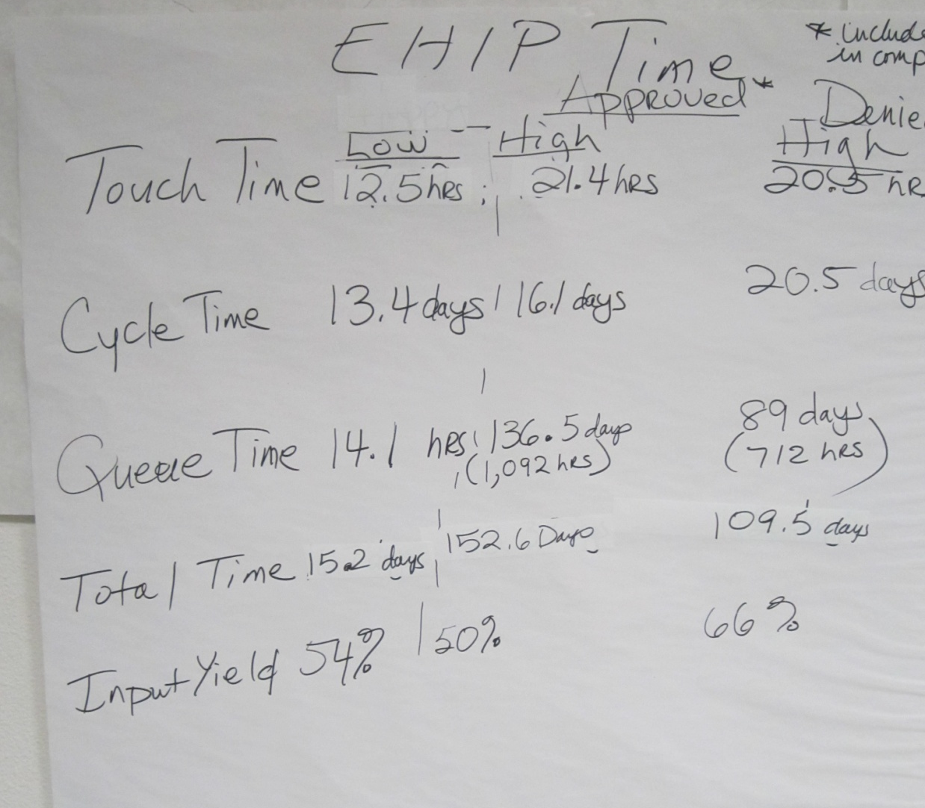
Summary of the Current State Map

Slide 14
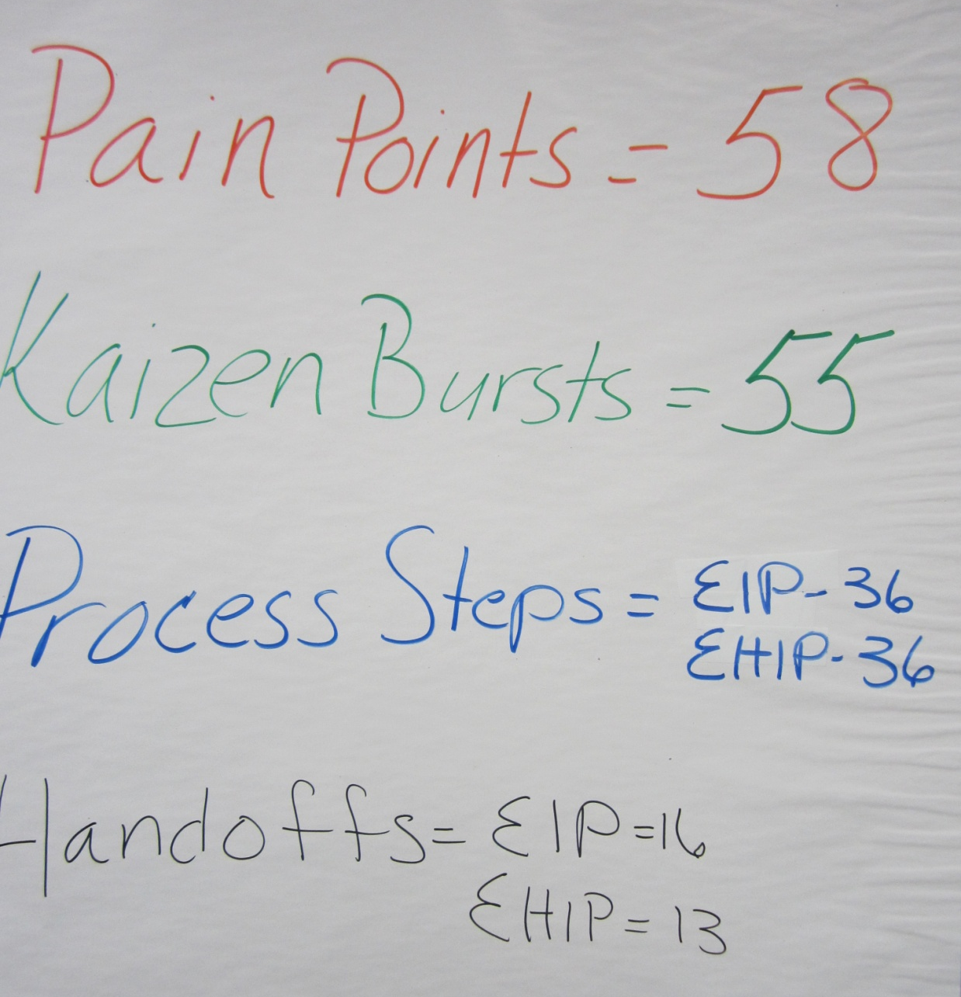
Summary of the Current State Map

Slide 15
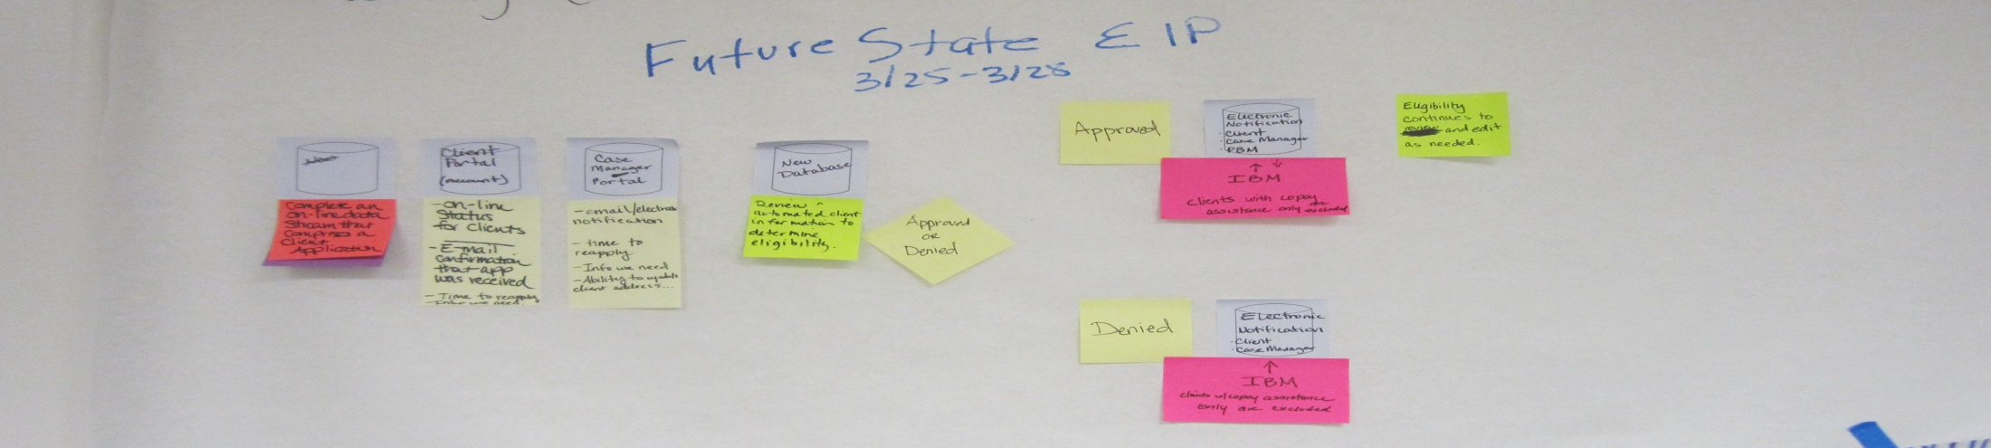
Envision the Future State - EIP
Client completes an on-line data stream that comprises a client application
Review client information to determine eligibility
Approve or deny application

Slide 16
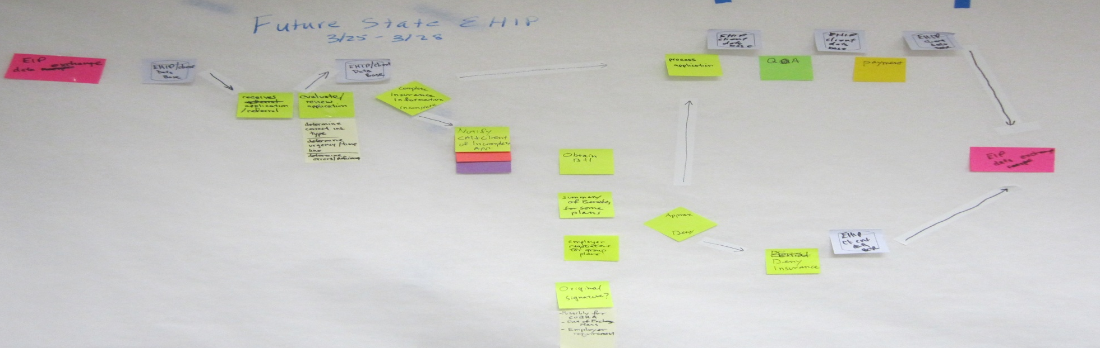
Envision the Future State - EHIP
Receive application through EIP data exchange
Evaluate application
Ensure completeness
Process the application
Approve or deny insurance application

Slide 17
Ideas for Improvement
Identified 58 ideas that connect to the 58 pain points
Online - combined application
Client access to check their eligibility
Real time data exchange
Eliminate paper waste
Increased access to data portals

Slide 18
Key Process Improvement Opportunities
We addressed all 58 issues--
Identified where in the process they fell, and what problem it addressed
Categorized them in “themes” and eliminated duplicates

Slide 19
Kaizen (continuous improvement) Action Plan
Kaizen 1: Customer Service
Kaizen 2: Contract
Kaizen 3: Staffing Resources
Kaizen 4: Training
Kaizen 5: Procedures/Systems
Kaizen 6: Policies
Kaizen 7: IT
Kaizen 8: Communications/Web
Kaizen 9: Reporting

Slide 20
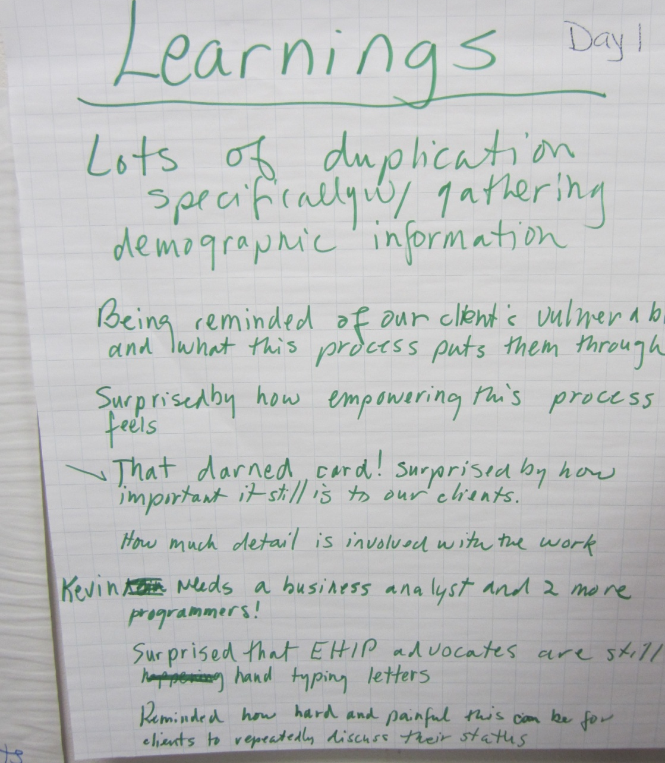
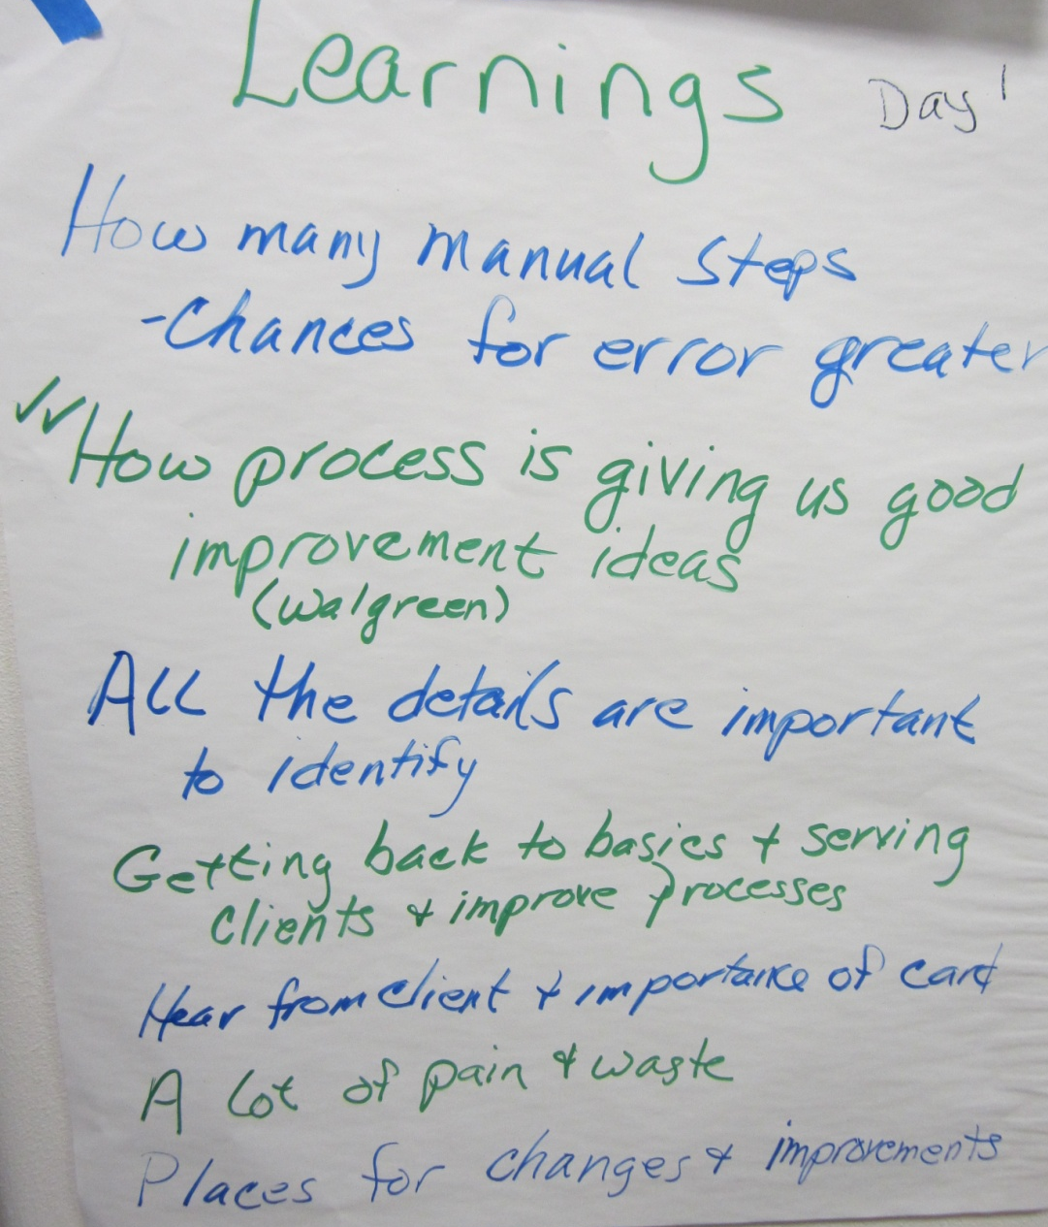
Lessons Learned (Day 1)

Slide 21
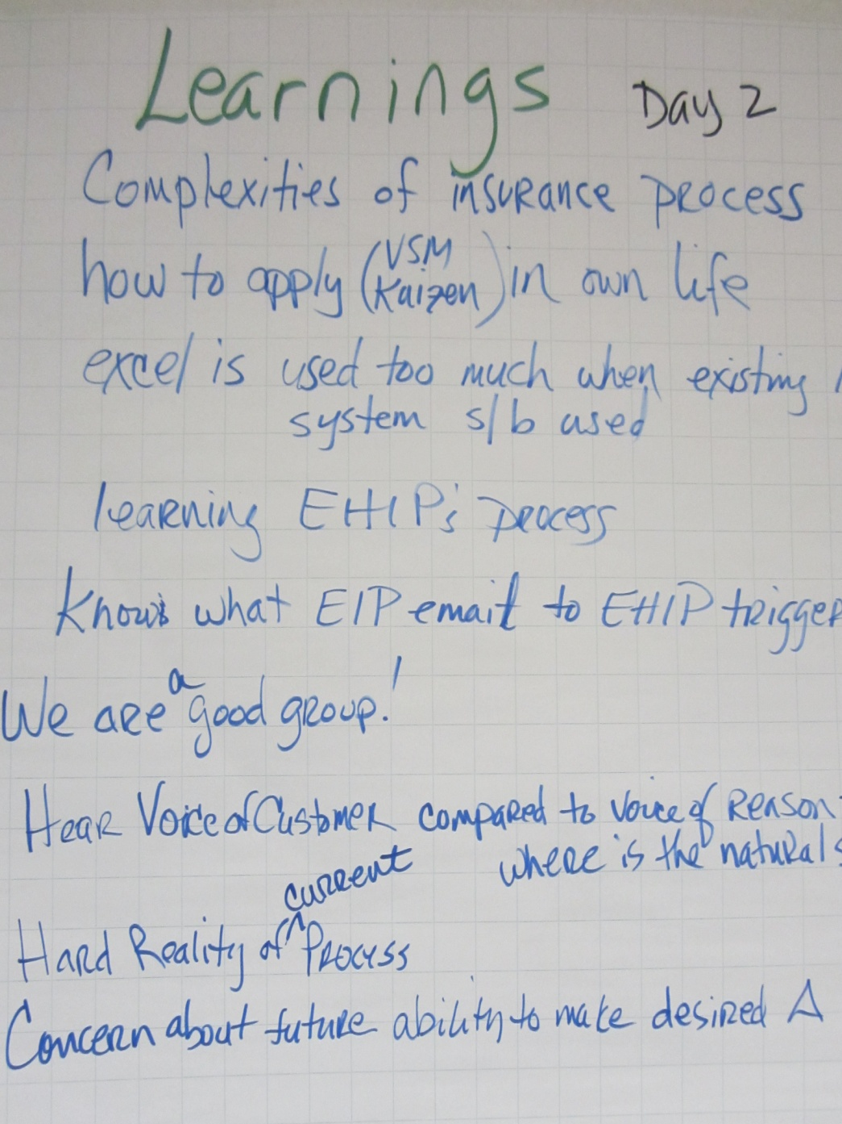
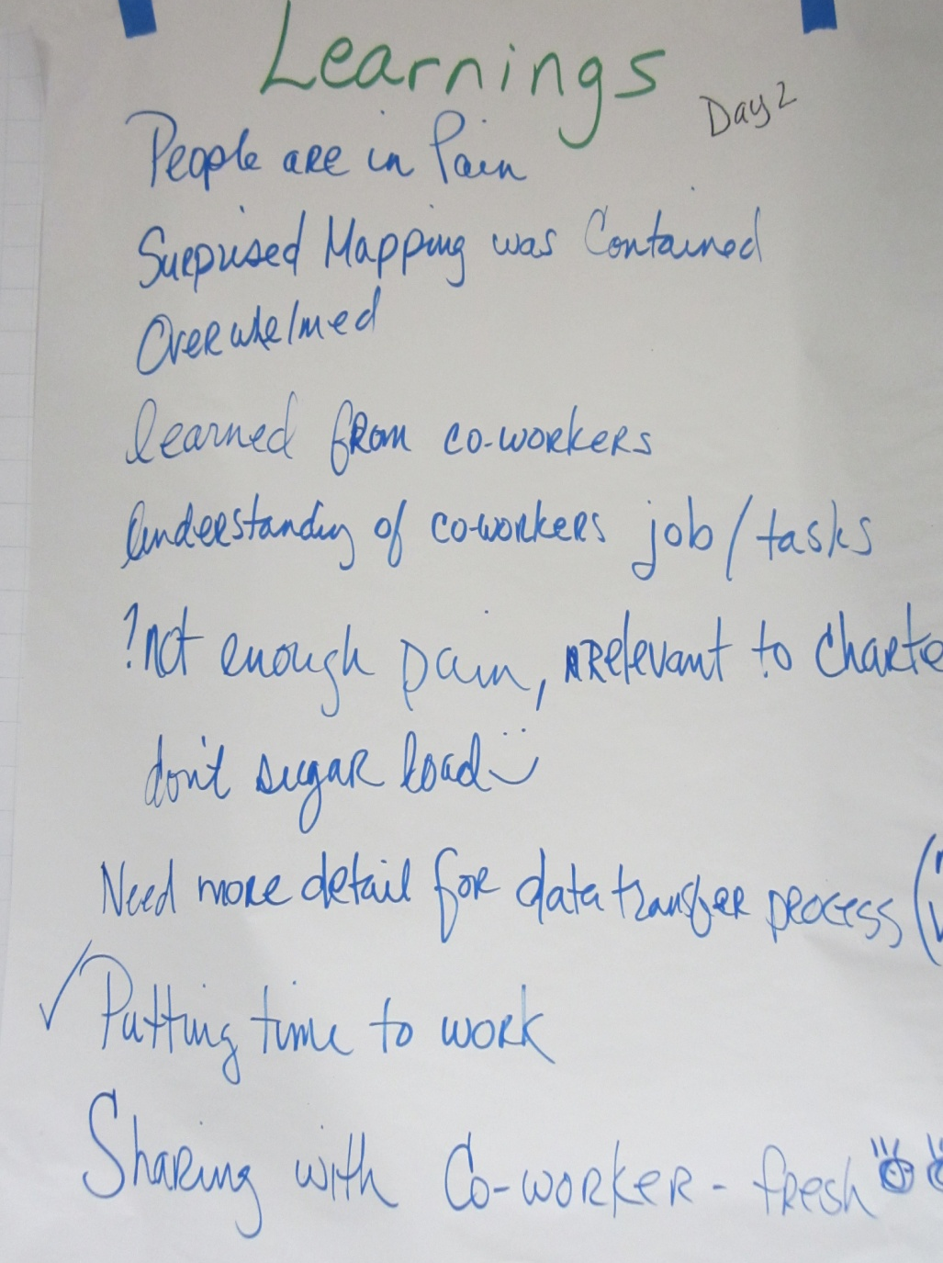
Lessons Learned (Day 2)

Slide 22
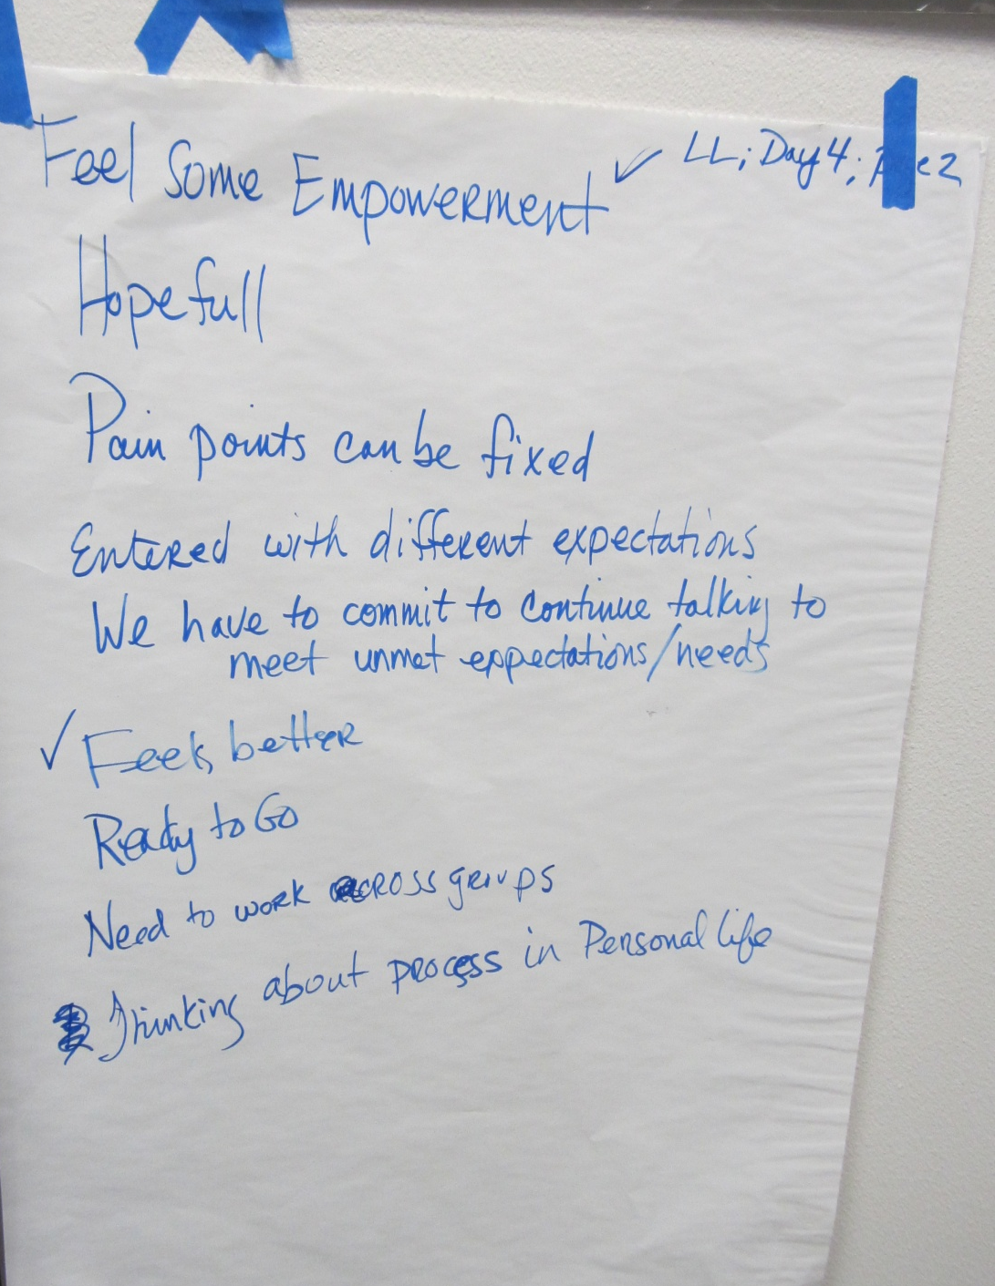
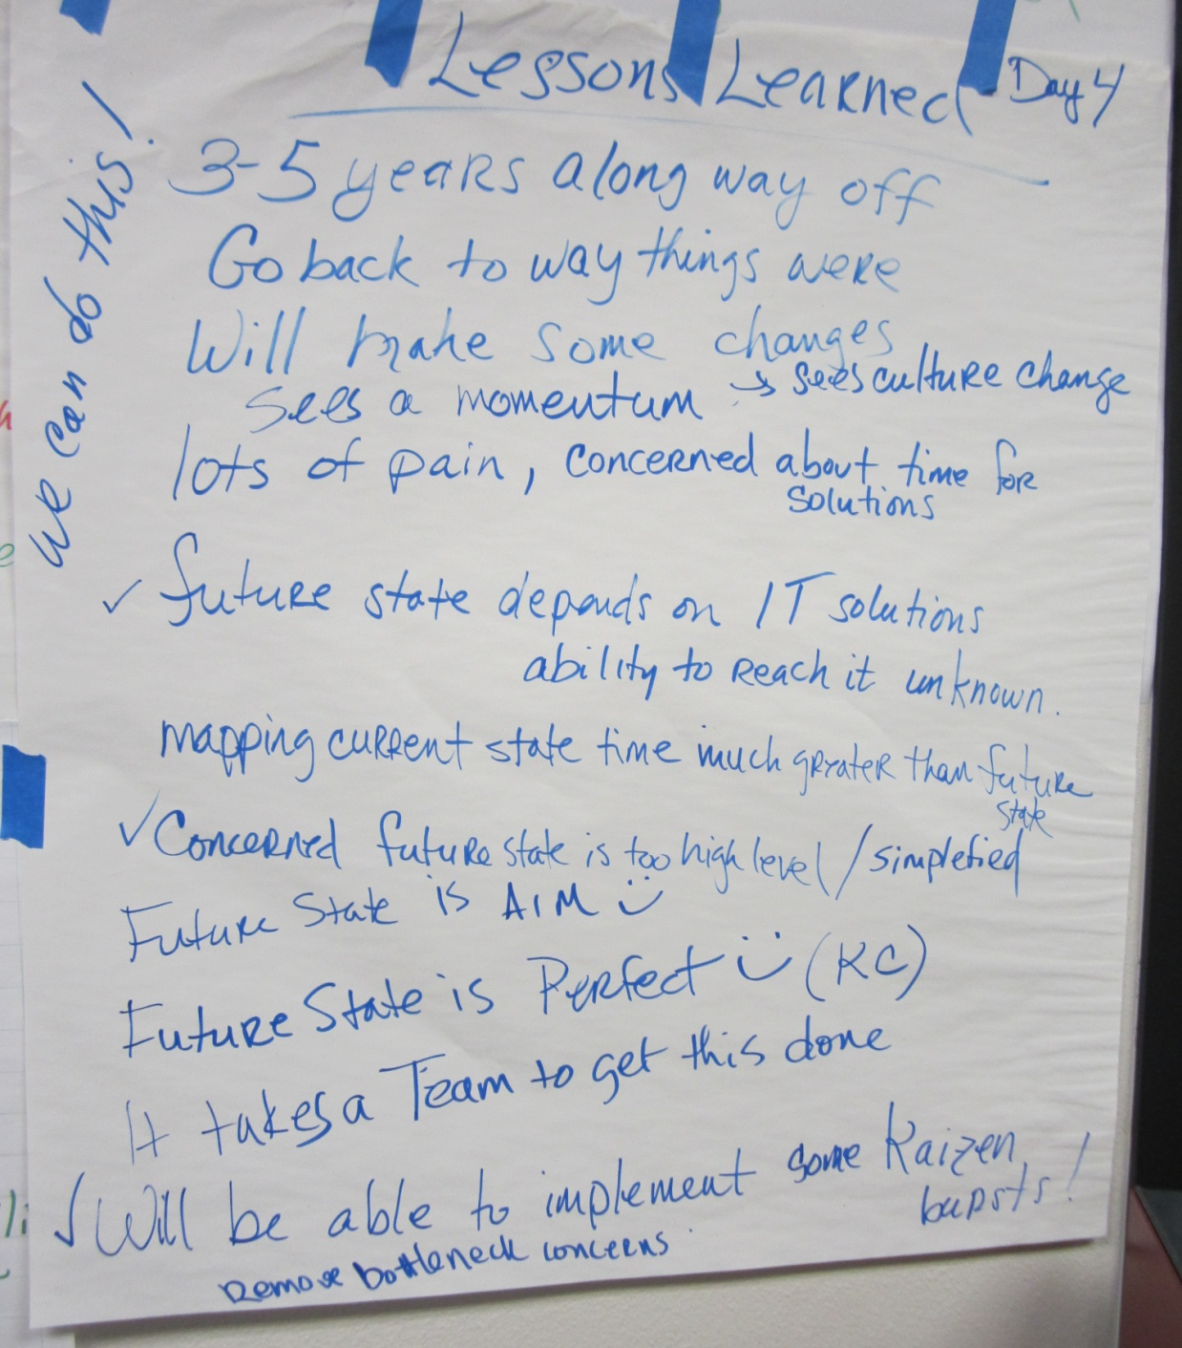
Lessons Learned (Day 3)

Slide 23
Next Steps
Within two weeks
Team is meeting weekly
Kaizen Groups are completing actions weekly
First visual board is up and being used
Team meetings are held at the visual board
Determine how to collect data (baseline)
30/60/90 day/Check-ins
Team will step back (pause and look at the big picture), reflect and make any needed adjustments
Provide an update to sponsors, key customers and process partners

