Slide 1
Kaizen Introduction Death Certificate Filing March 17 to March 21, 2014 8:00 a.m. – 5:00 p.m. Bohan Auditorium
Notes:
Make this personal

Slide 2
Do we all know each other?
Notes:
Add introduction approach with possibly an ice breaker. See Kaizen Desk Reference, pages 181-182

Slide 3
TEAM vs. GROUP
TEAM
Two or more people who pursue a common purpose together
Have significant interdependencies and are accountable for collective performance
Held mutually accountable for individual performance
GROUP
May have some interdependencies
Are primarily responsible for individual work product with individual accountability

Slide 4
Differences between Groups and Teams
GROUP | TEAM
A number of persons or things gathered, located, or classified together. | Two or more people who pursue a common purpose together.
An association by virtue of a common characteristic. | A unity by virtue of a common purpose and commitment.
A collection. | A force.
Multiple members and multiple performances. Best integration is “enabling.” | Multiple members but a single performance. Best integration is “synergistic.”
Best performance is: Cooperation! | Best performance is: Unified Success!

Slide 5
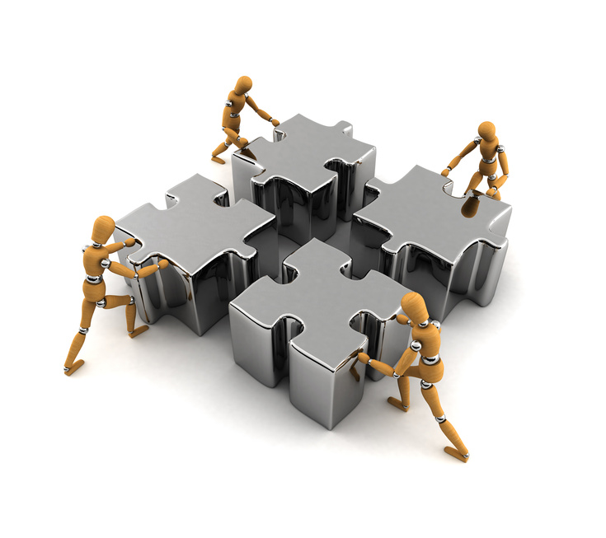
For a Kaizen event, we want a TEAM!
TEAM PERFORMANCE MODEL
Vision/Values
Relationships
RESULTS
Goals
Procedures
Roles

Slide 6
What do you know about continual quality improvement? What Do you know about kaizen? What do you expect to learn? What do you expect to achieve?
Notes:
Find out what the team members are thinking

Slide 7
What is Continual Quality Improvement?
Achieving sustainable performance beyond what is thought possible by unlocking the limitless capacity of an organization’s most valued resource – its people Through the identification of focused improvement areas, elimination of non-value added work through the use of improvement methods to diagnosis and solve problems, test solutions, measure results, learn, and install sustainable change

Slide 8
Enabling People
Continual Improvement is simply about helping people make things better
At a rate greater than ever before
And more than is currently believed possible
For either improving effectiveness or efficiency
Creating a win-win-win for Customers, the Team and the Funders

Slide 9
Building the Key Elements of High Performing Organizations
Powered by People
Special type of Leadership
Superbly Focused on their purpose
Use Learning to create results
Implement well, installing the new way and continually improving
Improvement Methods used to empower the individual and effectively solve problems
Kaizen is one of the methods

Slide 10
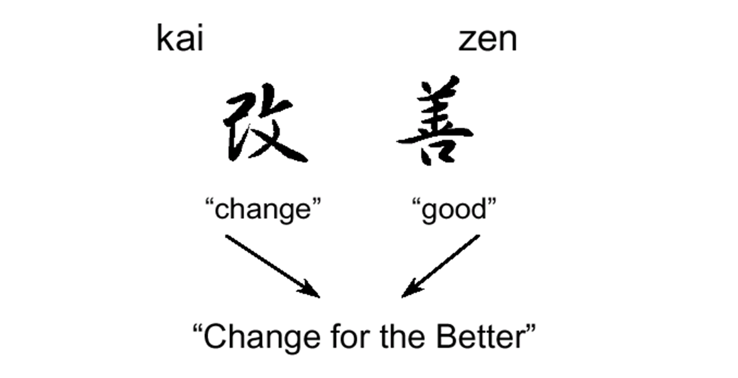
Before We Get Too Far: What is the Continual Quality Improvement method, kaizen?

Slide 11
Kaizen places an emphasis on the processes – on how to achieve the required results
Kaizen generates process-oriented thinking, is people-oriented, and is directed at people’s efforts
Rather than identifying employees as the problem, Kaizen emphasizes that the process is the target and employees can provide improvements by understanding how their jobs fit into the process and changing it

Slide 12
Conventional Approach | Process-Emphasis Approach
Employees are the problem | The process is the problem
Doing my job | Helping to get things done
Understanding my job | Knowing how my job fits in the process
Measuring individuals | Measuring performance
Change the person | Change the process
Correct errors | Reduce variation
Who made the error? | What allowed the error to occur?

Slide 13
Kaizen as a Method: Work Process Improvement
A group of methods for making work process improvements. The methods that have been placed under the label Kaizen are varied and range from use by the individual (Teian Kaizen) to planned teamed events conducted in the workplace that systematically uncover waste in a work process and eliminate it (Gemba Kaizen).
In this definition the Kaizen methods are organized in to 3 categories:
Individual
Day-to-day
Special event

Slide 14
Kaizen Methods: Special Event Work Process Improvement
Also known as Kaizen Blitz or Kaizen Event
Most common Kaizen method
Prior planning followed by fully executing the process improvement cycle over a period of days
Performed at the sub process level or where the work is done (“Gemba”)
Focus on making improvements by detecting and eliminating waste

Slide 15
The Improvement Cycle & A Kaizen Event
Similarities
Completing all the improvement cycle steps
Team members are critical
Information & data based problem solving
Differences for a Kaizen Event
Shorter cycle time to achieve results
Less work content time for project
Target running the new process the day after the event
More critical: Preparation work Speed of Observing/Evaluating Data, Testing, Making Decisions, & Implementing Actions

Slide 16
Let’s See Improvement in Action
The KOOSH Ball Exercise
First Trial
Team in a circle; one non-participant as timekeeper
Toss the ball so each person gets a chance
Time several attempts; try to do it faster
Second Trial: Standardized work
The ball must start and end with the same person
Each person must touch the ball in the same order as they did at the outset
Two people cannot touch the ball at the same time.
If the ball falls on the floor you must begin again
Goal is to halve the time

Slide 17
Koosh Ball Conclusions
Being able to…
Communicate effectively with others
Focus the improvement effort
See the wastes in processes
Get feedback through measurement
Learn from success and failure
Work as a team

Slide 18
Working with Others

Slide 25
Kaizen Objectives
TO: | Run an improvement event
FOR: | You as team members
SO THAT: | We achieve our improvement goal within this kaizen event week
STDS: | Successfully run kaizen event Updated standardized work, (including job aids) Training started for process members & stakeholders Event report out Project results measures

Slide 26
Typical Activities By Day
Day 1: Focus the team; understand the current state Day 2: Continue to understand the current state; evaluate & Solve the Problem Day 3: Develop solutions (job aids); Test; Learn; Develop training material Day 4: Continue to develop solutions; test; learn and train Day 5: Pilot the new process; learn; measure results; communicate results

Slide 27
Norms
Everyone's engagement
Use of Working with Others skills
Learning environment
Stay on track
One conversation at a time
Have fun
Others?
Notes:
Put on flip chart and then add to it.
Explain Parking Lot. This is where were record thoughts, questions, ideas, anything for later discussion

