Slide 1

DeKalb County Death Filings
Kaizen Event
March 17-21, 2014
Notes:
Make this personal

Slide 2
What Is Our Challenge?
The current death certificate filling process requires significant human resources to gather data, validate and input death certificate registration filings in an accurate and timely manner. consume a significant amount of labors from funeral director contact to mailing to State
Stakeholder | Description
Customers | 25 county funeral homes; Average 107 death filings in one work week 90% of incoming requests judged defective
Financial | Revenue is delayed when filings are unavailable Expenses are increased through personnel costs and mailing costs when certificates must be mailed via USPS, FedX or UPS, instead of delivering onsite
Your Team | One (1) dedicated FTE with additional support from one hourly staff, supervisor and manager

Slide 3
Results:
What Do We Think Will Be Achieved?
  Decrease in labor hours required for processing by 41%
Yearly reduction of approximately 1000 hrs or 0.5 FTE
Additional savings projected for the Registrar for other value added activities
Cycle time to process requests for customers reduced
An ENGAGED KAIZEN TEAM!

Slide 4
Now Some Details…
A Little Background on Continual Quality Improvement

Slide 5
What is Continual Quality Improvement?
Achieving sustainable performance beyond what is thought possible by unlocking the limitless capacity of an organization’s most valued resource – its people
Through the identification of focused improvement areas, elimination of non-value added work through the use of improvement methods (like Kaizen) to diagnosis and solve problems, test solutions, measure results, learn, and install sustainable change

Slide 6
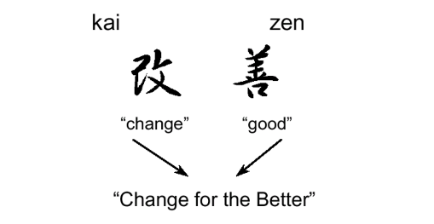
What is kaizen?
A group of techniques for making work process improvements in rapid fashion;
Planned, teamed “events” conducted in the workplace by systematically uncovering waste in a work process, identifying and developing solutions and quickly implementing them …

Slide 7
… And what are value and waste?
Value Is
Anything that
the customer recognizes as valuable and is willing to pay for, AND
Changes the product or information, AND
Is done right the first time.
Waste Is
Anything that
consumes resources without adding value
Notes:
7

Slide 8
Waste Presents Itself in Different Forms
Moving
Stopping
Searching
Inspecting
Getting Ready
Things Gone Wrong
More Than Needed
Not Needed
Notes:
8

Slide 9
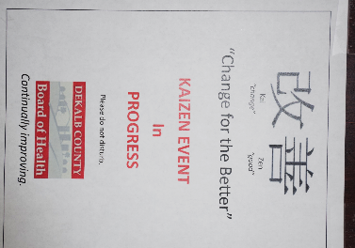
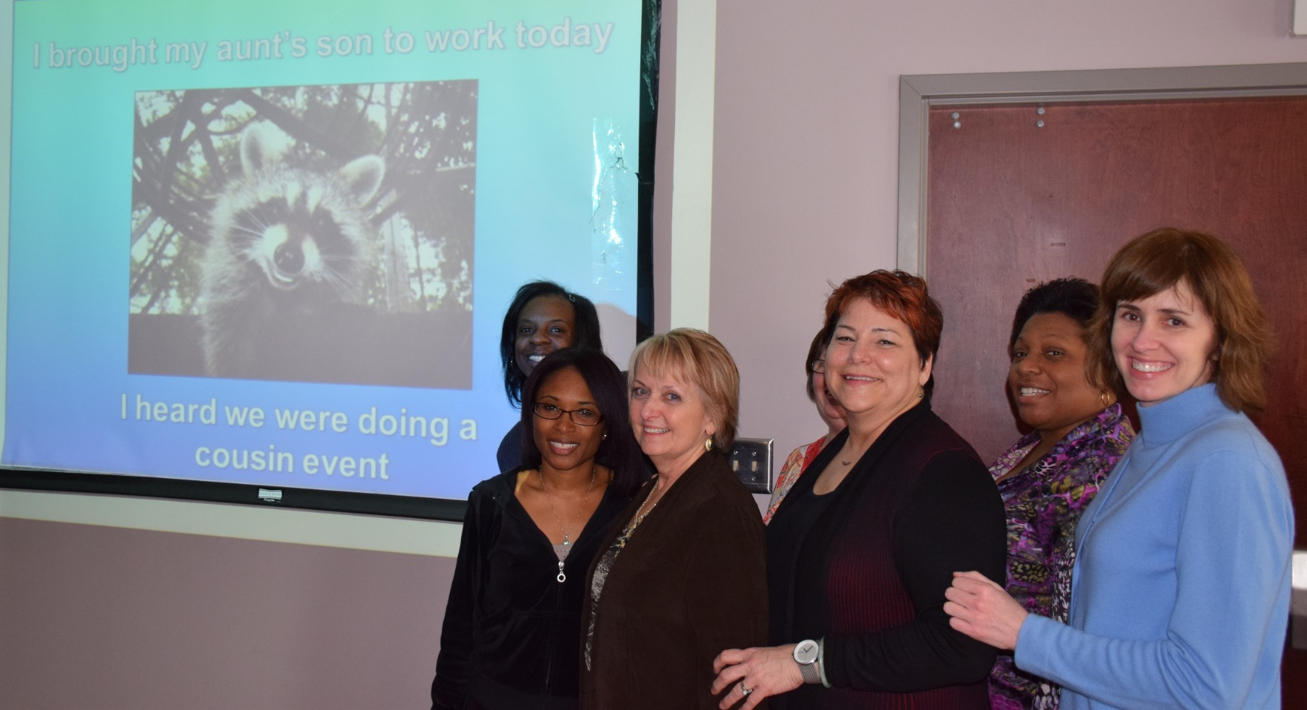
So let Kaizen improvement begin!

Slide 10
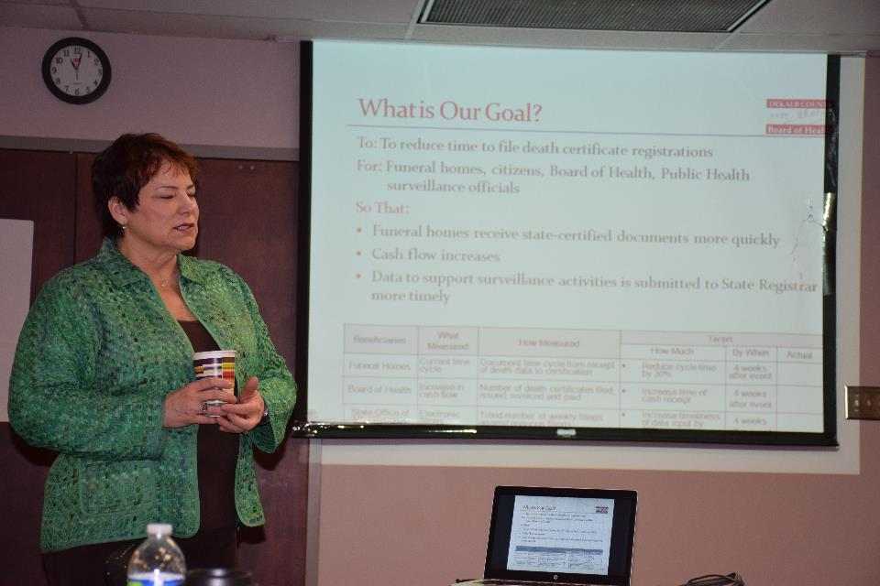
Day 1:
Getting Focused, Checking Our Goal, Looking for the Value and Wastes…
Notes:
Make this personal

Slide 11
Finalizing Our Goal
TO: Reduce time to file death certificate registrations.
FOR: Twenty-five (25) funeral homes, Citizens, Board of Health, Public Health surveillance officials
SO THAT:
Funeral homes received state-certified documents more quickly
Our resource requirements are reduced and can be applied to other value-added activities
Cash flow is more timely
Data to support surveillance activities is submitted to State Registrar more timely
•

Slide 12
Measures and Targets:
Customer Satisfaction and Labor Reduction
Beneficiaries | What Measured | How Measured | Target
 |  |  | How Much | By When
Funeral Homes, Dekalb Team | Current cycle time | Document time cycle from receipt of death data to certification processed (in “red folder” | Reduce cycle time by 30% (for same number of copies required) from current performance (15-20 min). | 4 weeks after event
Funeral Homes, Dekalb Team | Incoming defect rate | Defective certificate requests received from Funeral Directors (1st pass, as submitted the first time) | Reduce by 50% from current perceived rate of 90% defective (missing or incorrect information) | 4 weeks after event
 | Electronic filings | Trend number of weekly filings | No desired trend; for tracking and comparison ratios only | Go live

Slide 13
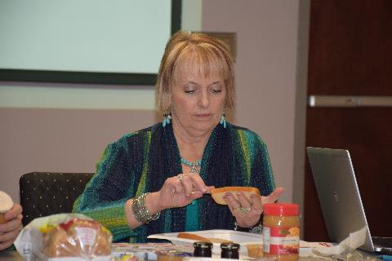
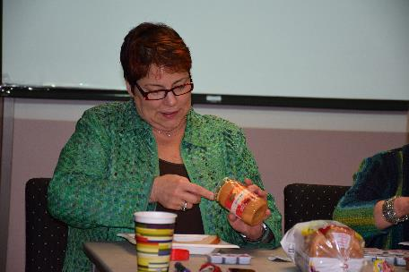
Learning to See The Process…

Slide 14
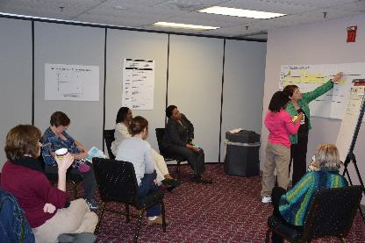
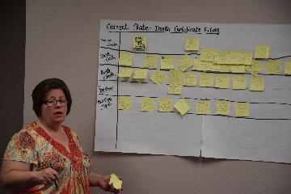
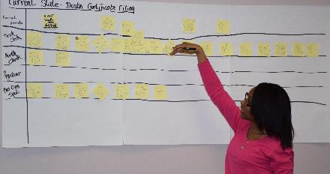
Building Our Current State
Long Form, Walk In Death Certificates;
65% of current requests

Slide 15
Day 2:
Analyze the wastes and identify solutions
Notes:
Make this personal

Slide 16
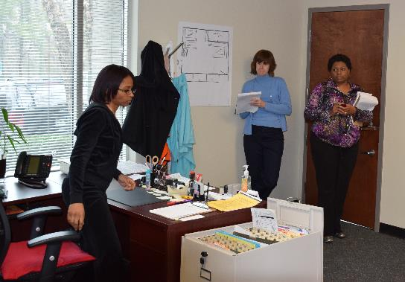
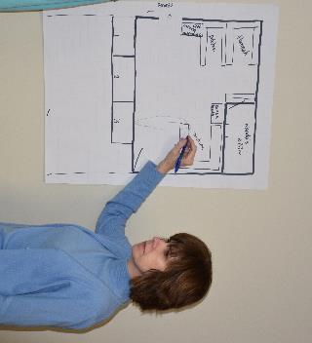
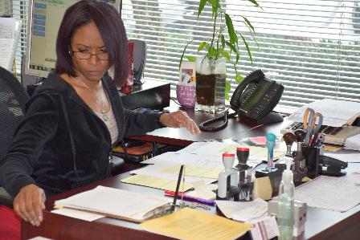
Seeing Our Process and Finding The Wastes

Slide 17
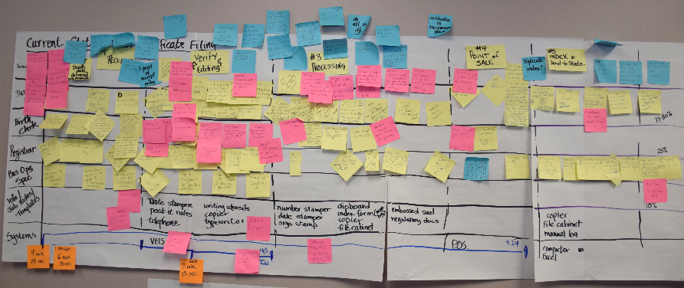
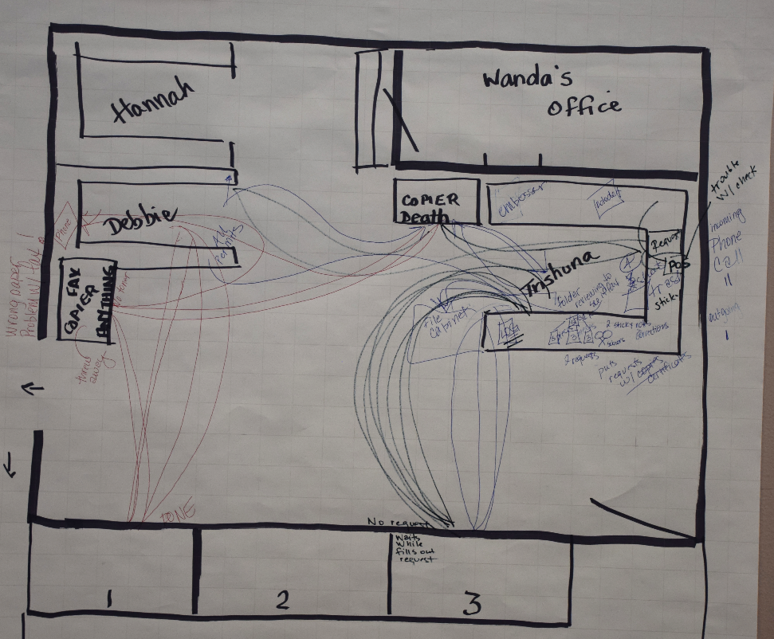
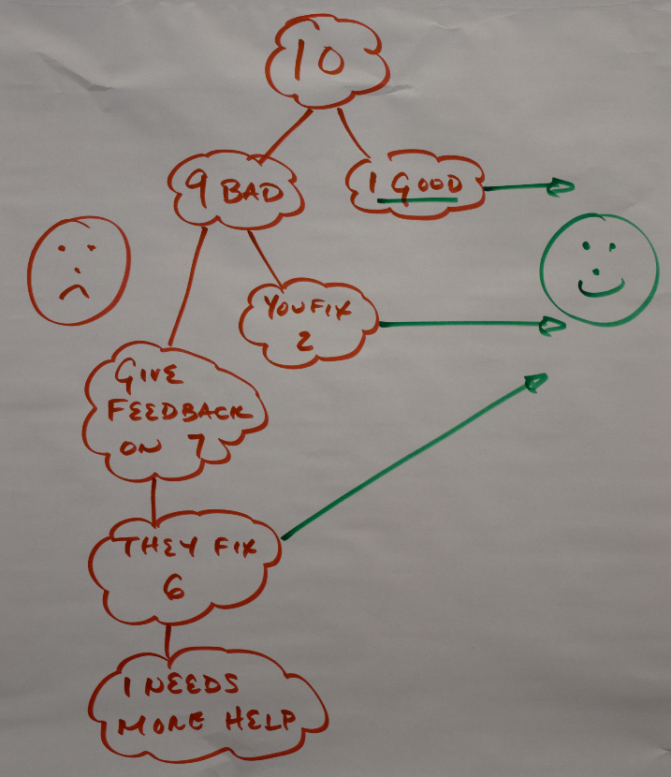
Our Current Process
Things Gone Wrong: Incoming Defect Rate
Movement: “spaghetti chart”

Slide 18
Analyzing the Wastes
Value - Waste Analysis - Sub Process Map
Work Process: Dekalb Death Certificate Processing |  |  |  |  |  |  |  |  |  |  |  |  | Date:
Current Work Process Information |  |  |  |  |  | Waste Evaluation |  |  |  |  | Impact
 |  |  |  |  |  |  |  |  |  |  |  | Rate/hr.:
Step No. | Step / Activity | Time for step | Labor time for step | Value Added Work Content Time (mins) | Frequency (# times completed per day) | Waste Type (see Forms of Waste Table) |  | Waste | Value-Added | Amount of identified waste potentially eliminated (%) | Target Labor Time for Step | Potential Reduction in Labor (mins/ day.) | Potential Reduction in Cost / day.
1 | Receipt | 7 | 7 | 1 | 25 | Moving; more conversation than needed; interruptions; stopping; |  | 85% | 15% | 50% | 3.8 | 68.8 | $ -
2 | Wait |  |  | 0 |  |  |  | 100%
3 | Verify and Editing | 7.25 | 7.25 | 0.25 | 25 | more than needed (birth search), moving (corrections); interruptions, things gone wrong (reviewing, searching and editing) |  | 97% | 3% | 60% | 3.1 | 105.0 | $ -
4 | Wait
5 | Processing | 9 | 9 | 4.5 | 25 | Interruptions (caused by unknown expectations); more than needed (redundancy of information); motion |  | 50% | 50% | 50% | 6.8 | 56.3 | $ -

Slide 19
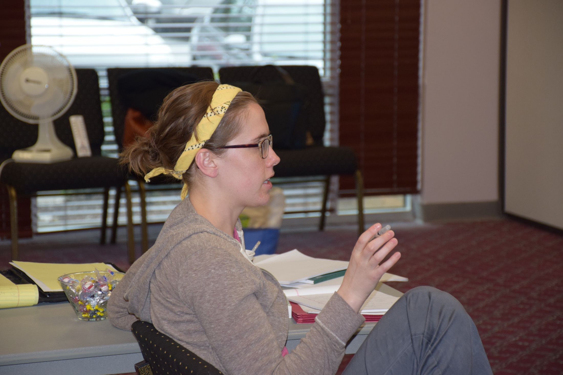
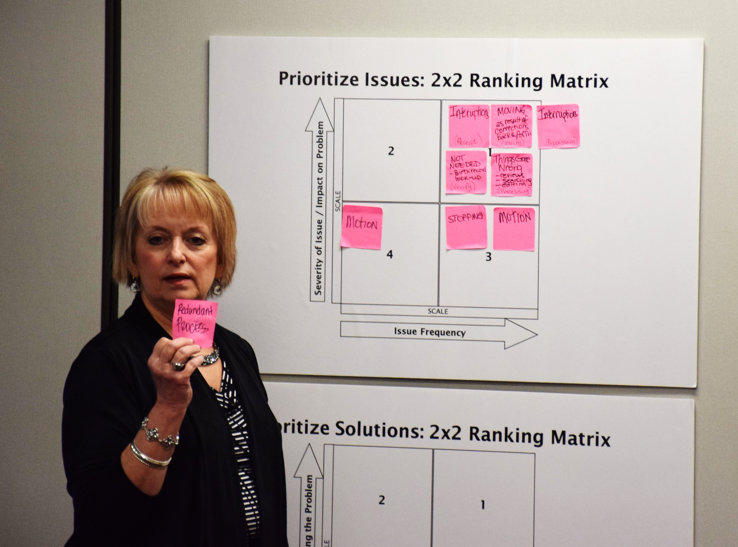
What Are the Priority Issues?
Incoming defects from customers
Inconsistent evaluation of required data
Redundant, inconsistent processes
Excessive motion to accomplish tasks
Phone calls routed to incorrect locations

Slide 20
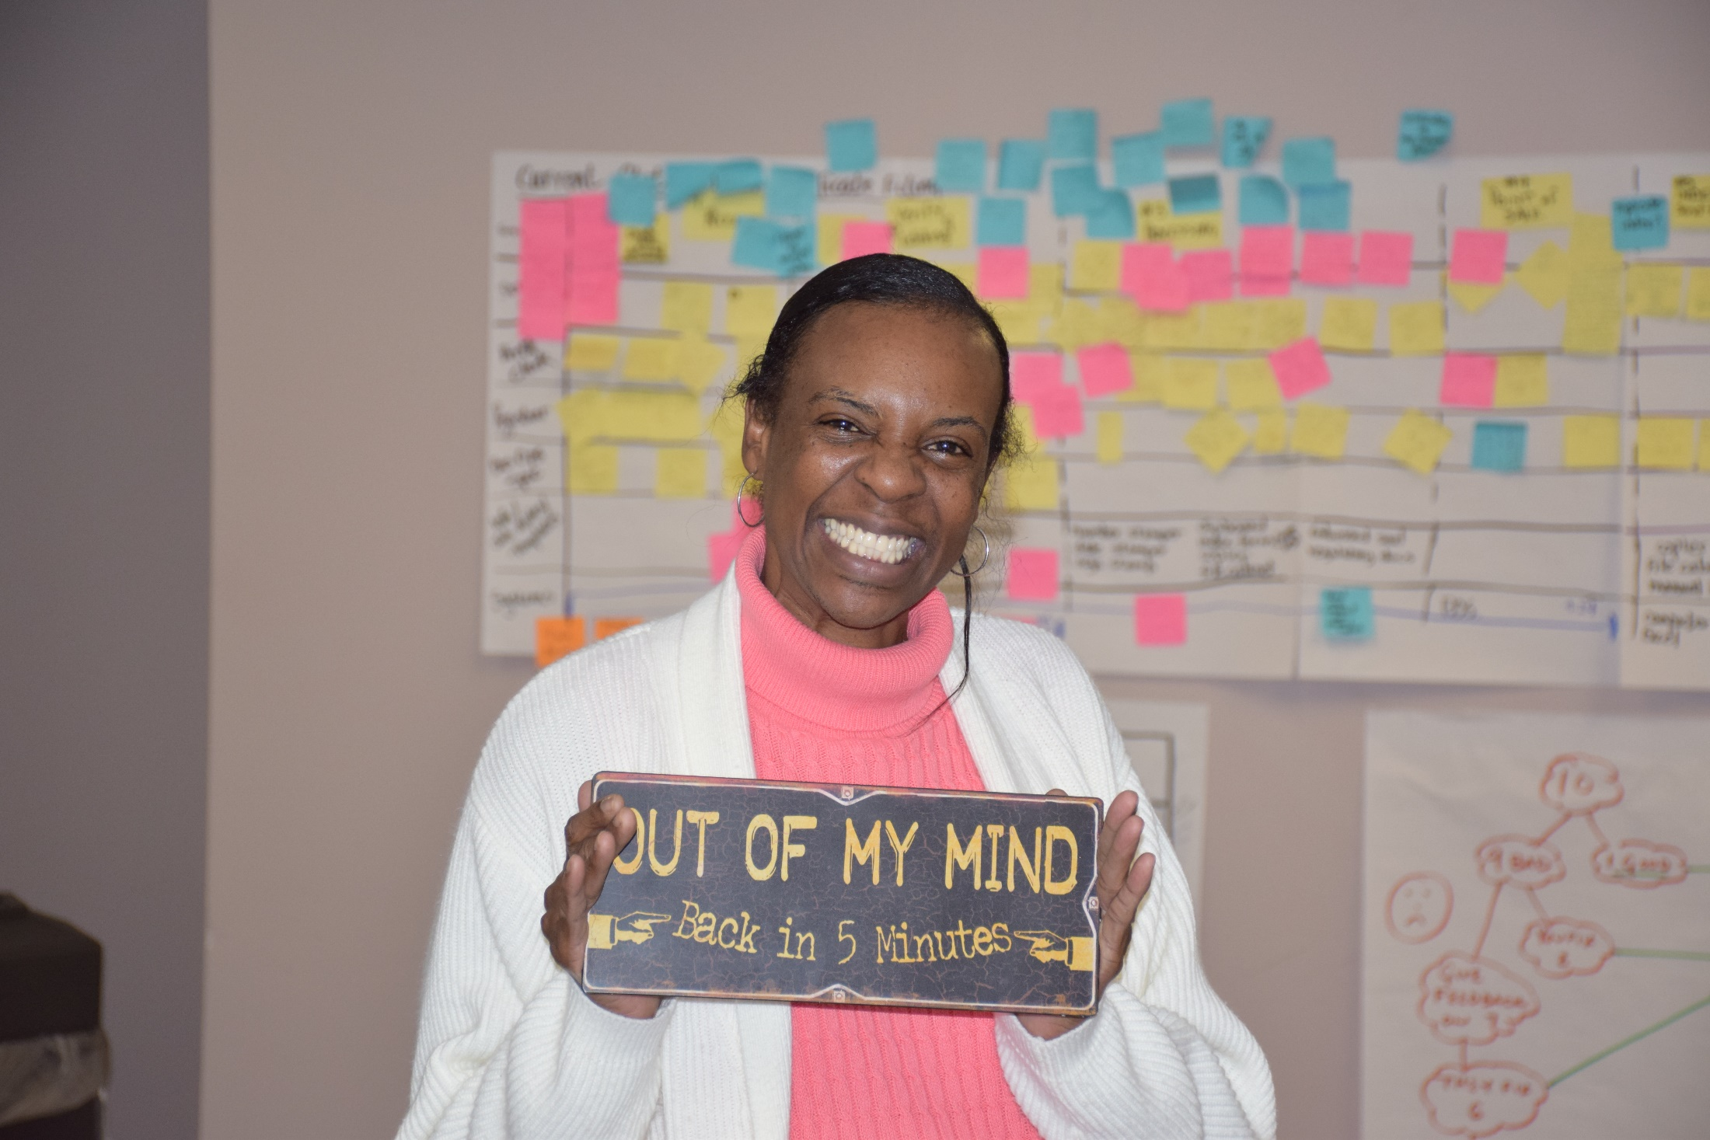
Day 3:
Start Creating the Future State
Notes:
Make this personal

Slide 21
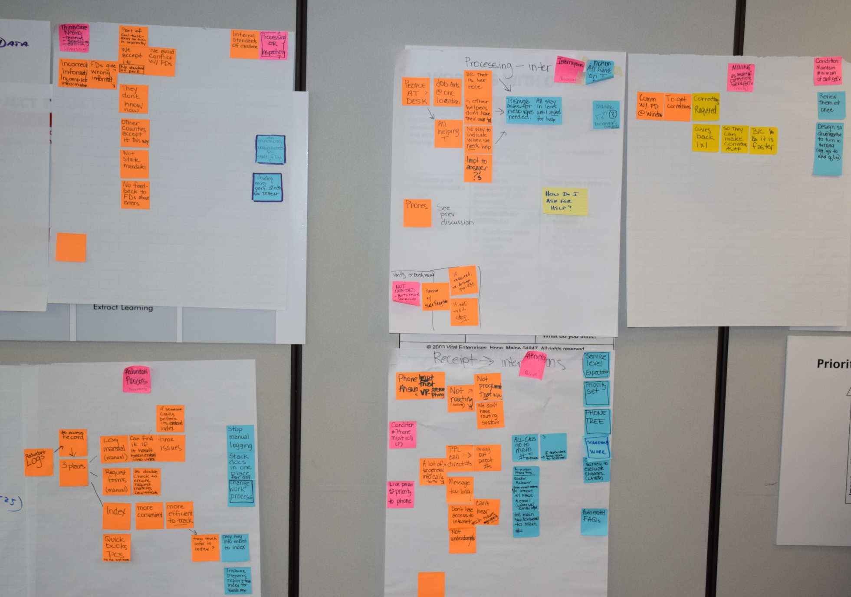
Getting to the Root Causes
Asking the
“5 Whys” For The Priority Issues

Slide 22
Root Cause Areas
Category | Issues/Wastes | Root Causes
Process step: Certificate processing | Waste: Stopping (interruptions due to phone calls to death clerk) | Incoming Phone tree and website not effective in providing information to customers due to length, accuracy and clarity of key information. Routing of calls not consistent with organization policy, not designed to reduce interruptions to death clerk. Organization policies do not exist to establish service level agreement, priority setting, and process coverage.
Process step: verify/edit | Waste(s): Not needed. Birth data verification, Waste: Things Gone Wrong, Movement. Verification of individual data fields | State standard not clear as to requirement for verification and leads to inconsistency and confusion in application No inspection standards for content of individual data fields exist; organization policy for whether DeKalb or Funeral director is responsible does not exist
Process step: certificate processing | Waste: Not needed Redundant tracking logs Dekalb process steps: Verification and inspection (final manager inspection) | Multiple logs believed required to ensure traceability; work process not standardized nor examined for how reliable traceability is achieved Team member roles and responsibilities not clear/established as to who does what, the individual’s accountability for self-inspection; work process not evaluated for how defects can be eliminated without inspection
Process step: certificate processing | Waste: Stopping (interruptions; team members at death clerks desk) | Lack of role clarity, no process for identifying overloads(help) and addressing
Process step: certificate processing | Waste: Stopping (interruptions) and Movement (office organization) | Death clerk physical location promotes interruptions by funeral directors
Phone tree and routing functionality
Requirements for acceptance and verification of data
Work process and standardization
Key service and resource policy gaps

Slide 23
Our Improvement Hypothesis
Issue | Improvement | Expected Results
Incoming defects | IF…we redesign the request form, provide clarity and feedback to the funeral directors as to frequently missed or corrected items AND we standardize our acceptance criteria for review of data… | THEN…incoming defect rates will drop and interruptions to the death clerk will be reduced.
Consistency of process | IF… we redesign our process to utilize the business operations specialist for intake, standardize and clarify roles and responsibilities and have the death clerk only receive “help” when it is requested… | THEN…labor required to process will be reduced and the consistency of the process output will be improved
Travel motion | IF… we move offices and equipment to match the work process... | THEN…travel for performing process steps, interruptions from other team members and labor required will be reduced
Redundant operations | IF…we introduce scanning hardware, software and a process for its use during initial receipt of documents… | THEN…redundant logs and processes can be eliminated and labor reduced without sacrificing traceability
Getting customers correctly routed for answers | IF…we redesign the phone messaging prompts and redesign the routing/rollover system so that it is shorter, clearer to customers and provides needed information… | THEN…customers will get their information faster with less transfers and there will be less interruptions to non-involved team members

Slide 24
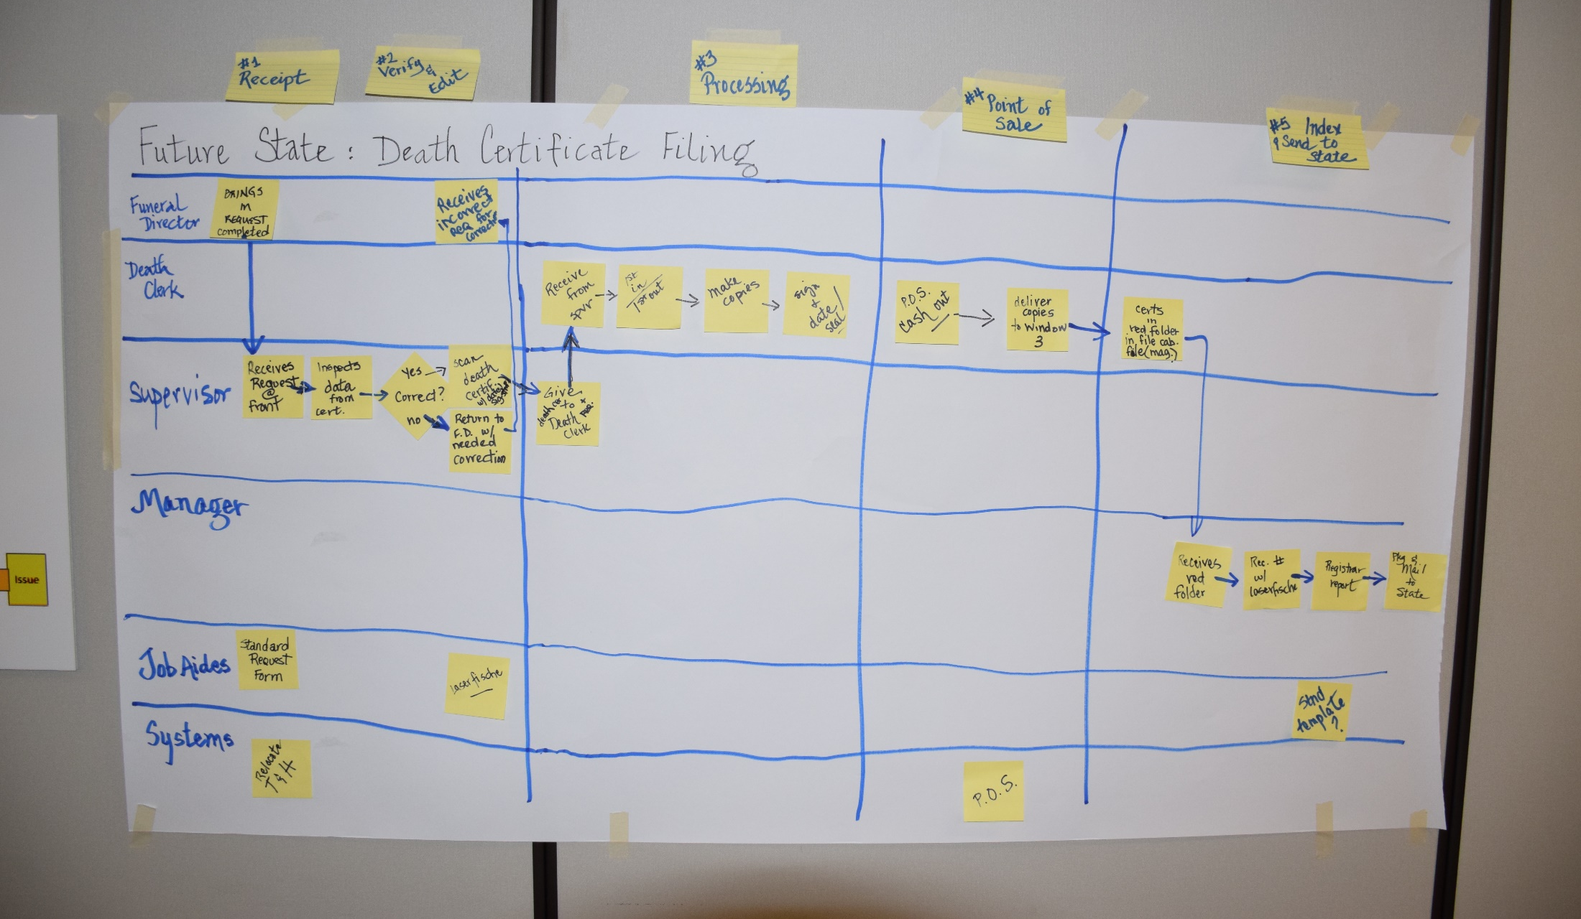
Building the Future State
Less defects, motion, interruptions, duplication…
Less labor, process steps, better quality, less frustrating

Slide 25
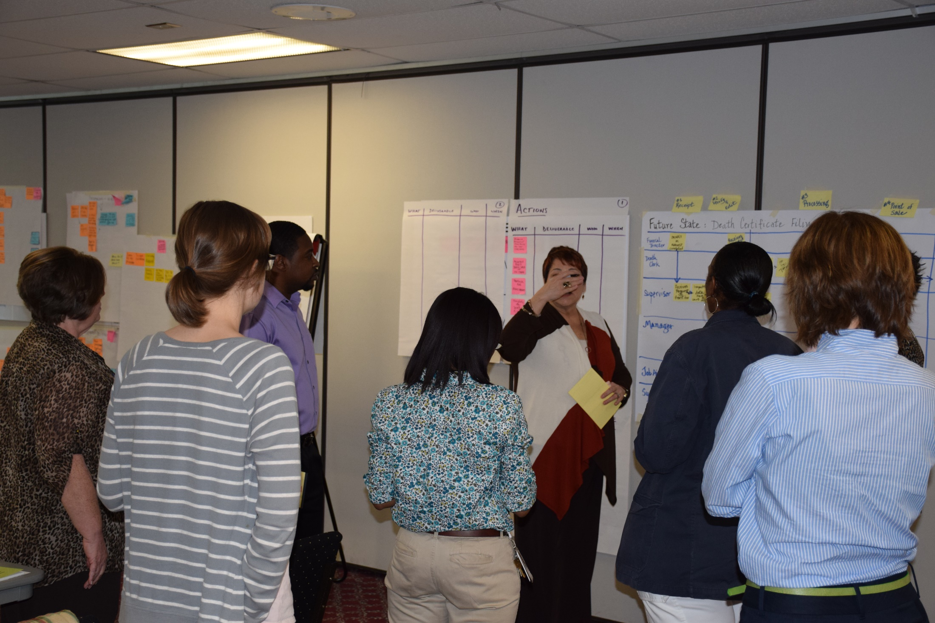
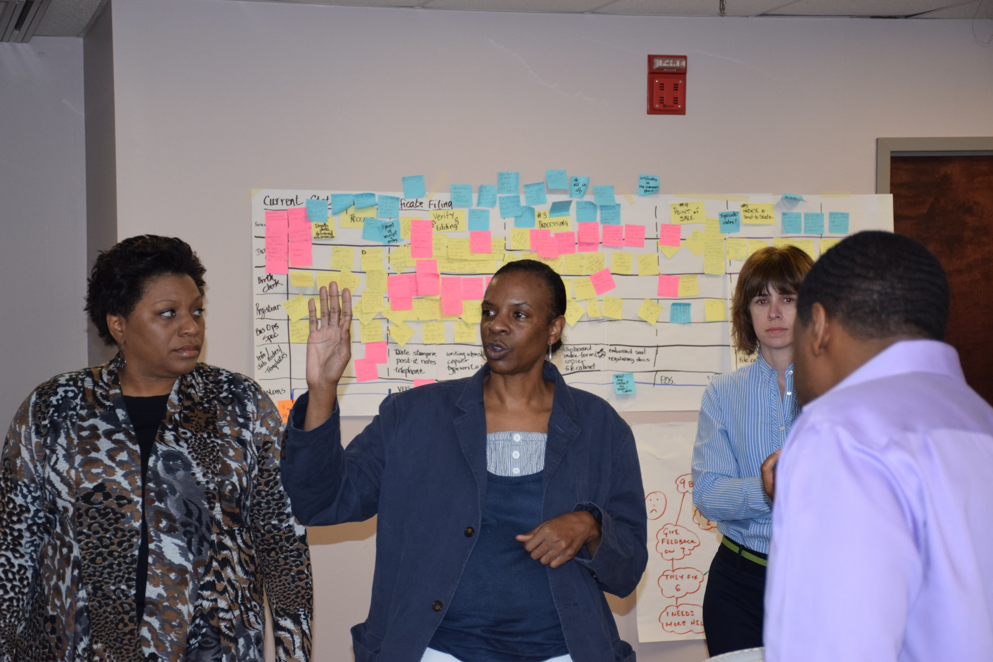
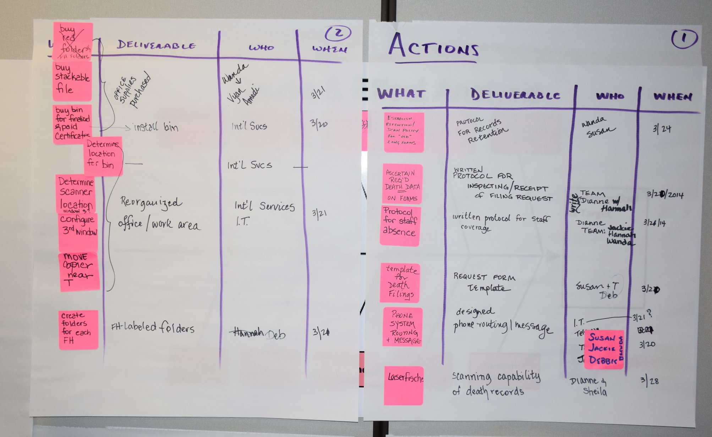
Day 4:
Developing Solutions and Job Aids to Enable the New Process

Slide 26
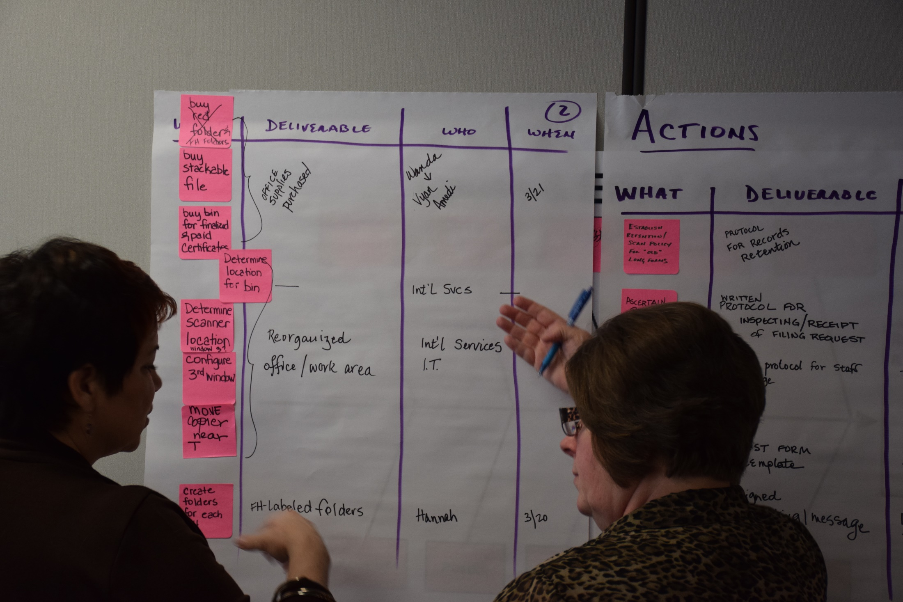
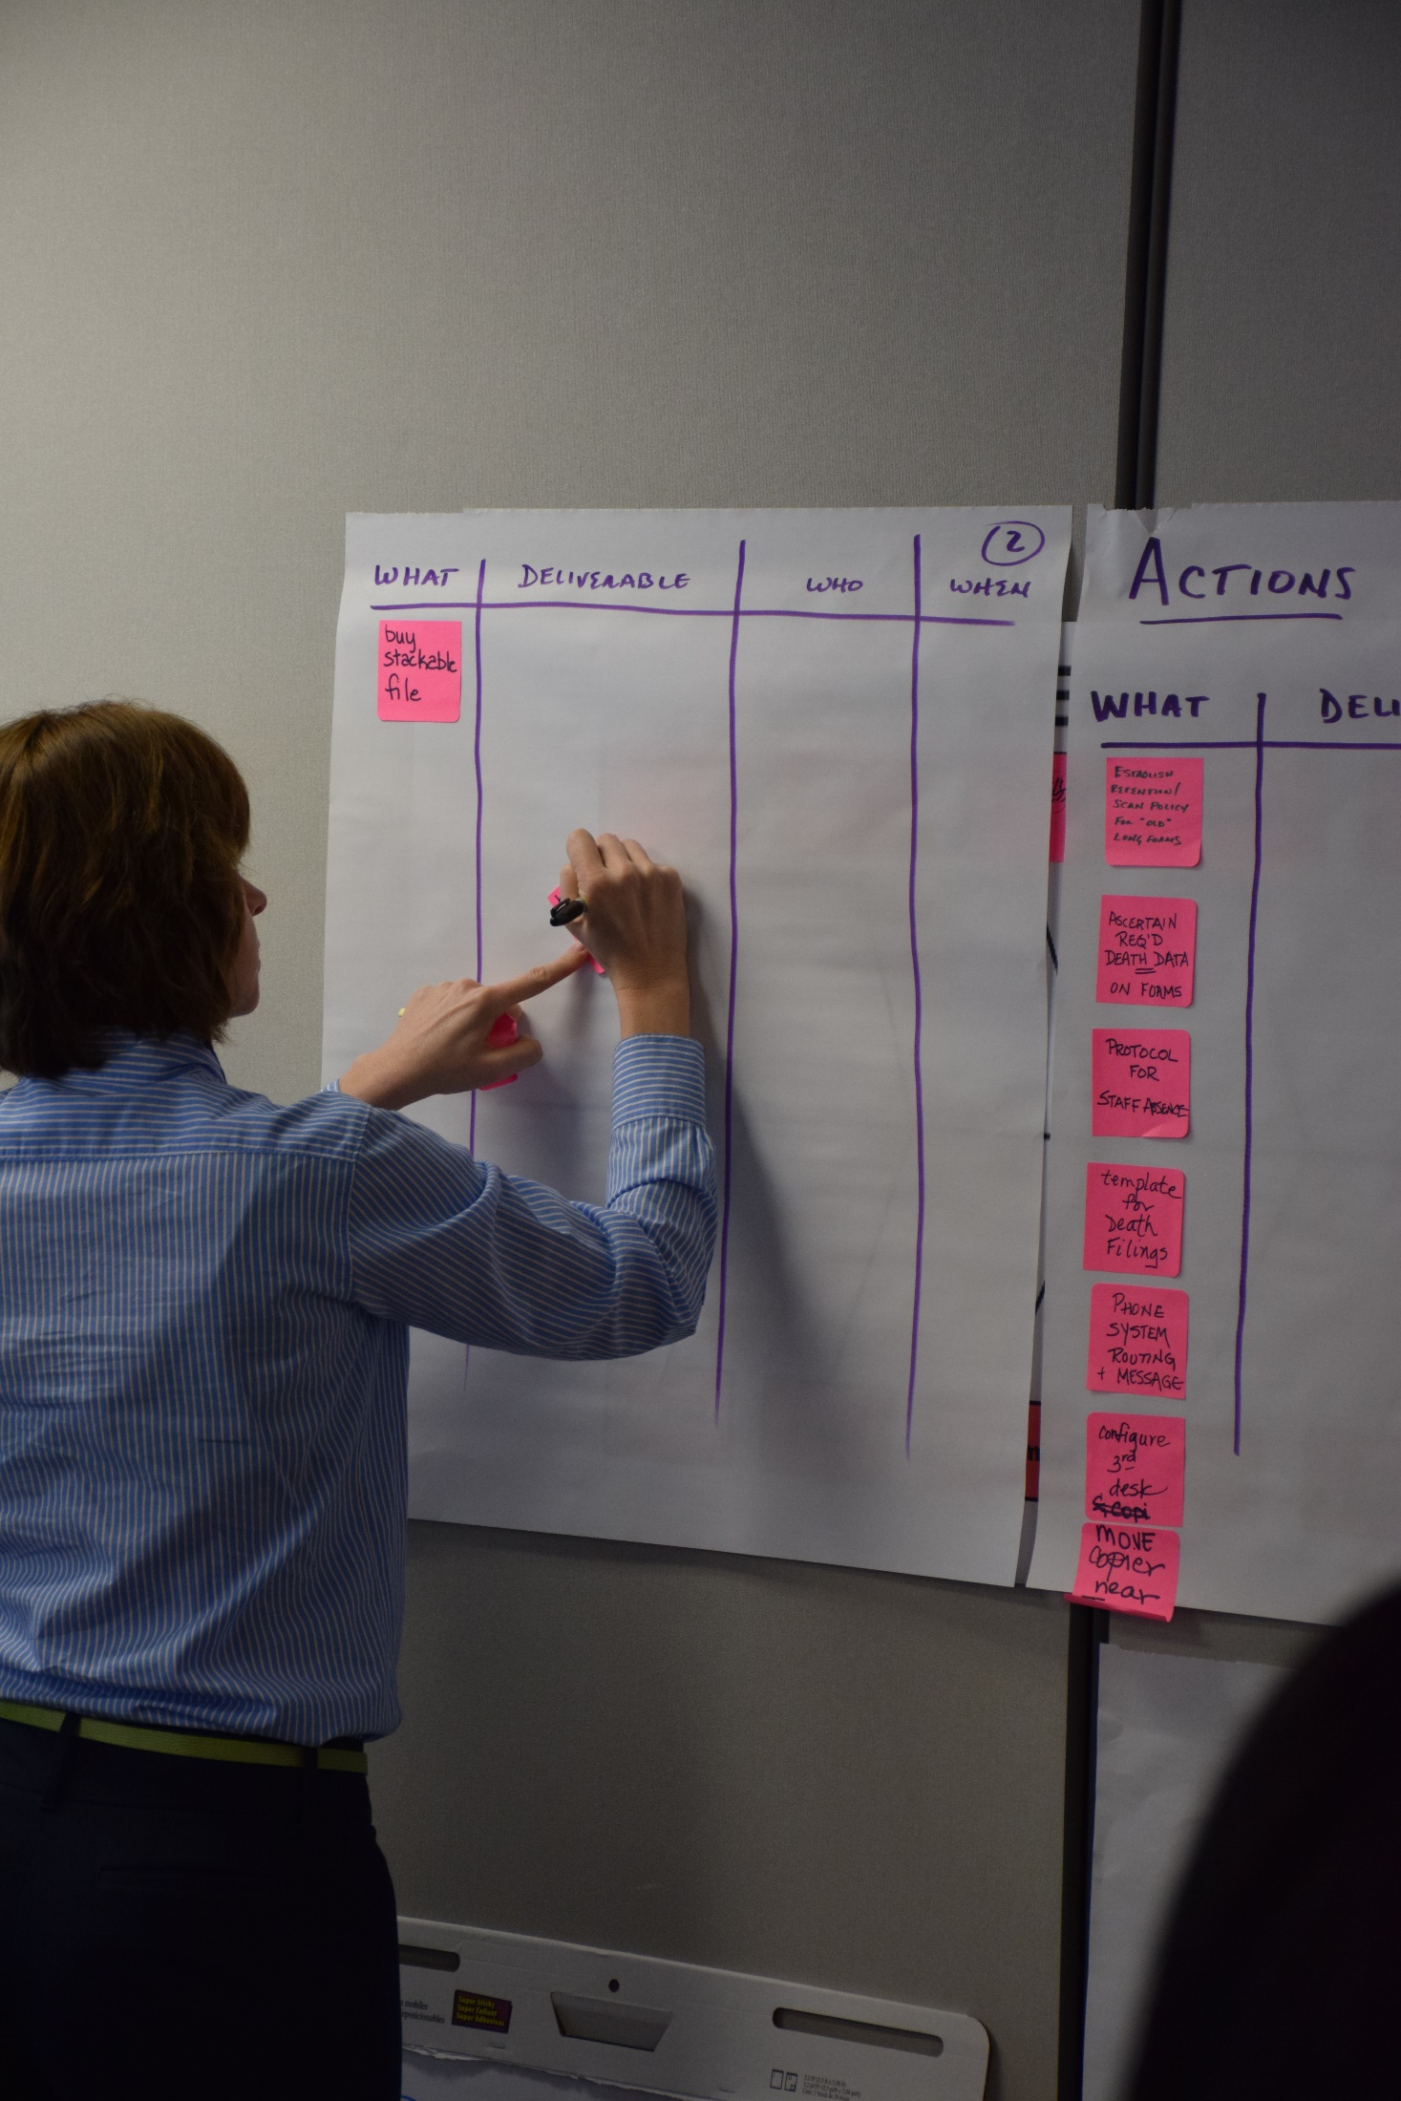
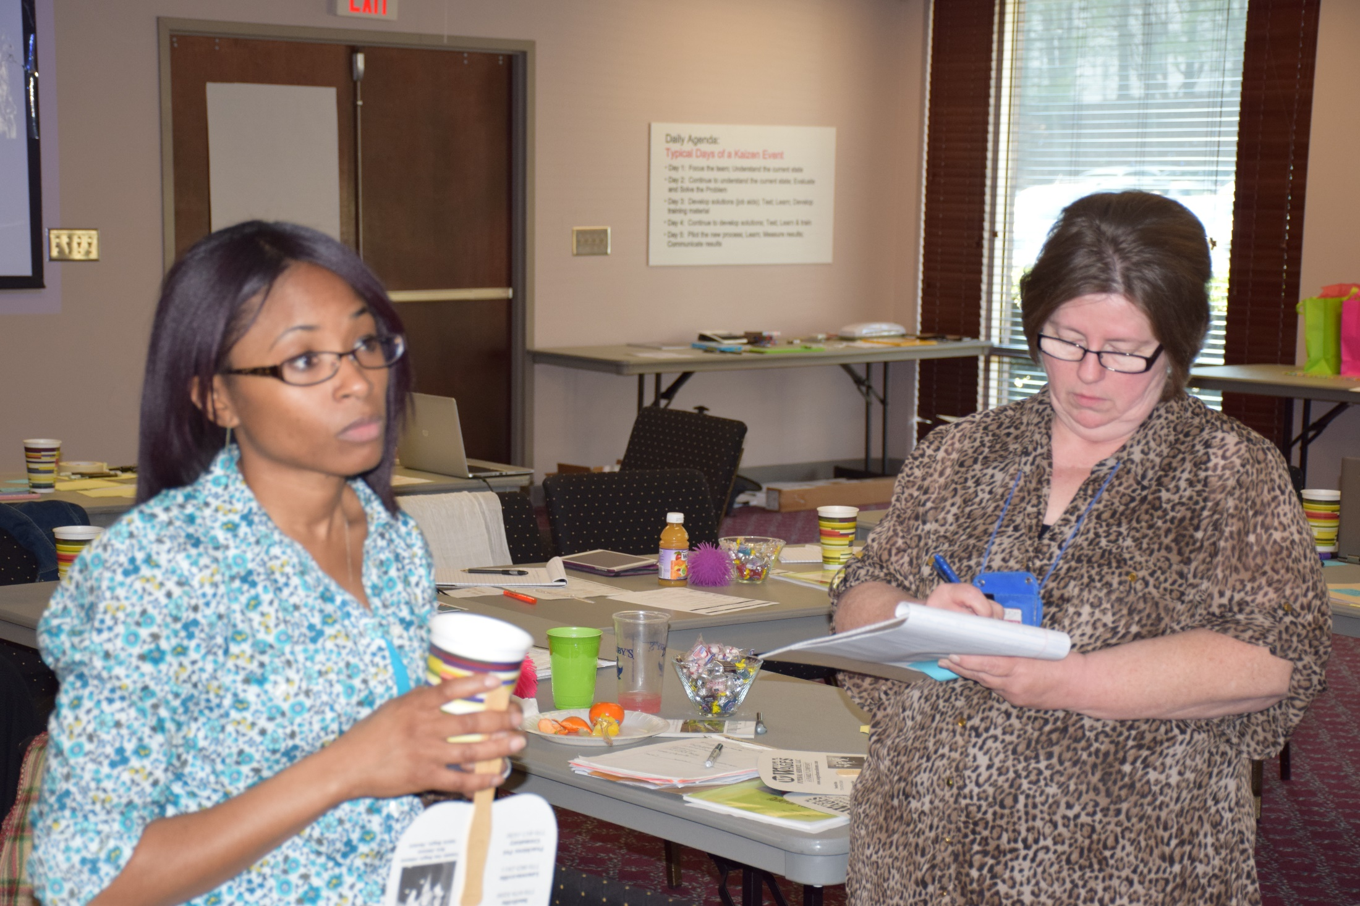

Slide 27
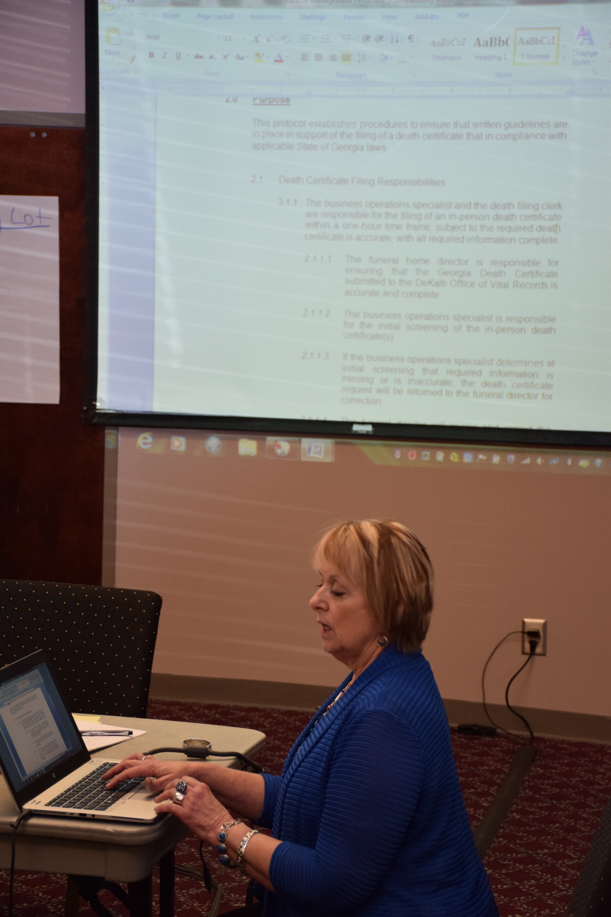
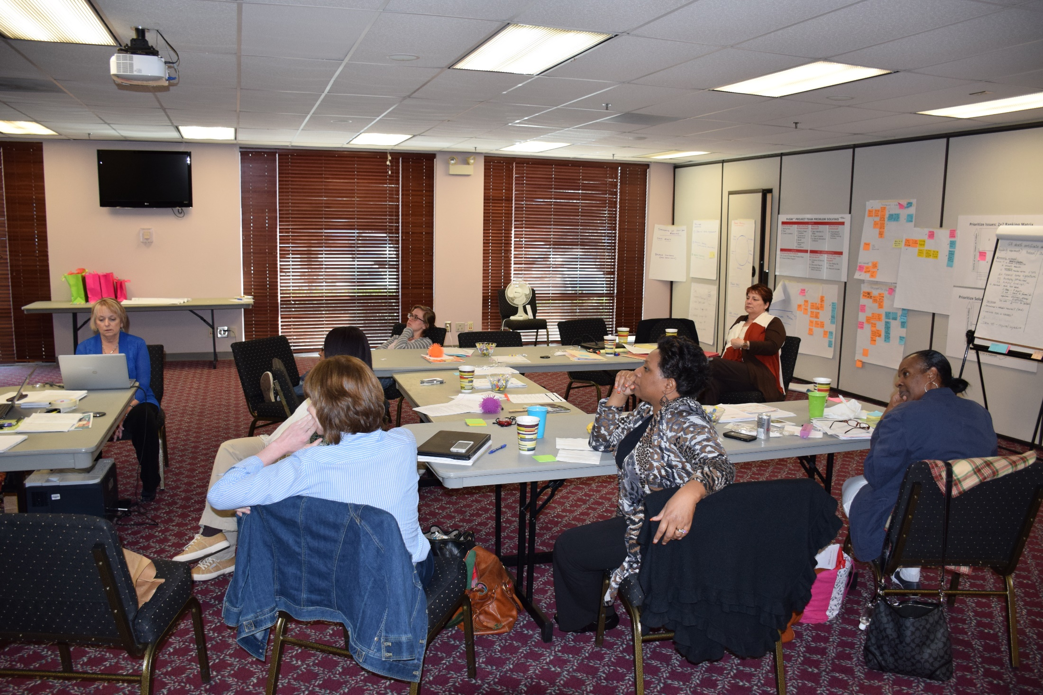
Developing Protocols

Slide 28
Day 5: Testing and Learning
Notes:
Make this personal

Slide 29
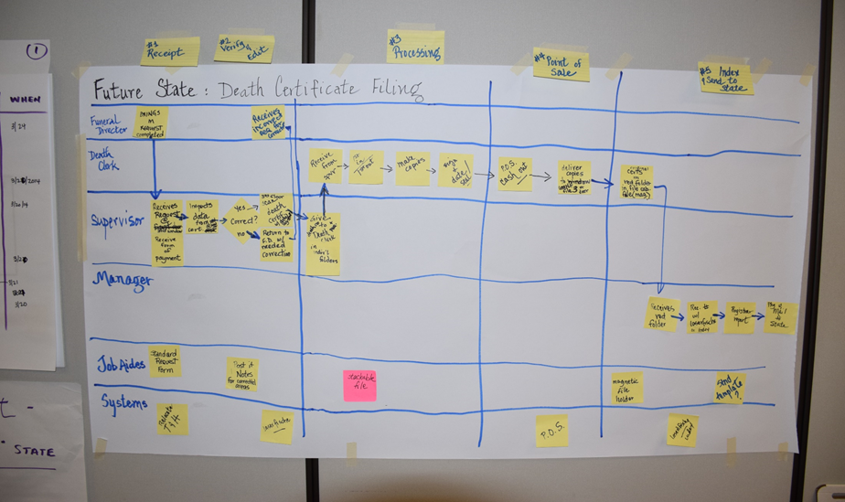
Continuing to Develop Solutions and the Future State
Standardized work and clear roles established; Operating policies revised
New intake materials to reduce defects
Scanning system and log
Verification checklist
Revised phone system
Office Area Layout revised

Slide 30
Testing the Changes
Tests | How | Successful if…
Future state Work process run though | Take sample request form and data and run through new process by role and using job aids | Process successfully achieves final deliverable; no more than 3 required changes identified
Phone tree (message) | Have 3 customers (birth and death) listen to new messaging, and attempt to access needed information | All customers respond favorably on 5 point scale that improvement over prior messaging made.
Routing (functionality) | Call in from external source and observe sequence and timing | Sequence and rollovers correct by process role
New Request form template (with visual guidelines) for Funeral director | Try new form with 3 Funeral directors; observe % of defective data received and reported ease of use | Defective requests reduced by 50% from assumed 90% level. All Funeral directors report requirements clear.
Data request inspection checksheet for Dekalb team | Give 3 members a common death certificate request and use the checksheet to establish what is acceptable/not acceptable | 90% of all fields are judged similarly by all 3 members
Scanning process and hardware | Install and run 5 records through | Hardware/software combination successfully scans, records and increments the record number window 3 station

Slide 31
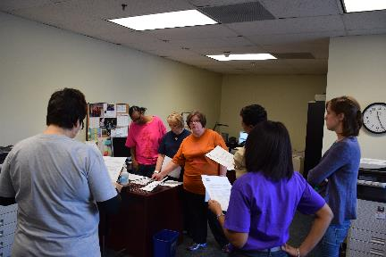
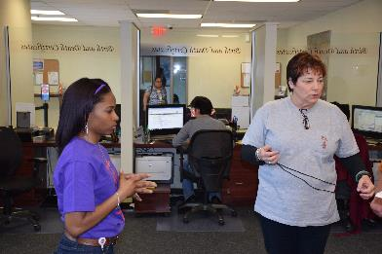
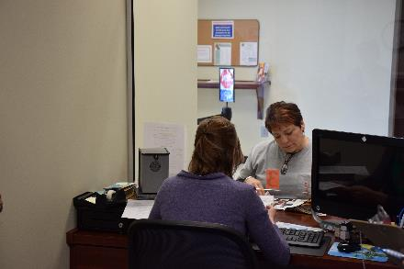
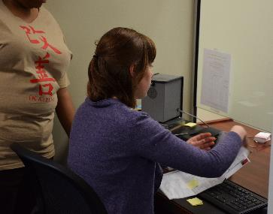
Testing the Changes

Slide 32
Lessons Learned From the Tests (SRLD)
Reasons | Learning: Why? | Direction: Actions to be taken
Funeral Director feedback was positive and helpful |  | Edit form for placement of information and additional content.
Business Ops Specialist interaction was professional and clear
Inspection of incoming data was a success
Requests needs modification | Need to “think” like a funeral not a staff member

Slide 33
Planning Our Rollout:
What Is Next?
Operationalize measures 25 MAR
Office scanning setup 25 MAR
Finish Training materials 25 Mar
Set up Continual Improvement System 27 Mar
Conduct training and observations 27-28 Mar
Phone system operational 28 Mar
GO LIVE! (31 MAR)
Measure, monitor and continue to improve!

Slide 34
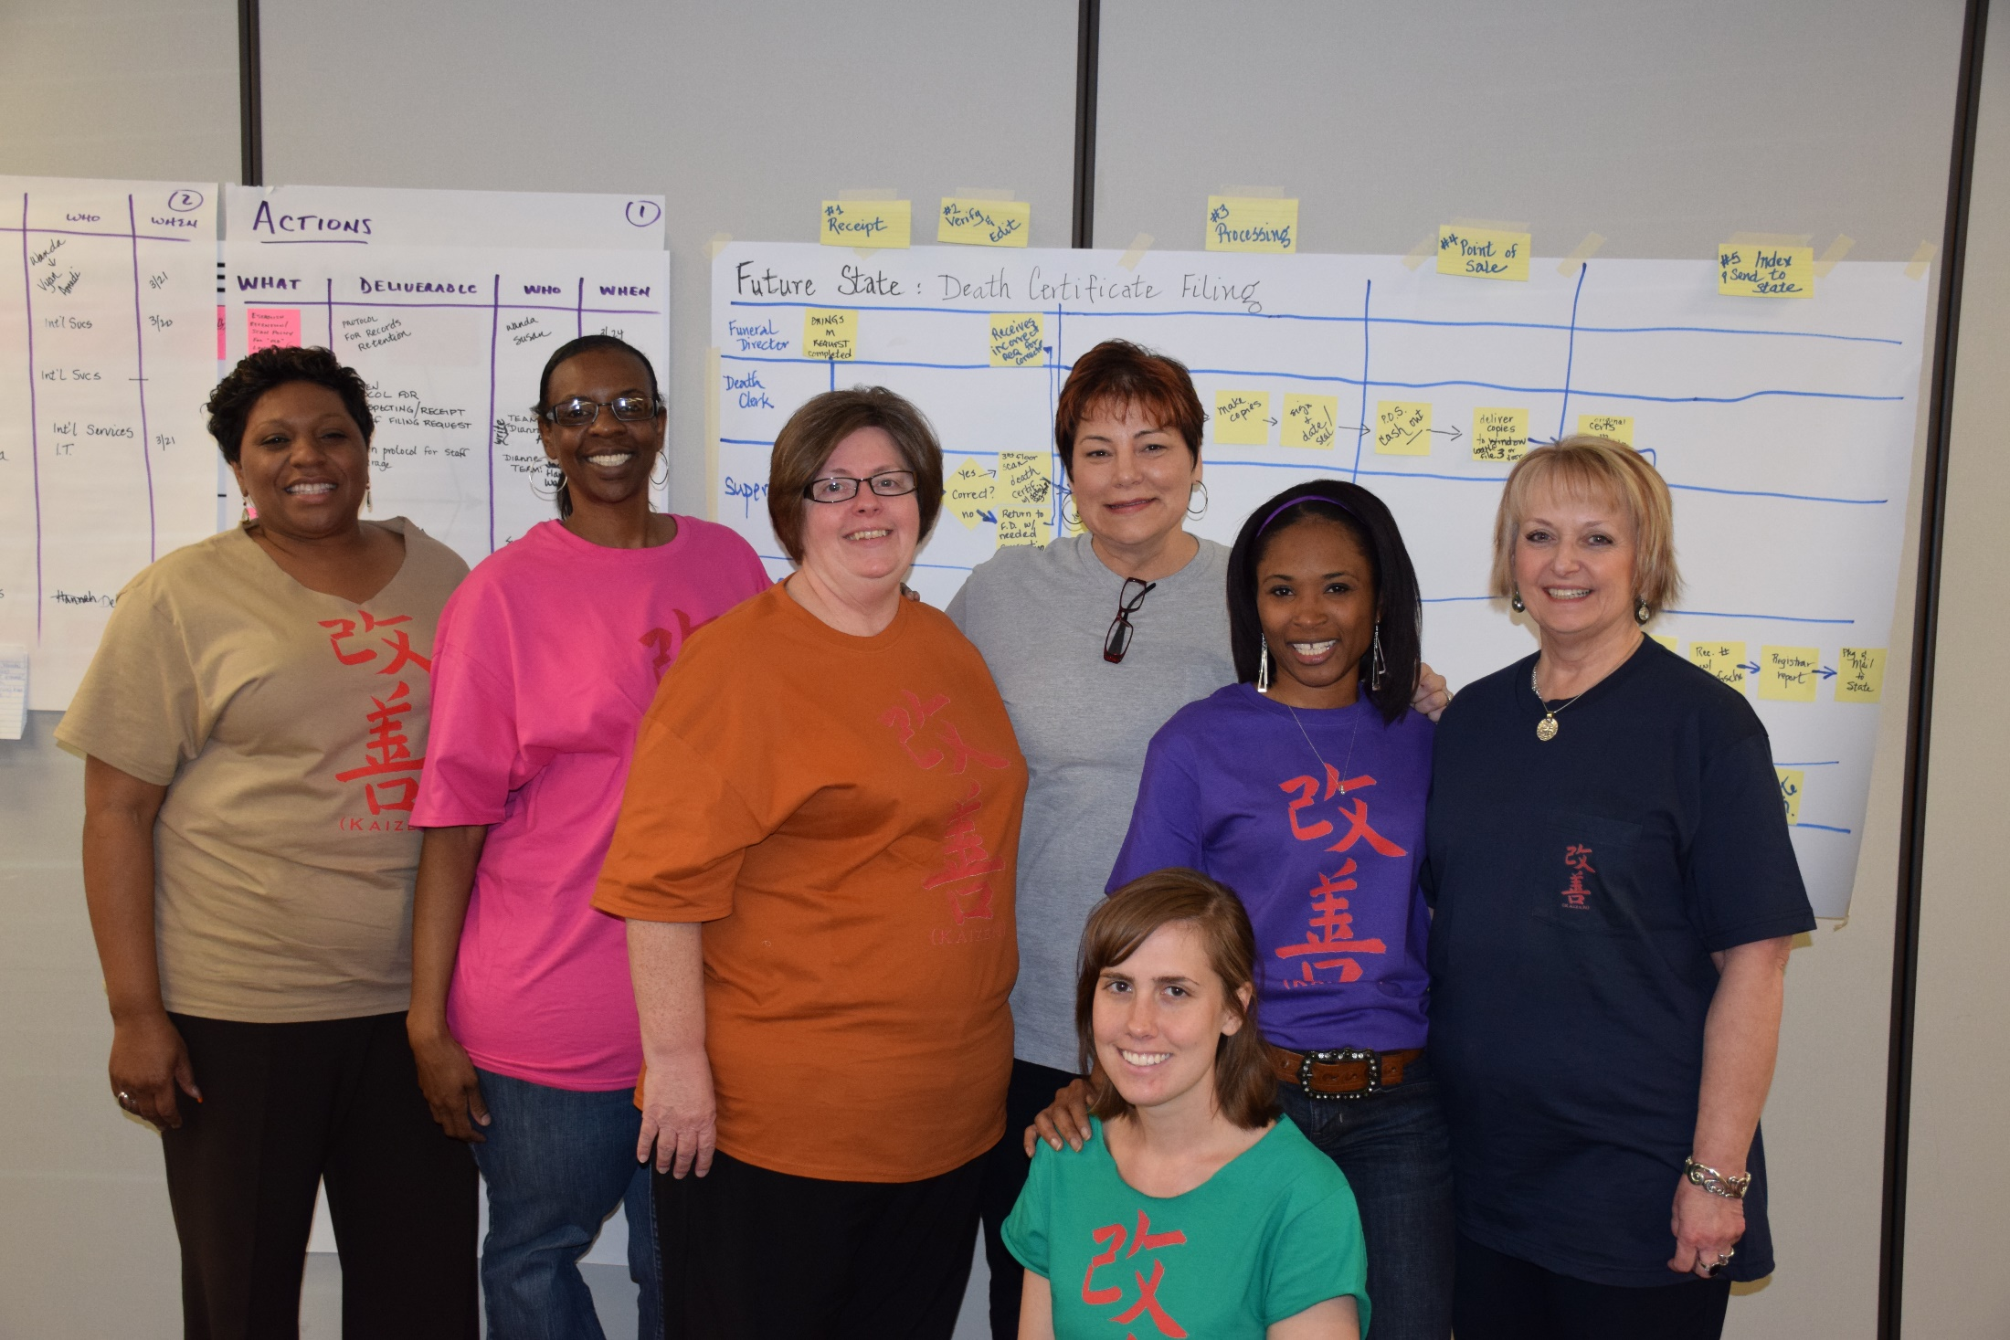
Our Team !!!

Slide 35
Team Member Observations
“Did not realize before the wastes in our processes—we do now”
“This was a rollercoaster-after I got off, I wanted to go again”; “Going from current to future state blew my mind, you have to experience it”
“Learned how we are going to improve our processes”
“We exceeded our goal through our kaizen!”
“Fun (and hard work)”
“Dealt with a lot of personalities—emotionally trying but very successful”; “Not a person of change but this was very helpful”
“Easy to see how this will benefit other functions”; “Could not have a come at a better time”
“Wealth of information that we can apply to our lives”

Slide 36
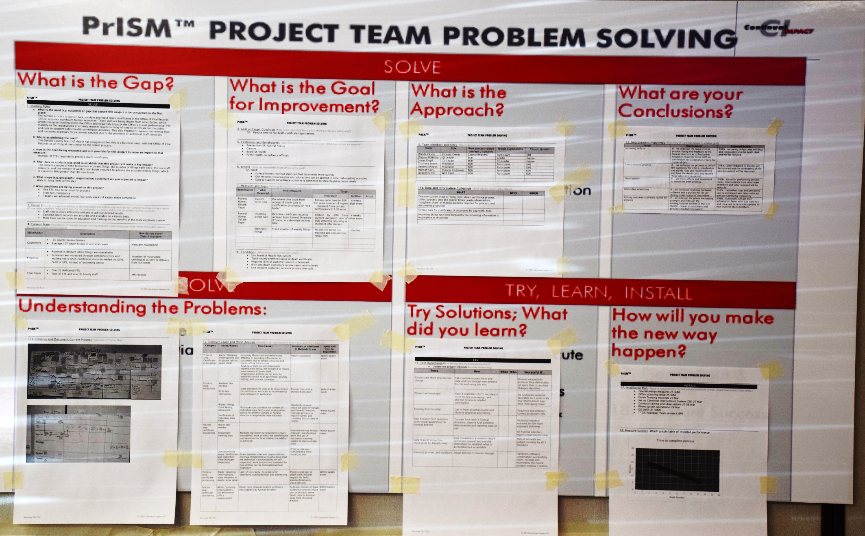
Reporting Out

Slide 37
Getting Feedback From Leadership

