Slide 1
PHABulous Response
Brenda Leigh Pohlman, BS, MPH
Fillmore County Public Health
October 4, 2012

Slide 2
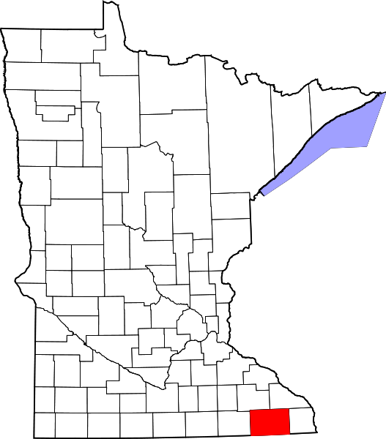
FILLMORE COUNTY
Fillmore County Public Health (FCPH) is a division of Fillmore County Community Services which is also comprised of Social Services and the Veteran’s Service Office.
FCPH is a sister agency with Houston and Winona county.
FCPH provides home care, family health, and health education and promotion.
Fillmore County, MN
Population: 21,122
Largest Amish Settlement in MN
MDH provides food, beverage, and lodging licensing

Slide 3
Session Description
This session will share how the process of quality improvement can be utilized to meet PHAB standards within a rural health department. Information regarding resources, tools, and partner engagement in improving response time to health problems and environmental health hazards will also be shared. Participants will be able to practice utilizing continuous improvement tools and will receive access to the Fillmore County model for responding to health problems and environmental health hazards.

Slide 4
Learning Objectives
Understand PHAB Standard 2.1 criteria related to investigating health problems and environmental public health hazards.
Learn how to access and utilize quality improvement methods and tools that align with PHAB Standard 2.1.
Be able to apply a continuous improvement tool to a health problem, environmental public health hazard, or another public health issue.

Slide 5
Learning Objective 1

Slide 6
Domain 2
Investigate health problems and public health hazards to protect the community.
Aligns with essential local public health activities 1, 3, 4, and 5 which are to: assure adequate local public health infrastructure, prevent the spread of infectious disease, protect against environmental health hazards, and prepare for and respond to disasters and assist communities in recovery.

Slide 7
Standard 2.1
2.1.1 A: Maintain protocols for investigation process (Written staffing plan and protocols).
2.1.2 T/L: Demonstrate capacity to conduct an investigation of an infectious or communicable disease (Case Reviews and After Action Reports regarding organizational capacity).
2.1.3 A: Demonstrate the capacity to conduct investigations of non-infectious health problems, environmental, and/or occupational public health hazards (Documented investigation report)

Slide 8
Standard 2.1 (Continued)
2.1.4 A: Work collaboratively through established governmental and community partnerships on investigations of reportable/disease outbreaks and environmental public health issues (Official written agreements, after action reports, and laboratory listings).
2.1.5A: Monitor timely reporting of notifiable/reportable diseases, lab test results, and investigation results. (Tracking log for lab and investigation results and documentation of relevant laws).

Slide 9
Learning Objective 2

Slide 10
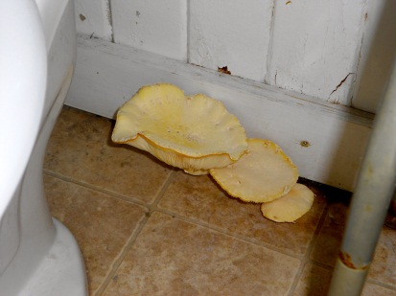
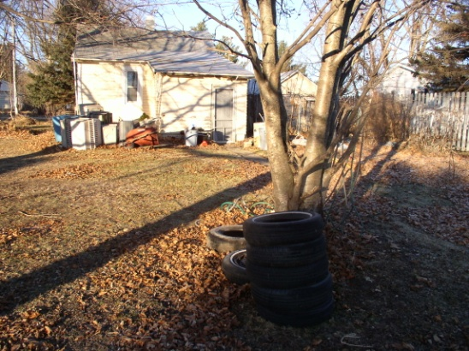
Mushrooms in rental property
Yard with unused tires
THE DILEMMA
How do you move forward with meeting PHAB Standard 2.1 requirements when no formal environmental services department is available?

Slide 11
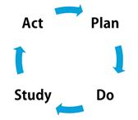
QUALITY IMPROVEMENT METHODS
Various tools are available for different forms of quality improvement or continuous improvement.
These tools may help with situation assessment, decision making, or program implementation.
Assessment – SWOT Analysis
Decision Making – Flowchart
Program Implementation – Strategic Planning
Quality Improvement Resources
Memory Jogger
MDH Office of Performance Improvement
National Network of Public Health Institutes (NNPHI)
Public Health Foundation (PHF)

Slide 12
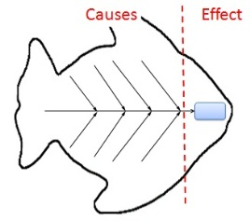
SITUATION ASSESSMENT FISHBONE DIAGRAM
Detailed graphical way of discovering root causes related to a problem or condition.
Focuses on content of the problem while limiting personal interests.
Builds teamwork and provides a resolution.
Requires continual questioning in order to get at deeper causes.
Provides and opportunity to develop strategies to tackle a cause in an attempt to change the effect.
Decide upon dispersion analysis or process classification
Generate list of causes using brainstorming or input gained prior to the process
Construct the fishbone diagram

Slide 13
Fishbone Application
Using either the dispersion analysis or process classification type of tool, determine the causes for one of the following effects related to PHAB 2.1.
Effect 1: Mold in homes.
Effect 2: Failure to mitigate homes for radon.
Effect 3: Lack of reporting of meth labs.
Effect 4: Recreational water contamination.
Effect 5: Inability to record lab results.
Effect 6: Lack of building code enforcement.
Effect 7: Delayed reporting of infectious diseases.

Slide 14
DECISION MAKING TREE DIAGRAM
Tool used to break a goal into more detailed, achievable, actions.
Encourages creative solutions while linking tasks to a goal.
Moves idea into practice and keeps it manageable.
The Process Decision Program Chart (PDPC) variation involves a goal, action steps, likely problems, and reasonable countermeasures. Countermeasures are noted as difficult/impossible (X) or selected (O).
List the goal or aim statement.
Assemble small team invested in the goal.
Generate three trunks, subgoals or means.
Identify branches or details that contribute to the trunk.
Review , connect task, and share.

Slide 15
Tree Diagram Application
Using either the Tree Diagram or Process Decision Program Chart identify three trunks and at least one group of branches.
Your goal is to improve collaboration among partners involved the investigation, reporting, or response to disease outbreaks, environmental public health hazards, or all-hazard emergencies.
Limit your scope to just one of the categories from above.

Slide 16
Learning Objective 3

Slide 17
Fillmore Background
Summer 2011: Completion of organizational self-assessment found gap with Domain 2.
January 2012: Applied for Strengthening the Community of Practice for Public Health Improvement Grant (COPPHI) through the National Network of Public Health Institutes (NNPHI)
April 2012: Awarded 1 of 30 COPPHI grants that included $5000, individualized coaching, online training, and the Open Forum Meeting for Quality Improvement.
April to December 2012: Develop and implement methods for meeting Standard 2.1.

Slide 18
Fillmore AIM Statement
Version 1 (Drafted 12/4/2012):
By November 2012, 90% of health and environmental health hazards will be investigated within twenty-four hours after initial notification to Fillmore County Public Health or referred to appropriate partnering agencies.
Version 2 (Drafted 5/23/2012): By November 2012, 90% of investigations regarding health problems and environmental health hazards conducted by Fillmore County Public Health will occur within 24 hours after initial notification as compared to the current investigation onset time of 43 hours.
Version 3 (Drafted 5/30/2012): By November 2012, 90% of initial investigations regarding health problems and environmental health hazards conducted by Fillmore County Public Health will occur within 24 hours after notification as compared to the current investigation onset time of 38.4 hours. This will reduce the initial response for animal bites, infectious diseases, and nuisances from 72, 36, and 38.4 hours respectively to within 24 hours.

Slide 19
Fillmore Activities
2.1.A – Developing standard operating procedures for health problems and environmental health hazards.
2.1.2 T/L – Implement standard operating procedures and track results.
2.1.3 A – Apply standard operating procedures, track results, and audit effectiveness.
2.1.4 A – Update agreements, condense incident management guidelines, and acquire legal documentation related to health and environmental hazards.
2.1.5 A – Develop a tracking system for recording labs, investigation results, and referral outcomes.

Slide 20
PLAN-DO-STUDY-ACT RAPID CYCLE IMPROVEMENT
Used to implement a program.
Allows for continual refinement.
Planning is the biggest component of PDSA because it involves selecting the problem, identifying opportunities, describing current processes, agreeing on root causes, and developing an effective, workable solution and action plan.
Complete planning phase.
Implement the solution or process change.
Review and evaluate the result of the change.
Reflect and act on lessons learned.

Slide 21
Fillmore Solution
Utilize electronic tools to provide a seamless, paperless, system for anyone in public health to start the investigation process for health problems and environmental health hazards.
One Final Solution: Creating assessment tools in PH-Doc.
Benefits for Local Public Health: Can be used internally but also shared with fellow PH-Doc users.

Slide 22
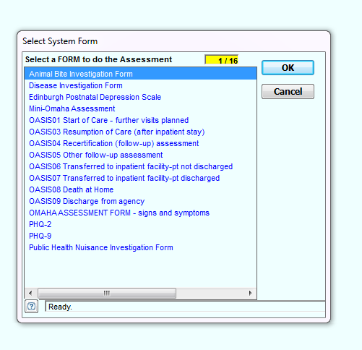
PH-Doc Form Selection

Slide 23
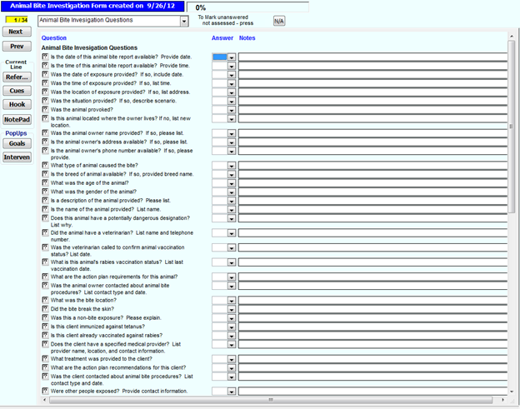
PH-Doc Assessment Form

Slide 24
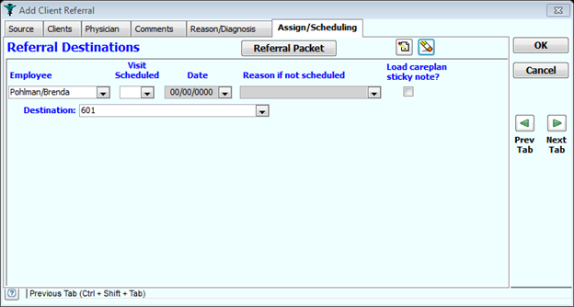
PH-Doc Staff Referral

Slide 25
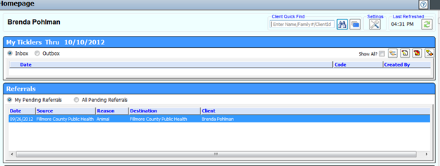
PH-Doc Staff Follow-Up

Slide 26
Thanks for Participating in PHABulous Response!
Any Questions?
Brenda Leigh Pohlman, BS, MPH bpohlman@co.fillmore.mn.us
507-765-2636

