Slide 1
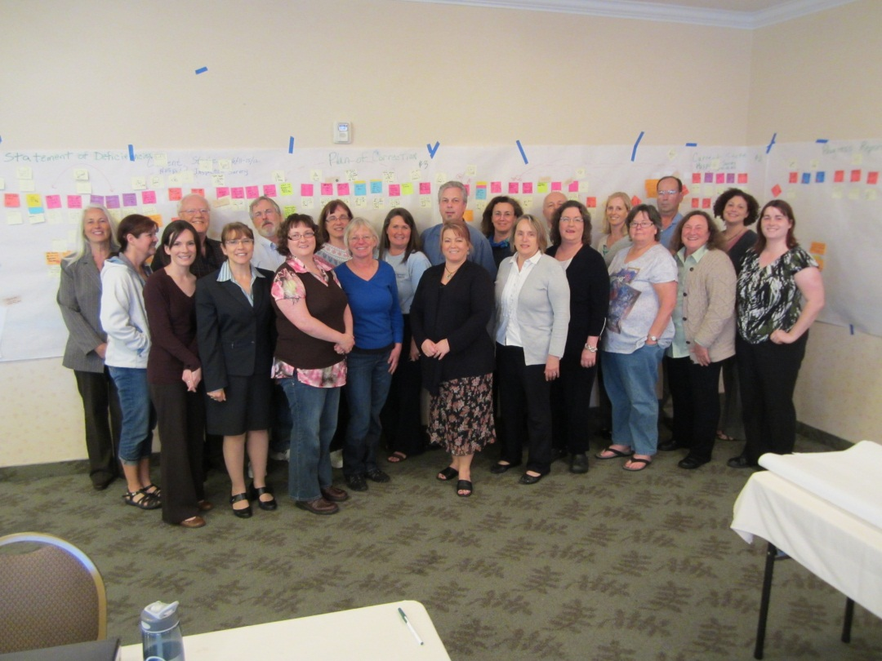
Quality Improvement Success
Hospital Survey Inspection Process
Goals:
Increase the quality of the on-site survey process
Make the survey process more meaningful
Optimize and maximize resources
Streamline business practices
PLAN:
Outcome: Increase the efficiency of the hospital licensing process to ensure surveys are completed within timeline.
DO:
The Quality Improvement Results:
Saved roughly 37 days (from 63 days to 26 days) through a new streamlined scheduling process.
Reduced the amount of time to notify the Center for Medicare and Medicaid hospital survey outcome from 201 days to 70 days.
CHECK: Regularly evaluate project implementation, assess data, and work with staff to resolve issues.
ACT: Develop office protocols and timelines for implementation for each of the key focus areas.
Collect metrics to assess the success of the Lean effort.
Balance staff skills and workloads with changes in responsibilities and duties.
Supports
2011-16 Strategic Plan
Goal 3: Everyone in Washington has improved access to safe, quality, and affordable health care.
Department of Health: Karen Jensen (Executive Sponsor), Dave Magby
and Trent Kelly (Project Lead), Linda Foss, Elizabeth Gordon, Cheri Carter, Rachael Lindstedt,
Shannon Walker, Kristen Peterson, Lisa Sassi, Marieta Smith, Lee Malberg, Paul Throne,
Lisa Mahoney, Larry Anderson, Valerie Walsh, Steve Mickschl, Barb Runyon
Other Agency: Karen Jones, Fire Marshall
Customers: Barbara Yoder, PeaceHealth Southwest Center, Linda Goodwin, Evergreen Hospital, Jean Borth, Franciscan St. Clair Hospital
Others: Anneke Jensen, Kathryn LePome, Susan Ramsey, Kris Kernan, Megan Davis, and Diana Ehri, DOH
June 2012
This message sponsored by the Office of Performance & Accountability.

