Slide 1
Utah Public Health Laboratory Customer Service Quality Improvement Project
Participants:
Utah Public Health Laboratory
Utah County Health Department
Utah Public Health Improvement Program

Slide 2
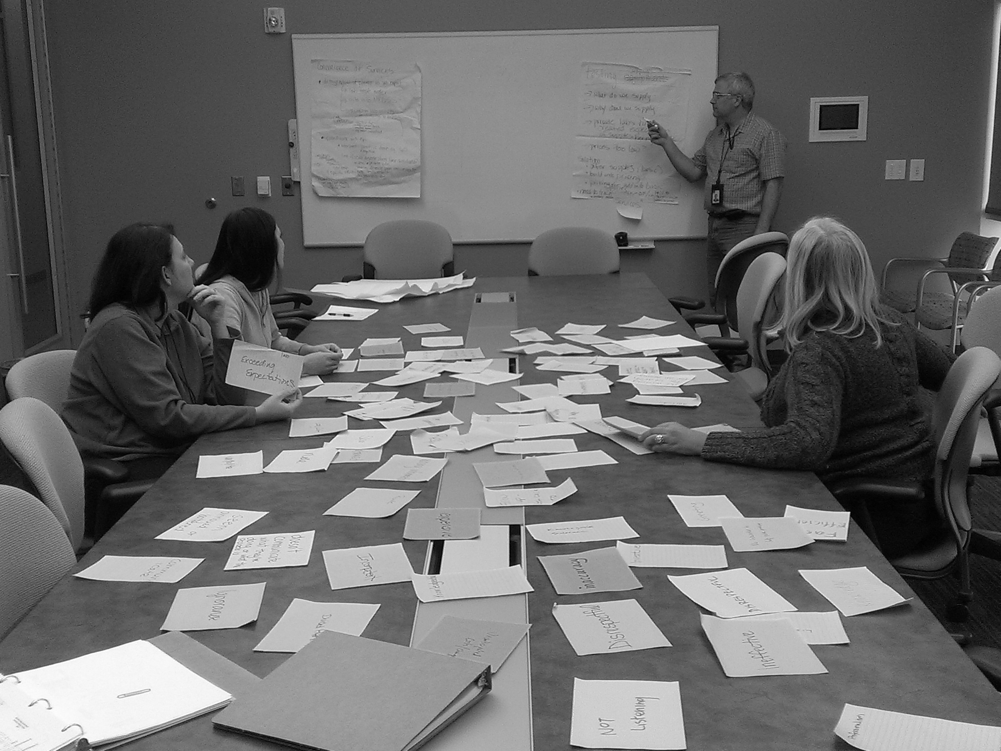

Slide 3
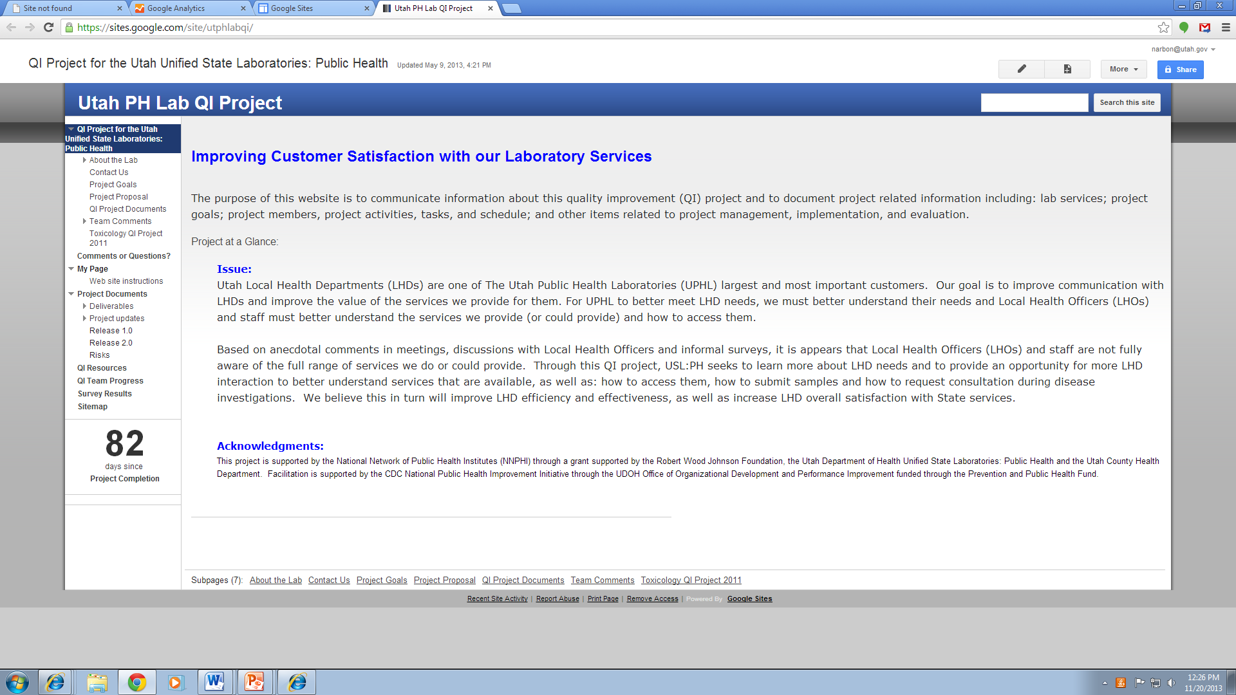
UPHL/LHD Quality Improvement Issue: Utah Local Health Departments (LHDs) are one of The Utah Public Health Laboratories (UPHL) largest and most important customers. Our goal is to improve communication with LHDs and improve the value of the services we provide for them. For UPHL to better meet LHD needs, we must better understand their needs and Local Health Officers (LHOs) and staff must better understand the services we provide (or could provide) and how to access them.
https://sites.google.com/site/utphlabqi/

Slide 4
Examples of outcomes from pilot
Quality Improvement project with
Utah County.

Slide 5
Update the Laboratory's website
Information on the UPHL Website:
List of tests conducted and associated fees
Information on proper sample collection and submission
Submission forms for chemistry, etc.
Courier pick-up for routine locations
Contact information by topic and area of the Lab
Client services manuals for Chemistry (environmental) and Microbiology (infectious diseases)
http://health.utah.gov/lab/

Slide 6
Increased courier pick up services including
Central Utah Public Health Department
Location | Days | Time
Central, Richfield, Sevier Co. (at health dept.) | TUE & THUR: Pick up | 10:45
Central, Manti, Sanpete | (800-344-5482 or 801-442-4090) | On call
Central, Nephi, Juab | (800-344-5482 or 801-442-4090) | On call

Slide 7
Added more convenient stall for sample drop-off parking
Comments:
33 (100 %) of all customers asked agreed to participate in the survey
20 (61%) of survey participants provided written comments, 17 (85%) of these comments were positive about the new parking stalls and/or Sample Receiving staff (complimentary feedback)
3 (15%) of the written comments provided negative comments (constructive feedback)
2 (6%) of survey participants who parked somewhere else did not know that new parking stalls had been created for Sample Receiving customers until they read about it on the survey
Notes:
Survey Questions:
Survey administered:

Slide 8
Sample Receiving Customer Service Survey Customer Comments
Parking for me is great when I come. I have only used the extra spot once. Thanks!
Good job!
Very nice people
Smiley Face
You guys do a great job keep it up!
Keep up the great work! Smiley Face
It’s close. Nice parking.
Keep up the great work(smiley face)
I usually don’t have a problem parking, I wasn’t aware that there was other. The SR personnel are usually great to work with. Thanks!
Need more parking.
Did not know about this.
Good Job
Everyone has a smile and is super nice!
No, everyone is awesome
You are all wonderful!
You are all so friendly no complaints
Did not realize there was additional parking
Busy –wait- have had to park on the south side due to no available spots. No sidewalk.
This time it was not full, but most of the time parking is scarce.
They [the new parking stalls] are great.
Need parking and one way around the building

Slide 9
Created Quick Sheet for Lab Tests, Days Tests Performed and Normal Turn-Around-Time for Tests
Tests | TAT | Testing days | Contact | Phone number | Fee- cost to LHD
CT-GC | 1 business day | Every day M-F | Virology Lab | 801-965-2584 | $18.11
HCVAB | 2-3 business days | Mon, TH | Virology Lab | 801-965-2584 | $16.50
HEP_B_ Antibody | 3 business days | Mon, TH | Virology Lab | 801-965-2584 | $13.80
HEP_B_Antigen | 3 business days | Mon, TH | Virology Lab | 801-965-2584 | $9.00
Herpes PCR, VZV, type 1 or type 2 | 3 business days | Mon, Wed | Virology Lab | 801-965-2584 | $28.50
HIV_AG_AB | 3 business days | Mon, TH | Virology Lab | 801-965-2584 | $11.81
Syphilis_IGG | 3 business days | Tues, Friday | Virology Lab | 801-965-2584 | $6.75
Virology | 7.4 up to 14 | As needed | Virology Lab | 801-965-2584 | Call
Quantiferon-TB IT –Gold | 3 business days | M, TH | Virology Lab | 801-965-2584 | $42.45
Rabies (bat) if submitted before 11 am | 1 business day | Everyday M-F | Virology Lab | 801-965-2584 | No fee
Rabies (everything else) | 2-3 business days | Everyday M-F | Virology Lab | 801-965-2584 | $85 rodent $15 inappropriate sample $No test Fee for appropriate sample
Courier Service costs to Lab: normal pick up = $9 each time; special pickup- $25.00, Call (801) 357-7465

