Slide 1
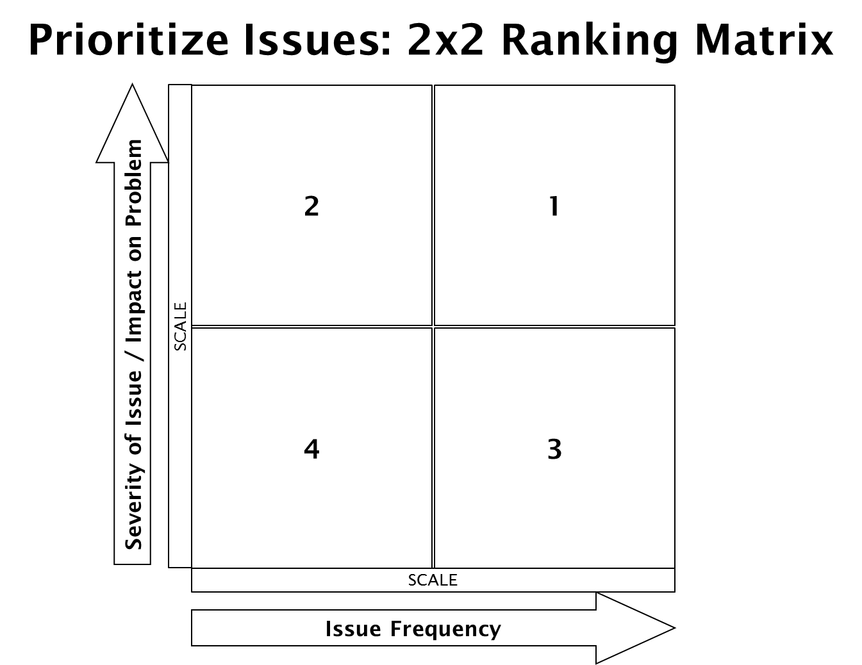
Capturing Wastes & Issues
Sometimes staff cut corners & not properly follow procedures resulting in violations when primary manager is not on duty
Culture – where some requirements of results not important culturally
Converting theory into action – make it personal
CV marked – Manager does not change procedure that resulted in violation just tries not to get caught again
Don't retain what owner/operator has been told by inspector
Mgr. doesn’t demonstrate knowledge during the inspection
Operator wants help with staff training but EHS not allowed
Staff doesn’t check for cleanliness
P/PF noted not priority after EHS leaves
Business is failing
Too busy to deal with
PIC not delegating
Operators do not know what violations are P/PF
Manager does not want to talk to inspector
Language barrier
Don’t care
Managers too busy to review report or ask questions
Employees don’t date
Wrong date on items
We don’t follow up to see if CDI resulted in long term improvements
Don’t prepare for inspection daily/Just in time preparation
Cold Holding temperatures not maintained
Lack of management experience, management control
Manager confused with importance of P/PF vs. core violations
Differences in training received - serve safe doesn’t tell everything need to know
Manager turnover & knowledge not passed on; Staff turnover & not trained
Don’t have power to correct
Correction may not reflect actual change & temporary only
Employees don’t care; don’t understand why they should care
Culture of not taking is seriously
No time to inspect your work
Don’t have labels for all bottles
Temperatures not taken routinely
Can’t find / don't have thermometers
Don’t have right way to date to food (proper procedures)
Owner focused on public – customer 1st, safety 2nd
Internal QA – consistency of REHS
No buy-in, government is bad, & inspectors are there to ruin business
Rush hour
Trying to correct all violations during inspection instead of staying with EHS
Report is a lot of small writing with words they don’t understand
Menu changes create ‘new’ issues resulting in P/PF violations
Not a fireable offense
Manager does not follow-up with CHA stating violations are completed
Many do not call – up to CHA to go by
Operators or staff lack basic science education – don’t get that something in deeper pan cools slower
Manager makes corrections according to what is easier to do
At permit – regulations are not provided
Food handlers lack knowledge
Low mental threshold/capacity

Slide 2
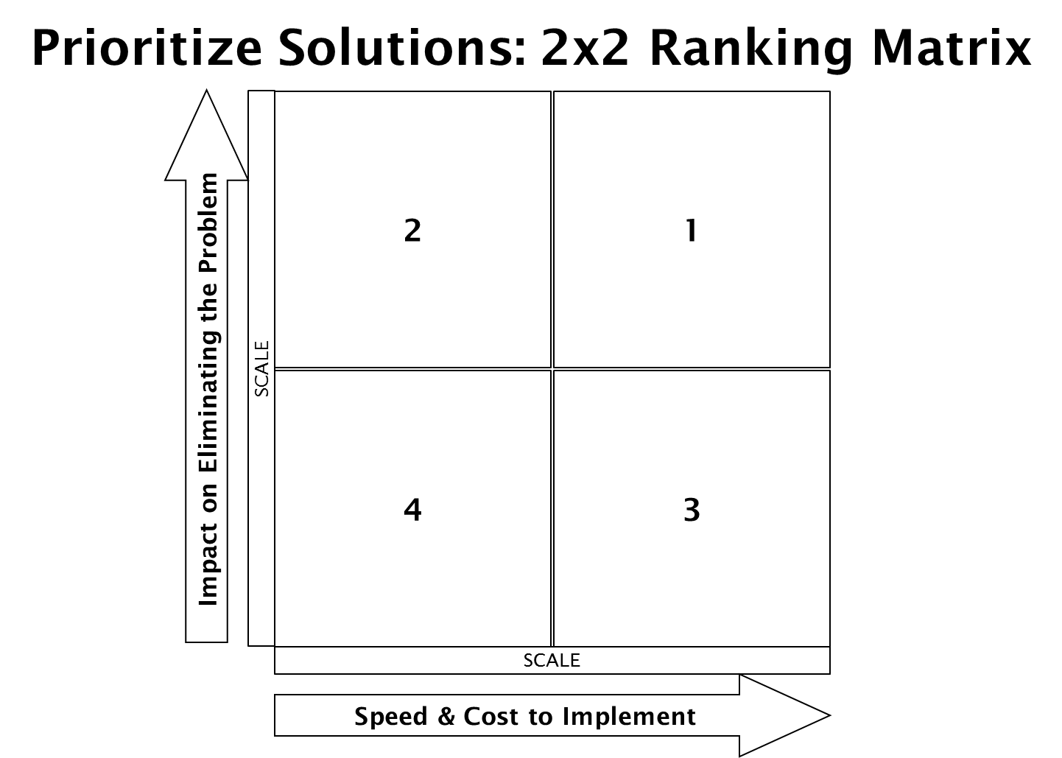
Prioritized Solutions
Date Marking (Put date supplies at point of use, mgr. show importance, date everything, use price gun, change color of date code)
Follow up on non-CDI (develop tool to log & follow up, set guidelines for P/PF that must have follow up, go by and visit when in the area/strategic inspection planning)
Active Managerial Control (teach them what this is)
Improve relationships (Eat where you inspect, interact with all employees, keep food safety in the fore-front of all employees minds)
P/PF Education (understand the what & why of violations, training once a year, checklist for mgrs., educate what these violations are, operators don’t know what is a P/PF vs Core, increase understanding for all employees)
Email (email last violations & links, email inspection report back to restaurant later, routine communication, email before next inspection – attach previous violations, ask EH front desk to call restaurants and get emails – create email database)
Concentration on high violation establishments
Tools (create how to instructions for top P/PF violations
Use Permit action
Change in thinking
2 infractions – fireable offense
Call place letting them know you will be following up that week
Going by when the score is not on the line & when they are not as busy may improve relationship
Provide training classes on P/PF violations
Make a later appointment to go over inspection sheet
Call out policy & enforce it
Buy-in from all employees
Be proactive
Increase EH staff
Follow-up visits to confirm corrections-highlight positives
Leave phone # for them to call if questions
Recommend Manager do daily walk thrus with self inspection sheet
Do we need to education public about what the grade actually means? Explain risks (newspaper, website)
Provide labels for sanitizers
Digital clock with date, place it next to calendar
Inspection notes in more detail
Visit documented under item numbers so auto populates for next inspection in DHD
Alternate timing when quarterly inspections are being done
Preventative Maintenance every 3-6 months
Call in 2nd shift
More places need to be using temp. logs
Publicize when corrections are made on DHD
Employee incentive
Have supplies on hand for them to buy

