Slide 1
Pertussis Prevention for Pregnant Women: P³W
Protecting Infants

Slide 2
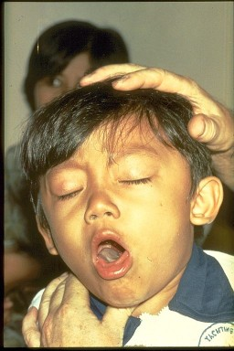
Whooping Cough
US 2010 - 27,550 cases of whooping cough
12% were infants < 6 months old
40% were transmitted from mother to infant
Collier 2011- 19 reported cases
1 age under 1 year
5 age 1-4 years

Slide 3
Easily Prevented with Tdap Vaccine
Advisory Committee for Immunization Practice (AICP) recommends Tdap Immunization for all pregnant women after 20 weeks gestation.
Women’s Health Foundation delivers approximately 1200 or 40% of all babies in Collier County

Slide 4
RWJ Grant
RWJ grant funded initial vaccine purchase.
GlaskoSmithKline patient assistance program will replenish vaccine for eligible clients and make our program sustainable.
Funding Source for Vaccine

Slide 5
Quality Improvement Tools
Cross Functional Process Map of anticipated referral process
Brainstorming of potential barriers
Data collection following the initiation of referral process
Root cause analysis and Rapid Cycle Intervention

Slide 6
Timeline
June 2012 Discussions with WHF regarding need for Tdap vaccine for pregnant women as recommended by ACIP
Problem Currently no women receiving vaccines
Iden. WHF unable to provide vaccines
July 2012 Identified GSK vaccine patient assistance program
Grant availability identified
Research
August 2012 Application prepared for COPPHI grant
Adult Immunization Policy updated to include Tdap recommendations in pregnant women
October 2012 ACIP recommends Tdap with each pregnancy

Slide 7
Timeline
November 2012 Notice of grant award
Registered with GSK VPAP
Plan Meetings with WHF – Physician Assistant, clinic coordinator and RN coordinator to discuss potential for data sharing
Training and Brainstorming with WHF staff Reviewed application and financial documentation requirements for GSK vaccine patient assistance program
WHF printed prescription for “TDaP client > 20 weeks gestation”
Flow Chart of anticipated process
Brainstormed potential barriers

Slide 8
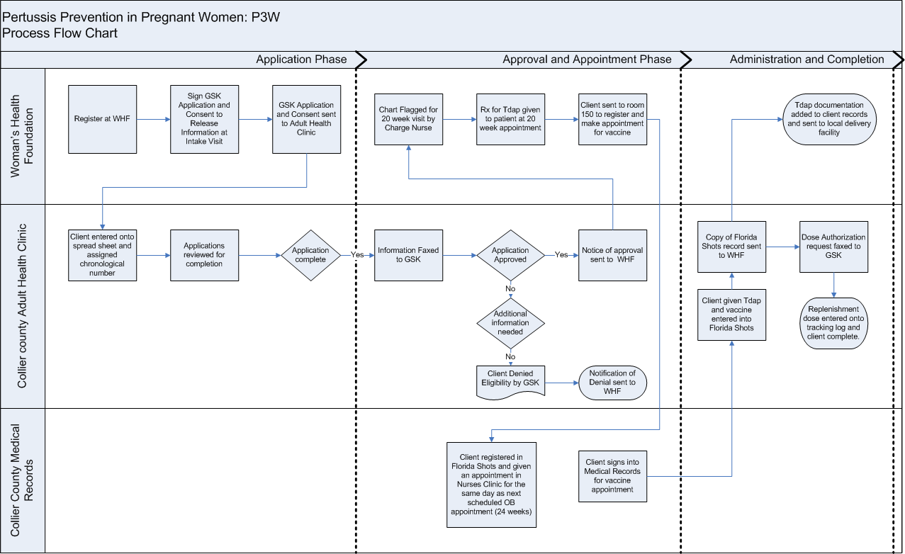
Process Flow Chart

Slide 9
Future Potential Barriers
Clients who refuse vaccines due to religious or medical concerns
Pregnant mothers with other small children unable to schedule appointments for Tdap
Clients who don’t qualify for VPAP and ongoing sustainability
Workload for WHF and CCHD

Slide 10
Timeline
December 2012 WHF began completion of applications
Do
Jan 2013 84 applications received 52% needed additional Study information
RCI Collaboration with clinic coordinator fixed problem
March 2013 Identified women were not making appointments for
vaccine.
RCI Trialed walk-in process so women could obtain vaccine while waiting for their OB appointment

Slide 11
Accomplishments to Date
329 women touched
250 apps processed
171 VPAP apps approved
115 vaccines administered
Initial process revised to meet customer needs
79 clients vaccinated who did not have VPAP application
Only one client declined!!!
Funding to cover all women

Slide 12
Oh, we didn’t think of that…
79 clients vaccinated who did not have VPAP application
Medicaid clients excluded from VPAP
Clients covered under VFC
Can we accommodate walk-ins
It takes a village

Slide 13
Next Steps for QI
Monitor and track how many woman with applications never obtain vaccine.
Monitor percentage of women are receiving vaccine at optimum 27-32 of pregnancy
Consider adjusting referral time as clients are covered on a walk-in basis.
Work with hospitals to determine overall Tdap coverage at delivery

Slide 14
Expand your horizons……….
Vaccine sent to Immokalee site to use with adult health clients and target fathers of clients seen at OB clinic
Begin to utilize vaccine assistance program for HIV and adult health clients
Work with child health on joint project to immunize fathers, grandparents and caretakers of newborns
Coordinate with private physician offices to assure Tdap for women seen at private OB providers

Slide 15
The Goal
WHOOP
Prevent Pertussis

