Slide 1

Lean Value Stream Mapping:
Early Intervention Program
Presented by: Cynthia Morrison, Education and Training Coordinator
Cher Levenson, Quality Management Coordinator
Diana Ehri, Performance Management Consultant
Susan Ramsey, Director
Date: March 25 - 28, 2013

Slide 2
Introductions/Logistics
Name, Office, Duties as they relate to this project
Expectations for the 4 day Lean event
Tell us your favorite movie and why?
Emergencies
Restrooms
Breaks
Food/beverages
Cell phones/blackberries
Roles and Responsibilities
Rules of Engagement
Notes:
Flip charts:
Introductions
Expectations (Kris and Diana will document)
Roles and responsibilities
Rules of engagement
Note:
When Trent speaks – handout charter
Flip chart – What does success look like

Slide 3
Objectives
Create an efficient process for determining EIP client eligibility and subsequent enrollment into EHIP by April 1, 2014. To accomplish this we will:
EIP Role:
Begin successfully tracking applications received by two categories: mini and full by April 1, 2013.
Establish baseline of completed full applications by July 1, 2013.
Increase the percentage of completed mini applications from 80% to 85% by July 1, 2013 and to 95% by January 1, 2014.
Once baseline result has been established on completed full applications, a target will be determined.
Increase the percentage of EIP applications processed within 10 business days from 10% to 35% by July 1, 2013 and to 60% by January 1, 2014.

Slide 4
Objectives
EIP Role Continued
Increase the average number of EIP applications processed per week from 120 to 150 by July 1, 2013 and to 200 by April 1, 2014 or 100% of applications received if less than these totals.
EIP and EHIP Combined Roles
Decrease the staff time necessary at both EIP and EHIP to monitor data exchange from 40 hours per month to 10 hours per month by April 1, 2014.
Modify data sharing requirements and processes to reduce duplicative work between EIP and EHIP staff.
Eliminate the need for two separate client applications to EIP and EHIP by April 1, 2014.

Slide 5
Objectives
EIP and EHIP Combined Roles
Decrease the staff time necessary at both EIP and EHIP to monitor data exchange from 40 hours per month to 10 hours per month by April 1, 2014.
Modify data sharing requirements and processes to reduce duplicative work between EIP and EHIP staff.
Eliminate the need for two separate client applications to EIP and EHIP by April 1, 2014.

Slide 6
Agenda
Day 1
Time | Activity | Owner
8:00-8:30 | Introductions, Logistics, and Expectations | Susan Ramsey
8:30-8:35 | Workshop Objectives and VSM Agenda | Susan Ramsey
8:35-8:50 | Comments from Executive Sponsor | Maria Courogen/Richard Aleshire
8:50-9:20 | Comments from Project Lead: Charter, Overview, Review of Data Available | Elizabeth Crutsinger-Perry
9:20-9:30 | Training: Lean Overview | Diana Ehri
9:30-10:00 | Voice of the Customer | Susan Ramsey
10:00-10:15 | Break | --
10:15-10:35 | Training: VSM Overview | Cynthia Morrison
10:35-11:30 | Current State VSM Construction | All Participants
11:30-12:30 | Lunch | --
12:30-1:45 | Continue Current State VSM Construction | All Participants
1:45-2:00 | Break | --
2:00-3:30 | Continue Current State VSM Construction | All Participants
3:30-3:45 | Review Parking Lot and Kaizen Newspaper Items | Diana Ehri
3:45-4:00 | Debrief (plus-delta) | Susan Ramsey
4:00-5:00 | Leadership Debrief

Slide 7
Agenda
Day 2
Time | Activity | Owner
8:00-8:15 | Agenda Review and Photo | Susan Ramsey
8:15-9:45 | Current State VSM continued | All Participants
9:45-10:00 | Break | --
10:00-10:15 | Training: Time and Waste | Diana Ehri
10:15-11:30 | Continue Current State VSM Construction | All participants
11:30-12:30 | Lunch | --
12:30-12:45 | Training : Root Cause Analysis | Cynthia Morrison
12:45-2:30 | Continue Current State VSM Construction | All participants
2:30-2:45 | Break | --
2:45-3:00 | Training :Is My Map Complete? | Cynthia Morrison
3:00-3:45 | Analyze Current State Map | All Participants
3:45-3:50 | Review Parking Lot and Kaizen Newspaper Items | Diana Ehri
3:50-4:00 | Debrief (plus-delta) | Susan Ramsey
4:00-5:00 | Leadership Debrief

Slide 8
Agenda
Day 3
Time | Activity | Owner
8:00-8:15 | Agenda Review | Susan Ramsey
8:15-9:45 | Walk through current state to validate | Cynthia Morrison
9:45 - 10:00 | Break
10:00-10:20 | Training: Flow, Pull, Kanban | Cher Levenson
10:20-11:30 | Identify high priority improvements | Susan Ramsey
11:30 – 12:30 | Lunch
12:30 – 1:00 | Training : Create Future State | Susan Ramsey
1:00-2:30 | Future State Construction | All Participants
2:30-2:45 | Break | --
2:45-3:30 | Continue Future State Construction | All Participants
3:30-3:45 | Review Parking Lot and Kaizen Newspaper Items | Diana Ehri
3:45 – 4:00 | Debrief (plus/delta) | Susan Ramsey
4:00 – 5:00 | Leadership debrief`

Slide 9
Agenda
Day 4
Time | Activity | Owner
8:00-8:15 | Agenda Review | Susan Ramsey
8:15-8:30 | Training: Verification of Future State | Susan Ramsey
8:30-9:15 | Future State Validation | Susan Ramsey
9:15-10:00 | Implementation Plan Development | Diana Ehri
10:00 -10:15 | Break | --
10:15-12:00 | Prepare for Report Out | Susan Ramsey
12:00-1:00 | Lunch | --
1:00-1:45 | Prepare for Report Out | Susan Ramsey
1:45-2:15 | 5S Garage Video | Susan Ramsey
2:15-2:30 | Break | --
2:30-3:30 | Report Out | All Participants
3:30-4:00 | Celebration | Maria Courogen, Richard Aleshire, Elizabeth Crutsinger-Perry
4:00-5:00 | Leadership Debrief

Slide 10
Lean Overview

Slide 11
Lean Overview
What is Lean?
A systematic approach to identifying and eliminating waste through continuous improvement
Why Lean?
  Reduces cycle time
  Reduces defects
  Increases quality
  Improves customer satisfaction
  Improves employee morale
Notes:
First, it’s not an acronym. Lean is a set of principles and practices which focuses on eliminating waste and non-value added activities in all areas of business.
Lean principles and practices address systems, ongoing improvement and most importantly “eliminating waste”.
Lean encourages us to strives for speed from start to finish, first pass quality
There are three concepts that draw my attention when I think about lean.
1) The first is this idea of systematic. We are looking at things at a system. We intentionally apply various tools and principles across the process chipping away and making improvements.
2) The second is Waste. Lean is about reducing unnecessary steps or activities in processes so that people can spend more time working on the things that add value to your customers and your agency’s mission.
3) The third concept is the idea of continuous improvement. To me, this means that a 30% solution today is better than a 100% solution tomorrow. If you can implement an improvement TODAY that reduces waste (time, steps, increase quality) – even if you know it wont fix everything, it is better than waiting 6 months planning out everything and then implementing. Doing it little by little over time will allow for continuous improvement.
That doesn’t mean that we will implement things in a poorly organized manner. What it does mean is that we will consider actions that don’t require us to wait for the perfect solution.

Slide 12
How is Lean of Value?
Allows staff to do their best every day
Improves customer experience
Increases efficiency and capacity
Encourages problem-solving
The Lean approach respects people
and honors their contributions.
Notes:
Why else would we use lean? Reducing time, defects while improving quality and customer and employee satisfaction is pretty great. But there is more!
Because Lean brings value to the table from the customer’s perspective we have happier customers. When we have happy customers, we are often more satisfied in our jobs.
What I’m really excited about is that it empowers employees to be a part of the change. Encourages employees to be innovative and be a part of the solution by encouraging problem solving.
Lean will better enable us to meet our agency’s mission given the tough times (limited resources) we’re enduring right now;

Slide 13
Lean fits DOH!
  Characteristics of an excellent organization
  Offers what customer wants
  Strives for customer satisfaction
  Follows efficient standardized processes
  Noted for high quality & quickness
Lean can help
  Defines value from customer’s perspective
  Strives for speed from start to finish, first pass quality
  Standard work is key enabler
  Establish competitive edge

Slide 14
Improvement Cycle
Define Value
Map
Value Stream
Create Flow
Establish Pull
Work Toward Perfection
5
1
Improvement
Cycle
4
2
3

Slide 15
Define Value
To be considered valuable or value-added, an activity must meet these three criteria:
  C The customer must care about it
  P It must modify the product or service
  (changing fit, form or function)
  R It has to be done right the first time
Look at the process from the perspective of the ‘thing’ that is going through the process
Notes:
So, the first step in being able to identify a “value added” step is defining your customer. Value is defined from the perspective of the customer.
These are the characteristics of value-added work:
1 - Is something the customer is willing to pay for (in time, effort, taxes or fees, etc.): This idea is difficult for state government because we don’t “sell” many products or services directly to customers. Another way of thinking about it is if you stop doing it, how many phone calls or emails will you get?
2. Changes the form, fit, or function of the product or service: example a review step → NOT A change.
3. Is done right the first time
All other work is non-value-added, or what Lean calls waste.
BUT there is a category of Non-value-added is not the same as unnecessary- Some activities are required, even if they’re not value-added. Example of non value added but necessary: policies, laws
We will work to make these steps more efficient or the process redesigned to no longer require the non-value-added task.

Slide 16
Voice of the Customer

Slide 17
Voice of the Customer
Hearing from the customer will help us determine the “value-added” steps in the process. As a customer, please answer the following questions:
What do you want
When do you want it
Why do you want it
How do you use the product and how much do you use it

Slide 18
Value Stream
Mapping Overview

Slide 19
Lean Improvement Cycle
Define Value
Map
Value Stream
Create Flow
Establish Pull
Work Toward Perfection
5
1
Improvement
Cycle
4
2
3
Notes:
Now that we have defined value, it’s time for us to move to the next phase where we roll up our sleeves and map the value stream.

Slide 20
Value Stream Mapping Event
Current state map
Future state map
Implementation plan
Notes:
Notes:
There are 3 components to a value stream mapping event.
The current state map – where we are now. In this phase you get down into the steps of the process by identifying all the components of what is actually happening.
The future state map is where you want to be after you have analyzed your current state and identified areas for improvement in the system.
Once you have decided where you want to be, you will develop an implementation plan to get you there. We will be developing each of these components over the course of a Value Stream Mapping Event.
Let’s focus on the Current State Map.

Slide 21
What is a Value Stream?
The entire set of activities (both value-added & non-value-added) needed to deliver a specific product/service to a customer.
A visual tool that illustrates how a product moves through the value stream with a focus on improving the whole value stream rather than optimizing pieces of it
Notes:
Helps you see the flow
Shows how each role impacts other roles and the process as a whole
Visibly identifies non value-added steps (waste)
When analyzing a value stream and identifying value added and non-value added steps, it is evident that value added steps account for a small percentage of the total time, often 10% or less of the time for a product (or lab
specimen) to move through the entire value stream.
Additional benefits of the Value Stream Map include:
Gives you a big picture perspective for value stream improvements.
Shows value-added transformations from the perspective of the product you are mapping.
Highlights sources of waste.
Ties together Lean concepts and techniques by providing a common language for talking about a value stream.
Describes how steps relate – makes “information flows” apparent and helps to visualize interactions and flows.
Identifies the constraint(s) – any resource whose capacity is less than customer demand.
Seven Flows through the process – raw material/raw data, components/sub-processes, product/finished goods/services, people, information, tools/systems/equipment, engineering.
A Value Stream Map: a visual representation of a process

Slide 22
What is a Value Stream?
Value Stream Map
A visual tool that illustrates how a product moves through the value stream with a focus on improving the whole value stream rather than optimizing pieces of it.
  Upstream Workshop Name, Date and Current or Future State Downstream
Supplier
Q
Q
Q
Q
Q
Customer
What
What
What
What
What
What
Who
Who
Who
Who
Who
Who
C/T
C/T
C/T
C/T
C/T
C/T
T/T
T/T
T/T
T/T
T/T
T/T
Q
C/T
T/T
Q
C/T
T/T
Q
C/T
T/T
Q
C/T
T/T
Q
C/T
T/T
Q
C/T
T/T
Notes:
Notes:
The Value Stream Map adds to the basic value stream and provides extremely important information. For example, it:
Gives you a big picture perspective for value stream improvements.
Shows value-added transformations from the perspective of the product you are mapping.
Highlights sources of waste and puts in place a plan to eliminate them.
Ties together Lean concepts and techniques by providing a common language for talking about a process.
Describes how processes relate – makes “information flows” apparent and helps to visualize interactions.
Forms a basis for an implementation plan.
Identifies the constraint(s) – any resource whose capacity is less than customer demand.

Slide 23
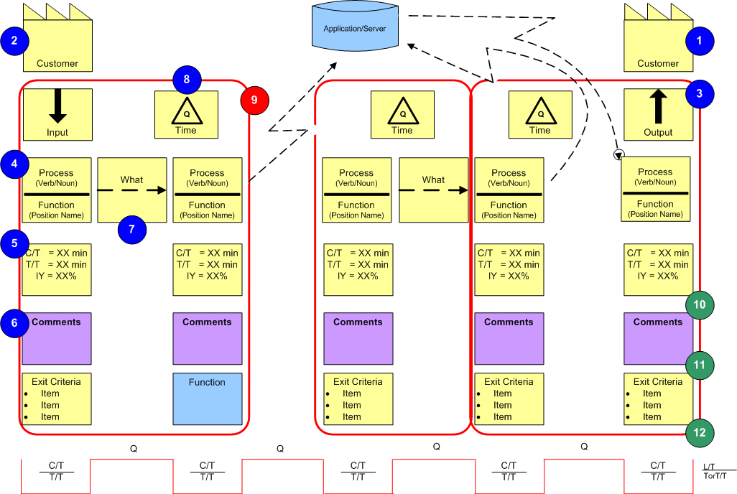
Steps for Building the Current State VSM
Supplier
5
7
Notes:
This handout shows you the steps for Building a Current State Value Stream Map.
In a minute we will practice building a Current State VSM. We will just focus on steps 1-4 and 7 to begin. Later you will get introduced to the rest of the steps.
Steps:
Identify the customer in the upper-right corner of the map
Identify the supplier in the upper-left corner of the map
Confirm the team’s common understanding of the delivered product
Identify the first step in the process (what by whom)
Identify appropriate metrics (cycle time, touch time, input yield) for each step
Attach any comments as appropriate to each step
Identify “what” flows to the next process
Identify queues that occur between steps
Repeat steps 4-8 until complete and then draw circles around improvement areas
Validate the current state VSM with the group
Conduct value-added test on each step
Does the customer care about each step?
Does the task physically change the product’s form, fit, or function?
Is the task done right the first time?
Document overall value stream metrics along the bottom of the page and total at the end.
Handouts – 12 step process and VSM tips

Slide 24
Develop the Kaizen Burst
A Kaizen is an improvement for the better
Determine how to alleviate each rework loop in the current state
Determine how to remove the non-value added steps
Determine how to simplify or combine non-value added but necessary tasks
Determine how to change from “push” to “pull”
Determine how to eliminate idle time/waste in system
Determine if all paperwork/systems are needed

Slide 25
Develop the Kaizen Burst
Determine if all systems are needed
Alleviate or minimize multi-tasking
Smaller batch sizes/one piece flow
Instant responses
Determine if all checks are needed/build mistake proofing into processes
Determine how to reduce the C/T of each step in current state by at least 50%

Slide 26

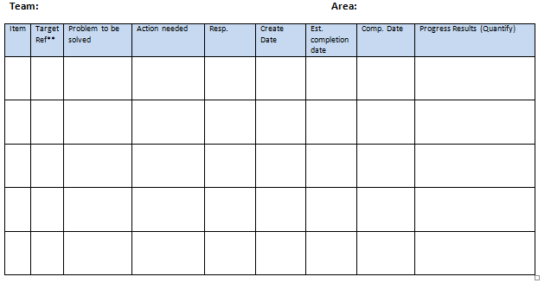
Open Parking Lot and Kaizen Newspaper
Parking Lot
Kaizen Newspaper
Parking Lot
Notes:
There are two important tools to help workshop participants build the Value Stream Map:
Parking Lot:
The Parking Lot is a large piece of Post-It or easel paper used as a holding area for good ideas that come up during the workshop. These ideas may have a big impact on the Future State map but often need more development before they can be implemented. Or may be out of scope and require another forum to complete.
Although it is tempting to spend lots of time discussing an exciting idea, these discussions can distract or slow down the group during the current stage of the workshop.
Use the Parking Lot to table discussion on these ideas until a more appropriate time.
Can be a deliverable to the sponsor
Kaizen Newspaper:
The Kaizen Newspaper is a Lean action item list that holds action items directly impacting the development or improvement of the Value Stream Map.
The name comes from “Kai” meaning “continuous improvement” and “NEWS” meaning “north, east, west, south” or “all encompassing.”
In other words, this paper captures all the ideas that lead to continuous improvement.
As your group builds the Value Stream Map, individual action items requiring further work or research will appear.
Use the Kaizen Newspaper to list and track these items to completion.
Make sure to id who’s idea it was
Handout – Kaizen Burst Newspaper
Flip Chart – Parking Lot

Slide 27
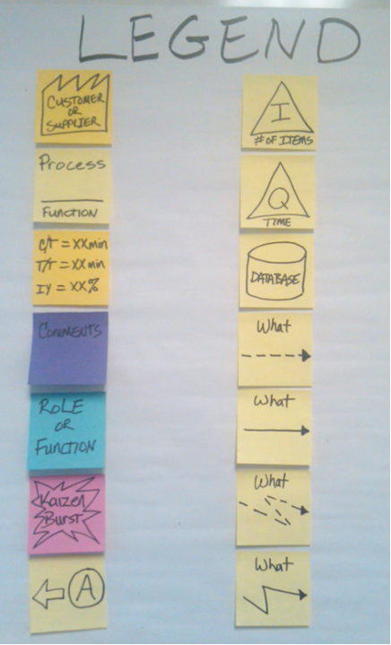
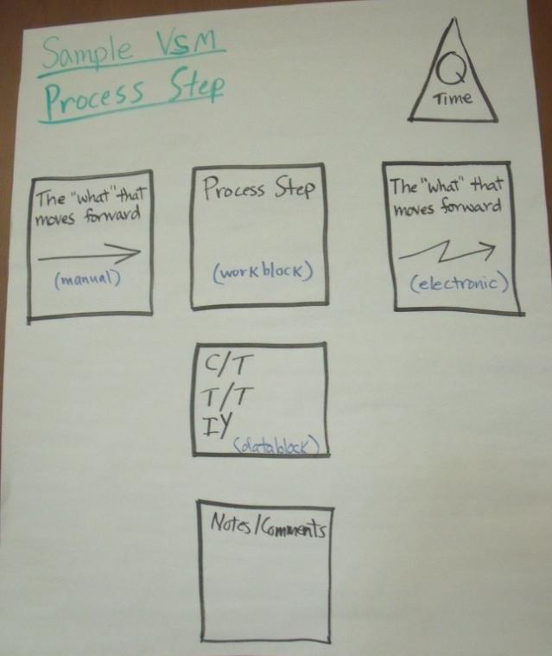
VSM Standard Legend
Notes:
The graphic depicts the most commonly used Value Stream Mapping symbols.
You may use other VSM symbols and whatever color “sticky” notes you have access to.
The first thing we will do when we start creating our current state map is create your legend. Most of these are standardized.
But each of the roles and processes or functions have their own color.

Slide 28
What we will do
Create the Current State
  Process steps
  Process issues
  Takt/demand time
  Process times
  Value added /non-value added
  Wastes
Apply Lean Tools to Create the Future State:
  Work/Visual Controls
  Flow/Pull/Kanban
Notes:
By the end of the week we will have a current and future state map. We will walk you through each of the steps as you get to that point.

Slide 29
Open Parking Lot and Kaizen Newspaper
Parking Lot
Kaizen Newspaper
Parking Lot
Notes:
There are two important tools to help workshop participants build the Value Stream Map:
Parking Lot:
The Parking Lot is a large piece of Post-It or easel paper used as a holding area for good ideas that come up during the workshop. These ideas may have a big impact on the Future State map but often need more development before they can be implemented. Or may be out of scope and require another forum to complete.
Although it is tempting to spend lots of time discussing an exciting idea, these discussions can distract or slow down the group during the current stage of the workshop.
Use the Parking Lot to table discussion on these ideas until a more appropriate time.
Can be a deliverable to the sponsor
Kaizen Newspaper:
The Kaizen Newspaper is a Lean action item list that holds action items directly impacting the development or improvement of the Value Stream Map.
The name comes from “Kai” meaning “continuous improvement” and “NEWS” meaning “north, east, west, south” or “all encompassing.”
In other words, this paper captures all the ideas that lead to continuous improvement.
As your group builds the Value Stream Map, individual action items requiring further work or research will appear.
Use the Kaizen Newspaper to list and track these items to completion.
Make sure to id who’s idea it was
Handout – Kaizen Burst Newspaper
Flip Chart – Parking Lot

Slide 30
Agenda
Day 2
Time | Activity | Owner
8:00-8:15 | Agenda Review and Photo | Susan Ramsey
8:15-9:45 | Current State VSM continued | All Participants
9:45-10:00 | Break | --
10:00-10:15 | Training: Time and Waste | Diana Ehri
10:00-11:30 | Continue Current State VSM Construction | All participants
11:30-12:30 | Lunch | --
12:30-12:45 | Training : Root Cause Analysis | Cynthia Morrison
12:45-2:30 | Continue Current State VSM Construction | All participants
2:30-2:45 | Break | --
2:45-3:00 | Training :Is My Map Complete? | Cynthia Morrison
3:00-3:45 | Analyze Current State Map | All Participants
3:45-3:50 | Review Parking Lot and Kaizen Newspaper Items | Diana Ehri
3:50-4:00 | Debrief (plus-delta) | Susan Ramsey
4:00-5:00 | Leadership Debrief

Slide 31
Time and Waste

Slide 32
Elements of Time
Cycle Time (C/T)
The amount of time to accomplish the standard work sequence for one product, excluding queue (wait) time.
Touch Time (T/T)
The time that the product is actually being worked on.
Queue Time (Q/T)
The time a product spends in a line awaiting the next event to occur – this wait time is waste, or muda.
Lead Time (L/T)
The total time a customer must wait to receive a product after placing an order.
Notes:
Touch Time – The actual time it takes for you, the worker, to do the work to complete the step/process.
Cycle Time
Total time from when product is “picked up” for processing until the item is passed to the next process.
Queue Time – The amount of time something sits there waiting to be worked on.
Lead Time – the amount of time it Takes to produce something from the time it’s ordered until the customer receives it.

Slide 33
Elements of Time
Takt Time (TT)
The available production time divided by the rate of customer demand
Set-up Time (S/U)
Set-up time is the period required to change from one process to another
Input Yield (IY)
The percent done right the first time through
Notes:
Takt time - How frequent we must have a finished product in order to meet customer demand.
Set-up time – The amount of time it takes us to change from one process to another.
Input Yield – The percent “the thing” is done right the first time. This is a cumulative number that by the end we know what percent of the time the process is completed correctly the first time through.

Slide 34

What is Waste?
Any non-value added activity
Adds problems and blocks the flow of value
Waste should be minimized or eliminated!
Notes:
Every process is made up of steps that are either value added or non-value added.
•Value-added procedures are necessary; these would include processing orders, answering customer inquiries, contract negotiation, etc.
•There are also necessary non value-added procedures, such as records retention, processing cancellations, transportation, shipping, etc.
•However, we need to avoid any unnecessary non value-added procedures, such as checking and rechecking others’ work, moving, additional inspection steps, additional paperwork, interim stock locations, packaging and unpackaging, multiple signatures, etc.

Slide 35
Root Cause Analysis

Slide 36
Root Cause Analysis
Goal:
  To find the real cause of a problem or issue
  Understand the impact to the organization
  Resolve it with a permanent fix.
We need to determine:
  what happened?
  why it happened?
  where it happened?
  how to eliminate it?
Notes:
As you went through creating your current state map, you identified areas that could be improved. The purpose of doing a root cause analysis is to figure out why the process is the way it is. Once you figure that out, you can make improvements. There are several different tools you can use. For this process we are going to use the 5 whys.

Slide 37
Five Whys?
What is it?
  A process of asking “Why?” at least 5 times in a row
When is it used?
  When people do not truly understand the situation, or when a deeper understanding is necessary
Why? (the Five Whys?)
  Causes people to use higher order thinking skills
  Cuts through layers of bureaucracy to find the true meaning
  Causes people to challenge their current situation or problem
  Helps people understand root causes or problems
  Helps people clarify motivation
Notes:
The 5 whys is a common tool to help you get to the root of the problem. It’s actually a very simple tool that helps you achieve great results. It really helps you narrow down what the actual problem is.

Slide 38
Five Whys – the process
Identify a problem, situation, or concept to be studied
Ask “Why?” this particular condition exists
Each time the question “Why?” is answered, ask “Why?” again
Continue to ask “Why?” until everyone involved is satisfied they have arrived at the root cause
Notes:
The 5 Whys is a question-asking technique used to explore the cause-and-effect relationships underlying a particular problem.
American railroad tracks are 56.5" wide (the "gauge") because the English built the first railroads in America and they used that width. Why did they use that width? Because the first rail lines were built by the same people who built the pre-railroad tramways, and that's the gauge they used. Why did "they" use that gauge then? Because the people who built the tramways used the same jigs and tools that were used for building wagons which used that wheel spacing.
Why did wagons have that particular odd wheel spacing? Because older wagon ruts throughout England used that spacing, and if they changed it, wagon wheels would break by either falling into or being forced out of the old ruts, which were 56.5" wide.
The old ruts were that size because the roads were built by the Romans, who arrived in England in 54 BC and left about 400 AD. Their wagons, and their chariots before their wagons, used that spacing, and that spacing was used all over Europe and wherever Rome conquered, because their wagons used the identical wheel base everywhere. So the modern railroad track width derives from the Roman chariot.
Why was the Roman chariot track width 56.5"? Because that was the width of a chariot that would equal the width of two "standard" Roman horses. Thus, wagon and horses would fit through the same narrow street. Specifications and bureaucracies live forever!
38

Slide 39
Is My Map Complete?

Slide 40
Is My Map Complete?
Identify customers or your organization
Identify suppliers of data information to your organization
Identify all process steps for the workshop scope at the level of detail that exposes waste
Once the map has all the process steps
  Update/develop Kaizen bursts – problem statement- name on the map and document Kaizen opportunity in the Kaizen newspaper – write the problem statement and potential improvement
  Identify arrows (push/pull)
  Identify rework arrows/percentage of occurrence
  Identify all information systems used
Notes:
Flip Chart – Current State

Slide 41
Is My Map Complete?
Connect the Information Systems/Tools (electronic or manual) with the process steps
Connect all process steps to indicate flow of work
Determine current metrics/measures and where they
are located on the map
Examples of input and outputs of group (screen print or reports/forms, etc.)
Notional timeline at the least – if time is available complete the data box with filled in data
  Total cycle time
  Total wait time
  Total touch time
Agreement/Concurrence from your group that the current state map represents reality
Agreement/Concurrence of connecting organizations

Slide 42
Open Parking Lot and Kaizen Newspaper
Parking Lot
Kaizen Newspaper
Parking Lot
Notes:
There are two important tools to help workshop participants build the Value Stream Map:
Parking Lot:
The Parking Lot is a large piece of Post-It or easel paper used as a holding area for good ideas that come up during the workshop. These ideas may have a big impact on the Future State map but often need more development before they can be implemented. Or may be out of scope and require another forum to complete.
Although it is tempting to spend lots of time discussing an exciting idea, these discussions can distract or slow down the group during the current stage of the workshop.
Use the Parking Lot to table discussion on these ideas until a more appropriate time.
Can be a deliverable to the sponsor
Kaizen Newspaper:
The Kaizen Newspaper is a Lean action item list that holds action items directly impacting the development or improvement of the Value Stream Map.
The name comes from “Kai” meaning “continuous improvement” and “NEWS” meaning “north, east, west, south” or “all encompassing.”
In other words, this paper captures all the ideas that lead to continuous improvement.
As your group builds the Value Stream Map, individual action items requiring further work or research will appear.
Use the Kaizen Newspaper to list and track these items to completion.
Make sure to id who’s idea it was
Handout – Kaizen Burst Newspaper
Flip Chart – Parking Lot

Slide 43
Agenda
Day 3
Time | Activity | Owner
8:00-8:15 | Agenda Review | Susan Ramsey
8:15-9:45 | Walk through current state to validate | Cynthia Morrison
9:45 - 10:00 | Break
10:00-10:20 | Training: Flow, Pull, Kanban | Cher Levenson
10:20-11:30 | Identify high priority improvements | Susan Ramsey
11:30 – 12:30 | Lunch
12:30 – 1:00 | Training : Create Future State | Susan Ramsey
1:00-2:30 | Future State Construction | All Participants
2:30-2:45 | Break | --
2:45-3:30 | Continue Future State Construction | All Participants
3:30-3:45 | Review Parking Lot and Kaizen Newspaper Items | Diana Ehri
3:45 – 4:00 | Debrief (plus/delta) | Susan Ramsey
4:00 – 5:00 | Leadership debrief`

Slide 44
Flow, Pull, Kanban

Slide 45
Lean Improvement Cycle
Define Value
Map
Value Stream
Create Flow
Establish Pull
Work Toward Perfection
5
1
Improvement
Cycle
4
2
3

Slide 46

Flow Production
(Future State)
A pipeline with steady, predictable flow
Work in Process is a known, fixed Level.
Scheduling is predictable.
Product or service moves quickly and Continuously through the system.
Notes:
Lean strives to “even the flow” to the greatest extent possible and continuous movement.
Continuous Flow
Say: Now think of continuous flow as water moving through a pipeline where information and products move in a straight line, at a set speed, and without slowdowns.
Continuous Flow is the flow of products and information at a steady velocity through the various steps in a process.
The intent is to increase the velocity of a process and to make the process cycle predictable.
Wastes create situations where its really, really busy – near the end of the year or when you receive a really big batch at a time. Or the calm before the storm.

Slide 47
Lean Improvement Cycle
Define Value
Map
Value Stream
Create Flow
Establish Pull
Work Toward Perfection
5
1
Improvement
Cycle
4
2
3

Slide 48
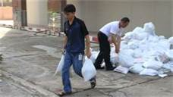
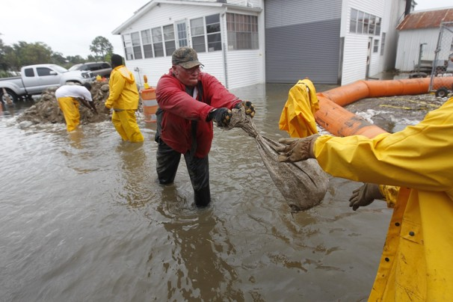
Push vs. Pull
Push (Current State)
Pull (Future State)
Sending work to the next role whether they are ready for it or not
Sending work to the next role when they are ready for it
Notes:
When flow is established, tackle pull
Pull is the concept that no one upstream produces anything until the customer asks for it.
You design your process around customer demand
The opposite of pull is push
Let’s use a coffee example, push to the customer would be that you walk into the coffee shop and find a line of pre-made coffees
Pull is that your coffee is made to order on the spot
Within the process, push would be a truck delivering a load of beans whether or not the coffee shop has space for it
For us, push is (Take a stack of papers and give it to a participant) It doesn’t matter if you’re ready for it, I’m done with my piece, so I throw it over the fence to you
Pull would be (Ask the participant to hold out his/her hand, and then hand them the papers) I don’t pass on the work until it’s asked for.
Pull systems help control work-in-process. What’s going to happen to the person who continually has work thrown over the fence at him or her? (It’s going to pile up, which leads to backlogs, defects, frustration, expediting systems, etc.)
Pull systems also help you allocate resources based on actual demand, rather than forecasted demand
Pull systems often rely on visual signals, called kanbans
You don’t pass the bag until the next person in line is ready for it…the flow of the line is level. If you want to move faster, piling up the bags in front of the slowest person won’t help.

Slide 49
What is Visual Management?
An innovative system that uses simple but powerful visual techniques to communicate
Notes:
Say: We are all familiar with the use of visuals in road signs. Even when driving in a foreign country, road signs quickly and clearly communicate information that can be interpreted even if you do not speak the language.
Say: Visuals use graphic representations to simplify the work area. They come in all shapes and sizes, but their basic purpose is to provide immediate visual instructions about where to locate needed information or resources, how to use required tools, how to behave in a particular environment, etc.
Say: A visual work environment will have signs, labels, color-coded markings, etc. so that in a matter of minutes anyone unfamiliar with the area will:
Know what is going on.
Understand the process.
Knows what needs to be done.
Know what is being done correctly.
Know what is out of place.

Slide 50
Types of Visuals
Four Types of Visuals:
Displays/Indicators
Signals
Controls
Guarantees
Notes:
Say: Visual cues come in four types: displays, controls, guarantees, and signals.
Transition:
Say: Let’s look at some examples of the four types of visuals.

Slide 51
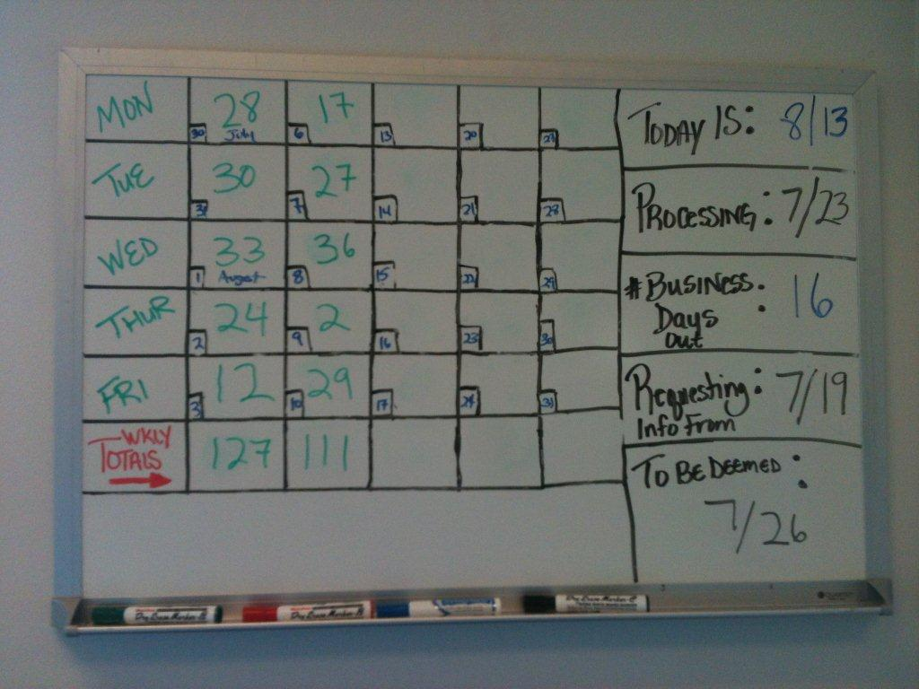
1. Visual Display/ Indicator
Tells only
Speed
Limit
40
Notes:
The characteristics of a Visual Display/Indicator are:
Passive
Shares information by displaying or showing it
Compliance or adherence is voluntary, you can choose to notice them or not, obey them or not

Slide 52
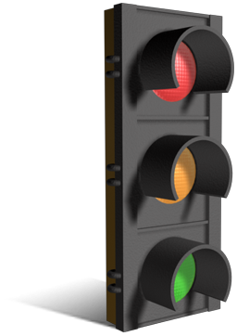
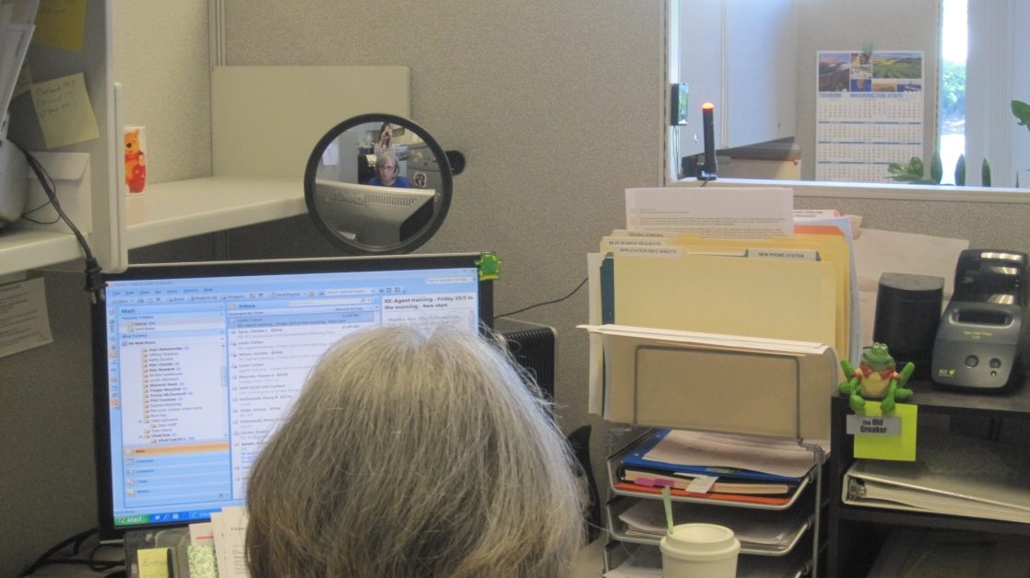
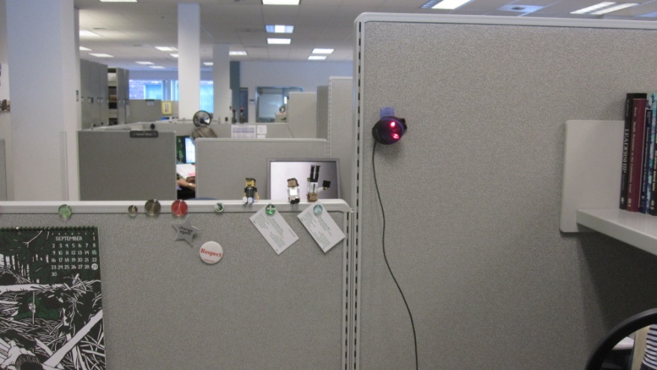
2. Visual Signal
Grabs Attention
Notes:
The characteristics of a Visual Signal are:
Slightly more powerful than an indicator
If first grabs our attention, then delivers its message by changing
Other examples include: red lights, blinking caution lights, coffeemaker light.

Slide 53
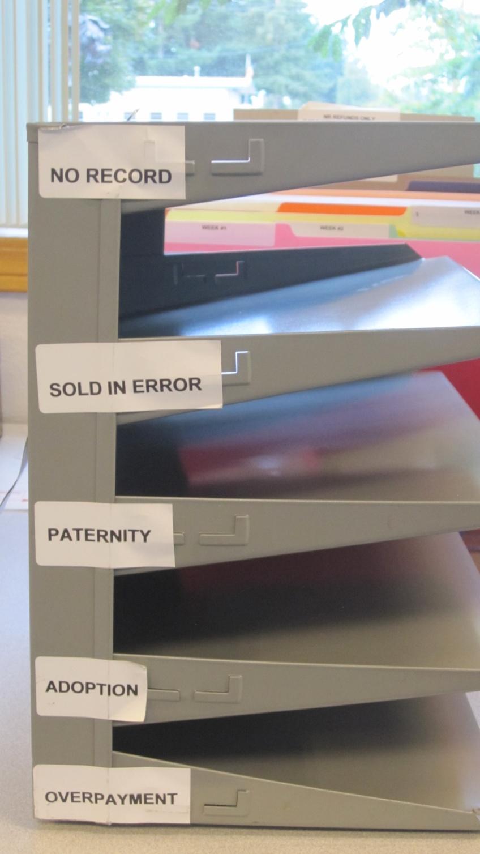
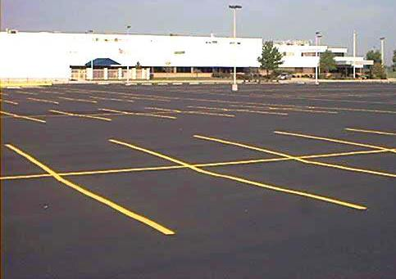
3. Visual Control
Limits Behavior
Notes:
The characteristics of a Visual Control:
A control crosses the line from optional to required behavior; adherence begins to get built in
The power of the visual control is structural, meaning the physical structure of the device sends the message
Narrows response options; restricts them by putting physical limits in place
Say: Instead of merely displaying or sending out information like indicators and signals do, controls attempt to impact behavior directly.

Slide 54
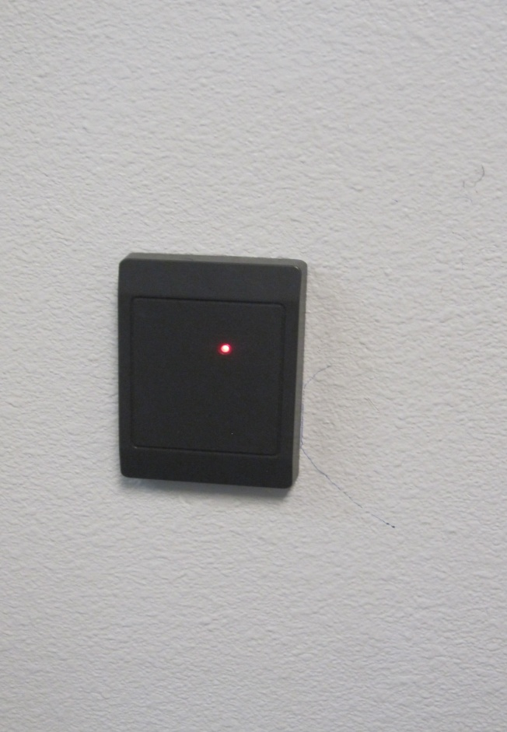
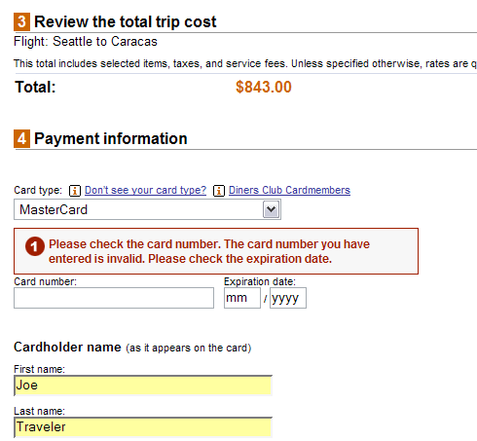
4. Visual Guarantee
Allows correct response only
Notes:
Say: The characteristics of Visual Guarantees are:
Also known as mistake proofing
Designed to allow only the correct response

Slide 55
Prioritizing Improvements

Slide 56
Prioritize Improvements
Goal:
  Identify the top issues to focus attention on over the next 90 days
Notes:
As you went through creating your current state map, you identified areas that could be improved. The purpose of doing a root cause analysis is to figure out why the process is the way it is. Once you figure that out, you can make improvements. There are several different tools you can use. For this process we are going to use the 5 whys.

Slide 57
Creating the Future State Value Stream Map

Slide 58
Lean Improvement Cycle
Define Value
Map
Value Stream
Create Flow
Establish Pull
Work Toward Perfection
5
1
Improvement
Cycle
4
2
3

Slide 59
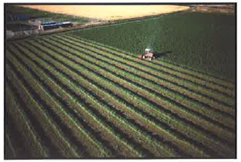
The Purpose of a Future Vision Value Stream Map
The future vision is an illustration of what the value stream will be once the goals are met (3-5 years)
Use the future vision like a farmer uses a distant landmark to keep your activities aligned
Keep big picture and long term goals in mind
Notes:
When farmers plow a field they choose a landmark way off in the distance and drive a straight line toward that point.
The farmers learn from experience, if they keep their eyes focused on the short term, they will zigzag back and forth and their rows will not be straight
The same holds true for continuous improvement
When we set goals at DOH, it is essential we create a future vision with our strategic plan where all our goals are met and our processes are improved.
This future vision ensures consistent direction, implementation, and communication over the long run
As we focus on this future goal or vision, we make smaller short-term goals to help us reach the long-term vision one step at a time.
A future vision is our long-term goal
The future state map is the short term goal that helps us realize the long term vision.

Slide 60
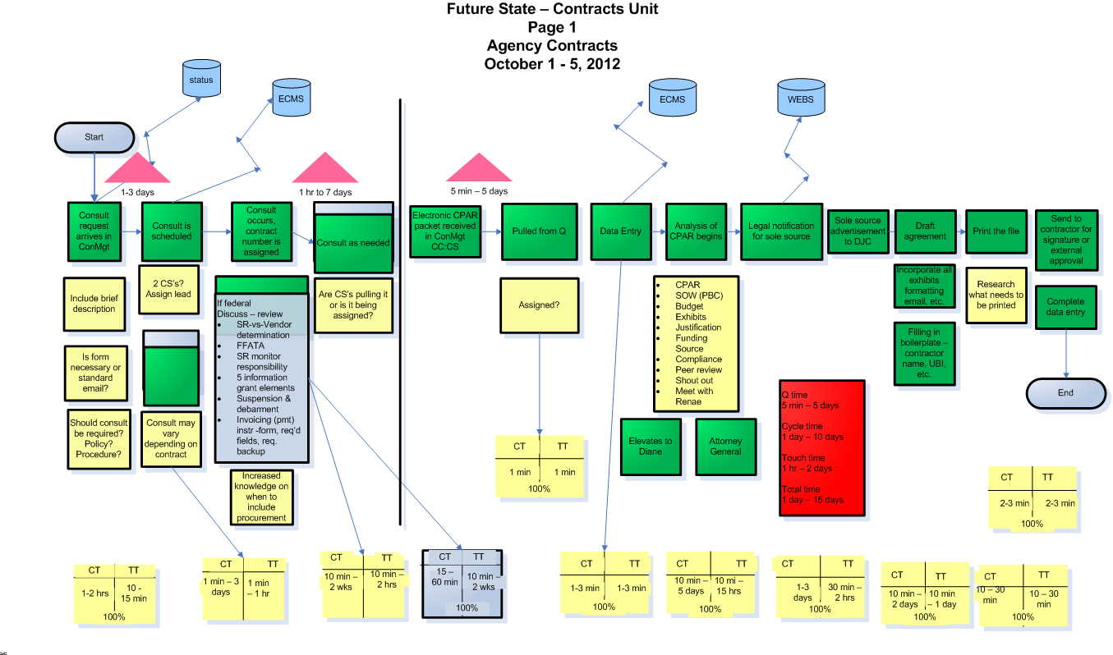
What is a Future State Value Stream Map?
Notes:
The future state map shows changes by implementing Kaizen bursts
A Future State Value Stream Map is a visual display of an improved material, data, and information flow.
This improved flow incorporates the principles of tact, flow, pull, and many other Lean principles
The Future State Value Stream Map proposes a new design for the value stream and is an intermediate step toward accomplishing the program/site goals written into the long term Future State Vision
This intermediate step is used to identify target areas for improvement and develop a short term implementation plan
Note that a Kaizen Burst may appear on a Future State VSM to highlight an individual improvement plan.

Slide 61
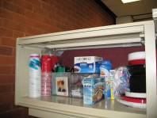
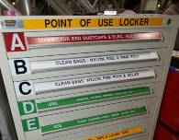
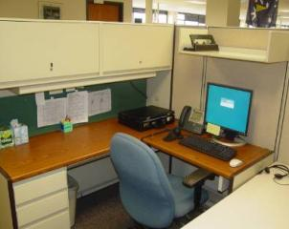
What Are the Five S’s?
“A place for everything, and everything in its place”
Sort
Simplify
Sweep
Standardize
Self-Discipline
Sort, Simplify,
Sweep, Standardize
Self-Discipline
Notes:
5S is the foundation of everything that is done in Lean and should be woven into every process. Let’s take a moment to discuss the definition of each “S.”
The Five Ss can be summarized in one simple phrase: “A place for everything, and everything it its place.”
If we follow this one simple phrase, we can make our work at DOH safer, more enjoyable and more profitable for everyone.

Slide 62
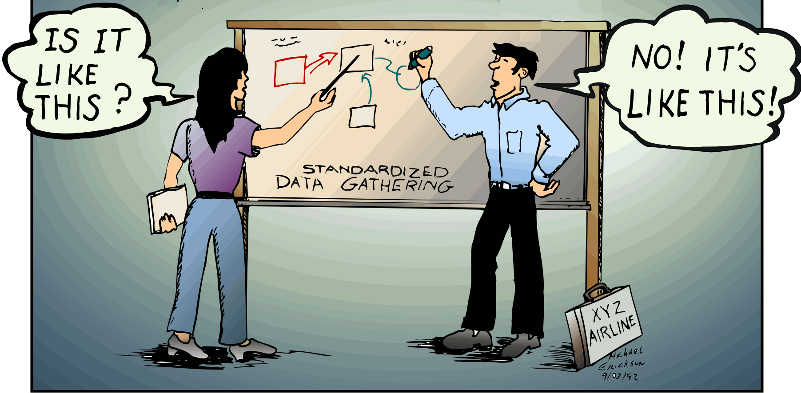
Standardize
Create a common set of practices everyone follows
No documented process used
(Documented processes)
Documented process used
Notes:
When you are moving from your current state to the future state it is critical that you standardize your work.
Standardizing means creating a common set of 5-S practices that everyone follows.
Say: Standardizing is a documented, common, repeatable process for improving, updating & maintaining the workstation environment.

Slide 63
How to Standardize
Define how a task should be done and share it with everyone involved in the process
Document and share process changes as they occur
Develop a standard method for naming files – author, document name, and version – both for computer files and paper files
Notes:
Say: The bullets on this page show three simple steps to implementing standards in your workplace.
Instructions: Read or have a participant read slide bullets for how to perform sorting activities.
Say: This slide can assist you in applying 5S to your work area.

Slide 64
Standard Work
The safest, easiest, most effective way of doing something that we currently know
Benefits:
Provides baseline for improvement
Enables more predictable results
Simplifies on-boarding and cross-training
Fosters organizational learning

Slide 65
Tools for Standard Work
The only way to do it
Fail-safe
Warn for abnormalities
Visual Control Tools
Show how to do it
Visual Aids
Tell how to do it
Procedures, Manuals, Instructions
Notes:
Voice of the consumer activity.

Slide 66
Future State Map
Step #1: Go through map again
If I could change this it would make my day a better one
What you would love to change
If you think of additional problems through this process, list on the flip chart – 5 minutes
Step #2: Review issue problems on flip chart
Step #3: What do you think needs changed? (critical success factors) top items
Make sure statements made in future state are phrased for the future work
Prioritize by each person checking their top 3 from the list
List on separate flip chart the top 3
Divide group in key areas
Work random or by choice at tables – 45 minutes
Define the section in the current state
Assign team leader for each section

Slide 67
Open Parking Lot and Kaizen Newspaper
Parking Lot
Kaizen Newspaper
Parking Lot
Notes:
There are two important tools to help workshop participants build the Value Stream Map:
Parking Lot:
The Parking Lot is a large piece of Post-It or easel paper used as a holding area for good ideas that come up during the workshop. These ideas may have a big impact on the Future State map but often need more development before they can be implemented. Or may be out of scope and require another forum to complete.
Although it is tempting to spend lots of time discussing an exciting idea, these discussions can distract or slow down the group during the current stage of the workshop.
Use the Parking Lot to table discussion on these ideas until a more appropriate time.
Can be a deliverable to the sponsor
Kaizen Newspaper:
The Kaizen Newspaper is a Lean action item list that holds action items directly impacting the development or improvement of the Value Stream Map.
The name comes from “Kai” meaning “continuous improvement” and “NEWS” meaning “north, east, west, south” or “all encompassing.”
In other words, this paper captures all the ideas that lead to continuous improvement.
As your group builds the Value Stream Map, individual action items requiring further work or research will appear.
Use the Kaizen Newspaper to list and track these items to completion.
Make sure to id who’s idea it was
Handout – Kaizen Burst Newspaper
Flip Chart – Parking Lot

Slide 68
Agenda
Day 4
Time | Activity | Owner
8:00-8:15 | Agenda Review | Susan Ramsey
8:15-8:30 | Training: Verification of Future State | Susan Ramsey
8:30-9:15 | Future State Validation | Susan Ramsey
9:15-10:00 | Implementation Plan Development | Diana Ehri
10:00 -10:15 | Break | --
10:15-12:00 | Prepare for Report Out | Susan Ramsey
12:00-1:00 | Lunch | --
1:00-1:45 | Prepare for Report Out | Susan Ramsey
1:45-2:15 | 5S Garage Video | Susan Ramsey
2:15-2:30 | Break | --
2:30-3:30 | Report Out | All Participants
3:30-4:00 | Celebration | Maria Courogen, Richard Aleshire, Elizabeth Crutsinger-Perry
4:00-5:00 | Leadership Debrief

Slide 69
Verification of Future State

Slide 70
Verifying the Future State
Verify that the future state answers the following questions:
Did you address what the customer really needs?
Does the future state meet metric (timeline) goals stated in the Workshop Charter mission statement?
Did you determine how often process performance will be checked?
Did you identify which steps create value and which steps create waste?
Did you discover how work can flow with fewer interruptions?
Did you determine how work will be controlled between interruptions?
Did you determine how the workload and/or activities will be balanced?
Did you determine which process improvements will be necessary to achieve the future state?
Notes:
Think of these while creating a future state

Slide 71
Implementation Plan Development

Slide 72


Develop
Implementation Plan
Create Individual
Improvement Plans
Cross-Check
Parking Lot
Finalize Kaizen
Newspaper
Notes:
A Value Stream Mapping Workshop Implementation Plan consists of a Kaizen Newspaper and a set of Individual Improvement Plans.
In order to develop your Implementation Plan, there are three steps you should take to evaluate all the options that appeared during the Value Stream Mapping workshop:
The Kaizen newspaper is the top-level document for your implementation plan.
Create Individual Improvement Plans
Ensure all relevant Kaizen Bursts are documented on the Kaizen Newspaper.
Identify the Kaizen Bursts requiring Individual Improvement Plans.
Use the sub-team approach to develop Individual Improvement Plans.
Review Individual Improvement Plans with entire team and make changes as necessary.
Cross-Check Parking Lot
Review for closed items (no longer pertains or addressed during workshop).
If item is open, review for applicability in Kaizen Newspaper for follow-up.
Ensure that out of scope items remain visible (as Parking Lot artifact).
Finalize Kaizen Newspaper
Verify single-line entries for each Individual Improvement Plan.
Verify all relevant Kaizen Bursts to be implemented are represented, in single-line entries, or captured in the Individual Improvement Plans.

Slide 73
Preparing for the
Report Out

Slide 74
Report Out Agenda
Welcome and agenda
Introduce Workshop Participants
Present the Charter document
Overview of Current State map
Current State analysis
Overview of Future State map
Summary of results
Present Implementation Plan
Review Parking Lot
Help needed/next steps
Workshop Sponsor Comment
All Workshop Participants are expected to
participate in the report-out

Slide 75
Report Out
Break into your teams
  Review Kaizen newspaper and prioritize the actions
  Any additional parking lot items
  Discuss key points of the proposed changes
Set up room
  Tape all post its
  Label value stream maps
  Draw any additional lines
Does the room tell the story?
Does everyone buy-in to our future state?
Dry runs

Slide 76
Report Out Agenda
Topic | Time
Welcome and Charter document review | 5 minutes
Current state review | 15 minutes
Future state review | 20 minutes
Kaizen newspaper items | 5 minutes
Next steps | 5 minutes
Q & A | 10 minutes
No questions from audience until end of report out

Slide 77
Cynthia Morrison
Education and Training Coordinator
(360) 236-3498 cynthia.morrison@doh.wa.gov
Diana Ehri
Performance Management Consultant
Office of Performance and Accountability
(360) 236-4015 diana.ehri@doh.wa.gov
Thanks for participating!
Good bye, folks!
Cher Levenson
Quality Management Coordinator
(360) 236-3453
cheri.levenson@doh.wa.gov
Susan Ramsey
Director
Office of Performance and Accountability
(360) 236-4013
susan.ramsey@doh.wa.gov
Notes:
I know I’ve covered a lot of ground in a short time period, so we have some time now for a few questions or feel free to send me an email with any questions that come to mind as you move forward with building a quality culture in your agency.

Slide 78


